Slide 1
The A-Level Mindset
How to be successful at A-levels

Slide 2
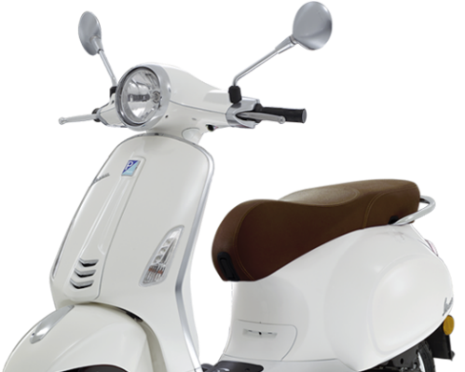
Having a Vision
Commitment to the Effort
Having Systems
Practice
Positive Mental Attitude
All of these can be practiced and learned and we will help and support you with this.
VESPA is the key to success at A-level

Slide 3
Vision – knowing what you want to achieve
Notes:
You have decided to come into the 6th Form at Bishop Stopford School. Why? Speed dating. You will have 30 seconds to answer the question that appears and then you must listen while you ‘date’ answers the next question.

Slide 4
What is possible with your GCSE grades?

Slide 5
There is a far less significant link between exam success at GCSE level and A-level than you might think. The past doesn’t equal the future!

Slide 6
GCSE Score | No of students | Highest | Middle | Lowest
9s only | 3 | A*A*A* | A*A*A | A*AB
Mainly 8 and 9s | 6 | A*A*A | A*AB | A*BB
 | 11 | A*A*A*A | A*AA | ABC
Mainly 7, 8 & 9’s | 5 | A*A*A* | ABB | BCC
 | 7 | A*A*A | AAB | ABB
Mainly 7 and 8’s | 8 | A*AA | AAA | BCC
 | 13 | A*AA | ABB | BCE
Mainly 7’s few 6’s | 18 | A*A*A | AAB | CDE
Mainly 7’s and few 6’s and 5’s | 26 | A*A*B | ABB | BCD
 | 17 | A*A*A | AAB | ADD
Mainly 6’s few 5’S | 16 | ABB | BBC | BBE
 | 19 | AAB | BBB | CDD
Mainly 5’s few 6’s | 10 | AAB | BCC | BDD
 | 10 | BBB | BCC | DDE
Mainly 5’s few 4’s | 10 | BCC | CCC | CDD
 | 6 | ACD | CCD | DDD
Mainly 4 and few 5’s | 7 | CDD | DDD | DEE

Slide 7
Resources Search Results | Net Sixth Form
BSS28 – Induction Videos – Leap from GCSE to Sixth Form 1: Realising
the Challenges (4 ½ minutes)

Slide 8
Dreams v Goals
There is a difference between a dream and a goal.
A dream is something you imagine happening; a goal is something you take action towards.

Slide 10
Dreams v Goals Fill in the table on page 4 and 5.
Reflect on the questions at the bottom of page 5.

Slide 11
Your 21st Birthday (Page 6) Have a look at this. What do you want to be said about you?

