Slide 1
Biology Induction

Slide 2
Protein synthesis
LO: Explain how transcription and translation of genes result in the synthesis of polypeptides
Starter: GCSE Knowledge
What is gene?
What is a protein?
DNA is a polymer. What name do we give to the monomer from which it is formed?
Extension: Transition
What do you understand by the term ‘complimentary base pairing’
Notes:
Section of DNA that codes for a specific protein by coding for the sequence of amino acids
Long chain of amino acids
Nucleotide

Slide 3
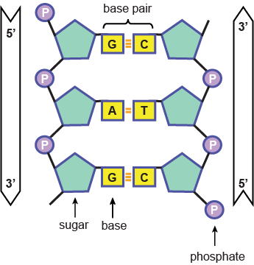
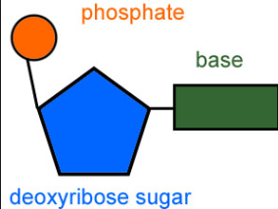
GCSE Reminder: The Structure of DNA
DNA is a polymer made up nucleotide monomers.
There are 4 types of nucleotide monomer – G, T, A, C,
A DNA molecule has two strands forming a double helix
DNA nucleotide (monomer)

Slide 4
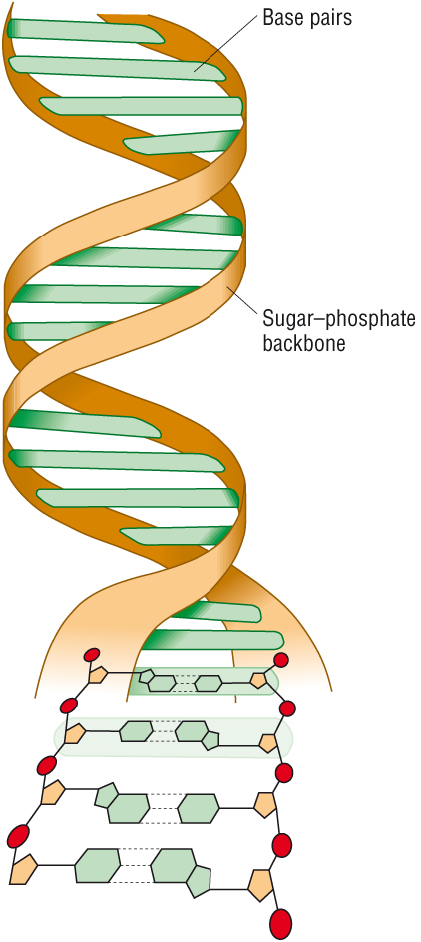
GCSE Reminder: (Triple only)
Complementary base pairing:
Notes:
Explain that DNA is a double helix. This means that it contains two polynucleotide chains joined together by hydrogen bonds. The whole thing is then twisted into a helix to give it more stability.
Explain that Adenine always binds with thymine. Cytosine with guanine.

Slide 5
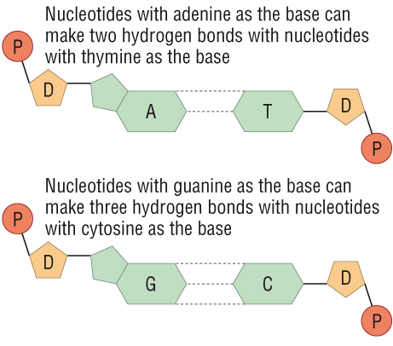
Quick Check
What would be the complementary strand?
A T G T A C C G A T T

Slide 6
Protein synthesis
So how do we get from a gene (section of DNA) to a protein (sequence of amino acids?
Stage 1: Transcription
Stage 2: Translation

Slide 7
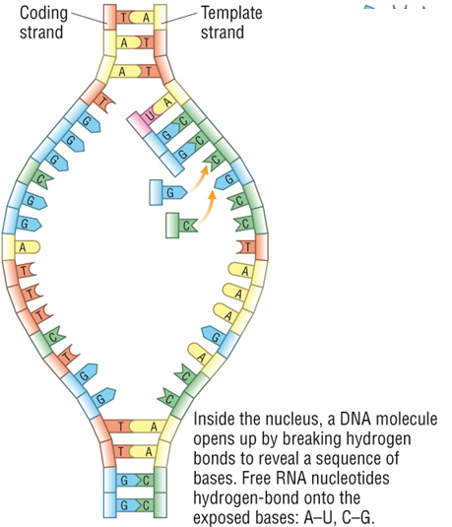
Transcription-making a copy of the DNA
RNA polymerase enzyme attaches to the double helix at the beginning of a gene and the bonds between the 2 DNA strands break
Only one side of the DNA molecule is copied
The RNA polymerase moves along the DNA adding complimentary mRNA nucleotides to the DNA bases to form a complimentary strand of mRNA
Note: There is no T mRNA nucleotide. Instead of a T there is a U.

Slide 8
Quick check
What would the complimentary mRNA strand be to this DNA sequence?
C G A T T A G A C
Remember: There is no T mRNA nucleotide. Instead of a T there is a U.

Slide 9
Translation- mRNA is translated to make a polypeptide
mRNA moves out of the nucleus through a nuclear pore and attaches to a ribosome.
The mRNA is read 3 bases at a time (triplet code).
tRNA bring the correct amino acids to the mRNA molecule
The amino acids are joined with peptide bonds to form the of the polypeptide

Slide 10
The mRNA codon (triplet of bases) binds with its complimentary tRNA anticodon. This ensures amino acids are joined in the correct sequence.

Slide 11
Codon table (mRNA) – The Genetic Code

Slide 12
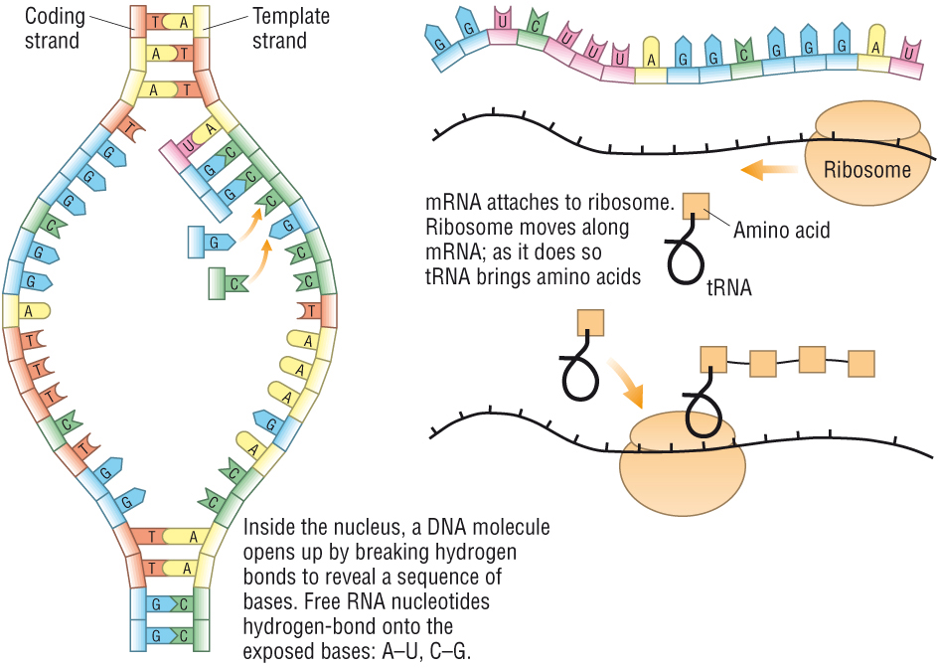
Protein Synthesis – an overview

Slide 13
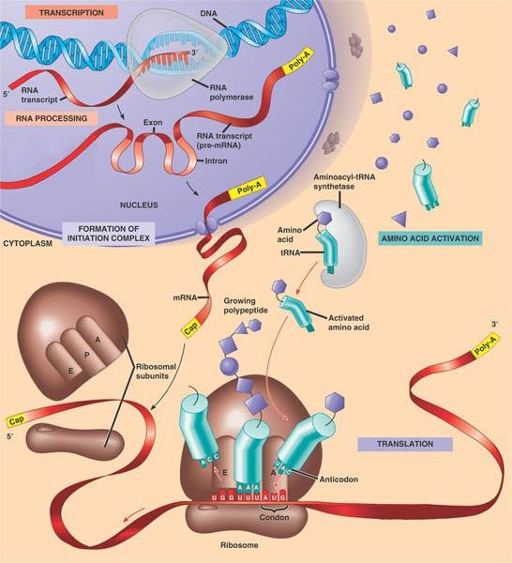
Cake Recipe
STEP 1Heat oven to 190C/fan 1
STEP 2IAdd 200g caster sugar, 200g softened butter, 4 beaten eggs, 200g self-raising flour, 1 tsp baking powder and 2 tbsp milk together until you have a smooth, soft batter.
STEP 3Bake for about 20 mins until golden and the cake springs back when pressed.
STEP 4Turn onto a cooling rack and leave to cool completely.
STEP 5To make the filling, beat the 100g softened butter until smooth and creamy, then gradually beat in 140g sifted icing sugar and a drop of vanilla extract (if you’re using it).
Cake Recipe
STEP 1Heat oven to 190C/fan 1
STEP 2IAdd ingredients and together until you have a smooth, soft batter.
STEP 3Bake for about 20 mins
STEP 4Turn onto a cooling rack
STEP 5To make the filling,

Slide 14
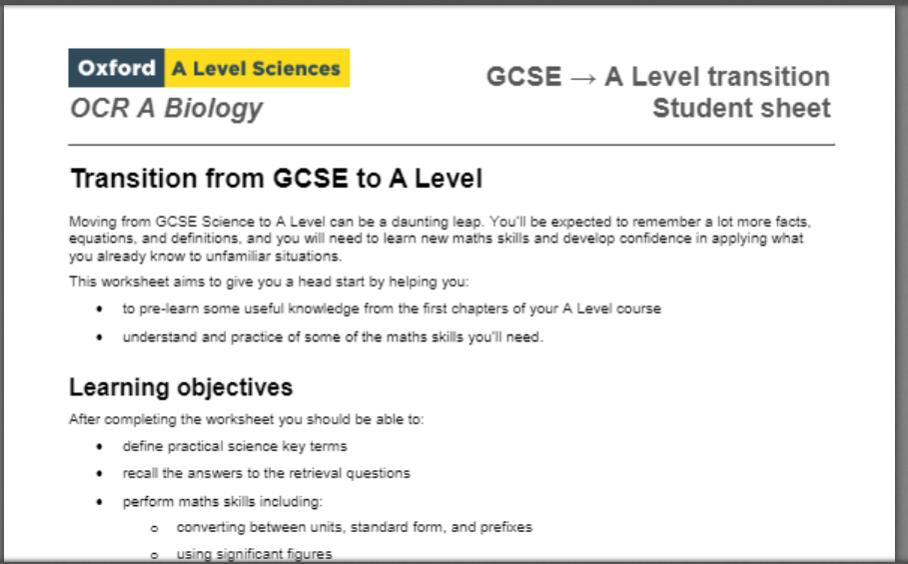
Follow up tasks:
1) Watch the following videos to go over DNA structure and Protein Synthesis:
DNA: https://www.youtube.com/watch?v=0_b80fHmuWw
Protein Synthesis: https://www.youtube.com/watch?v=gG7uCskUOrA
2) Complete the GCSE ➔ A level transition task and bring to your first Biology lesson. In the first couple of weeks we will have a transition test on the content of this task
https://bishopstopford.fireflycloud.net/sixth-form/year-11---looking-ahead/biology
3) Look at the Year 12 Induction materials for A Level Biology
(including a copy of this PowerPoint)
https://bishopstopford.fireflycloud.net/sixth-form/year-11-into-12-induction-summer-2021/biology

