Slide 1
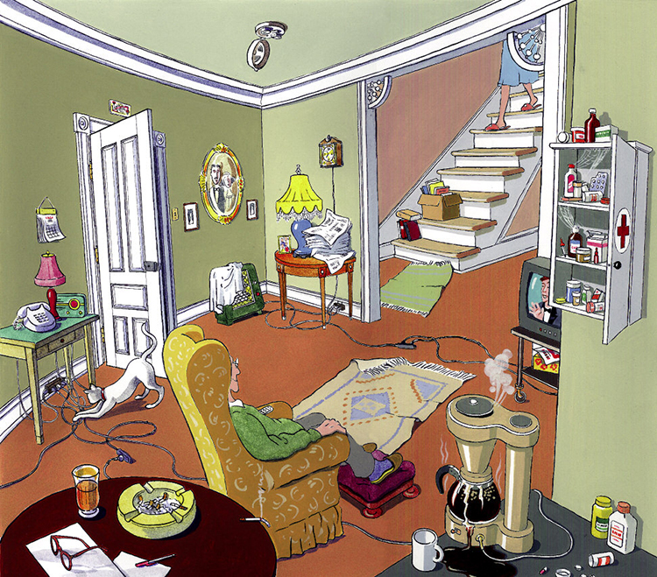
How many potential dangers can you spot in this room?
Do you know what you could do to make it safer?

Slide 2
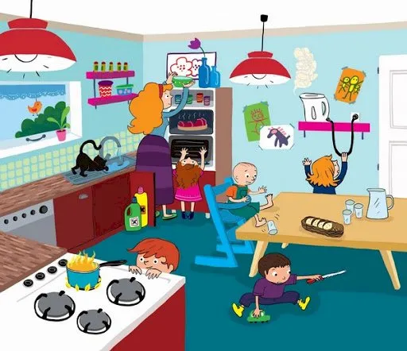
How many potential dangers can you spot in this room?
Do you know what you could do to make it safer?

Slide 3
How SMART are you with your online behaviour?

