Slide 1
History A Level

Slide 2
Why choose History at A-level?
History is stimulating, challenging and rewarding. It can totally change your view of the world.
In our course we journey back from the present to explore the rich tapestry of the past. We focus in on sixteenth century England to look at dynastic struggles in the Early Tudor period, before focusing on the twentieth century to consider the radical changes in Revolutionary Russia and post-war USA. We also investigate the rise and decline of witchcraft during the 16th and 17th centuries and how far it emerged out of the popular culture of the time. By looking in depth we illuminate wider historical themes and equip ourselves with the skills to see patterns in any period of the past.

Slide 3
Structure of the course
Specification: OCR H505
Year 12:
Unit 1 (25% A-Level) British Period Study
Unit 2 (15% A-Level) Non-British Period Study
Year 13:
Unit 3 (40%) Thematic Study and historical Interpretations
Unit 4 (20%) Coursework
Exams for units 1,2 and 3 will be taken at the end of Year 13
Head of Subject: Mr Jennings pjennings@bishopstopford.com

Slide 4
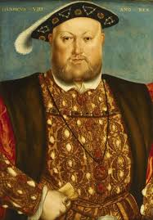
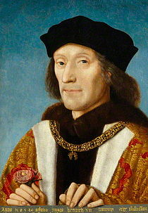
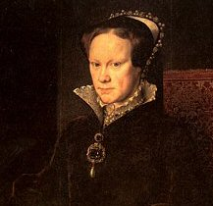
Unit 1 (25%): British period study and enquiry
England 1485-1558: the Early Tudors

Slide 5
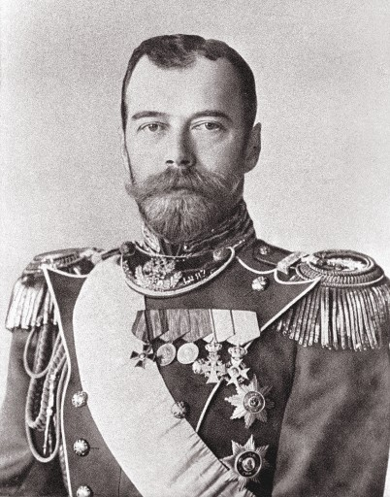
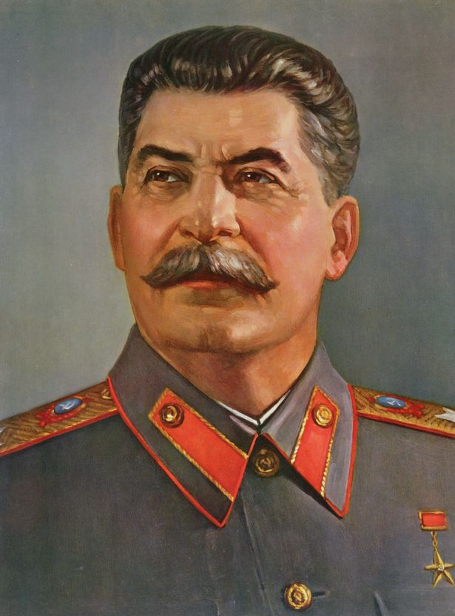
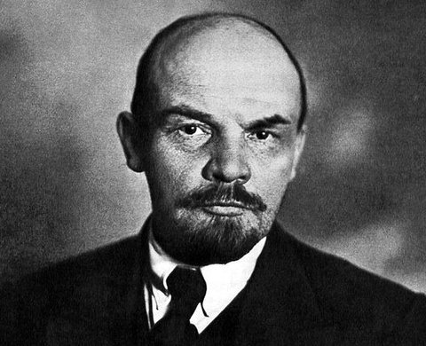
Unit 2 (15%): Non-British period study
Russia, 1894-1941

Slide 6
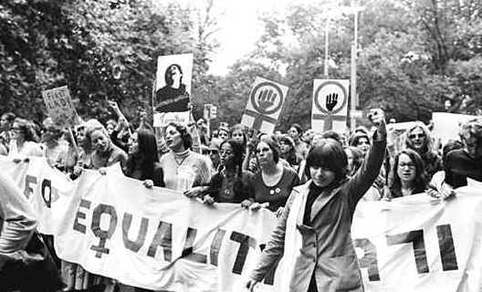
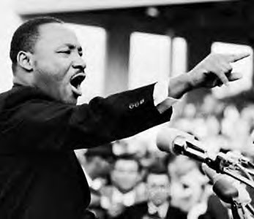
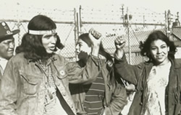
Unit 3 (40%): thematic study and
historical interpretations
Civil Rights in the USA 1865–1992

Slide 7
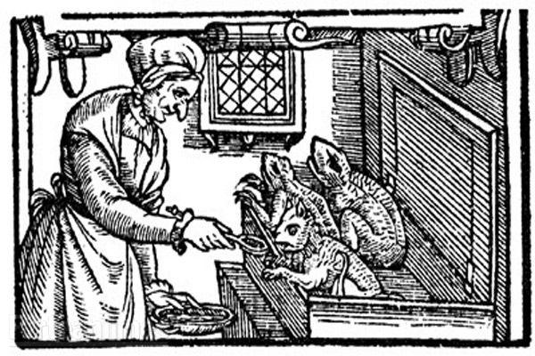
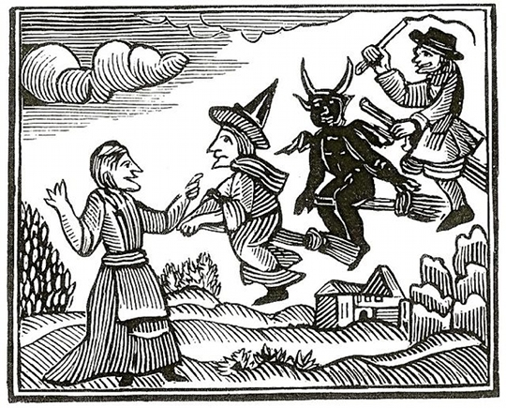
Unit 4 (20%): Coursework
Popular Culture and the Witchcraze of the 16th and 17th Centuries

Slide 8
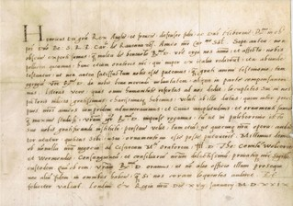
Methods of study
Reading
Note taking
Discussions
Presentations
Document analysis
Essay writing
Trips

Slide 9
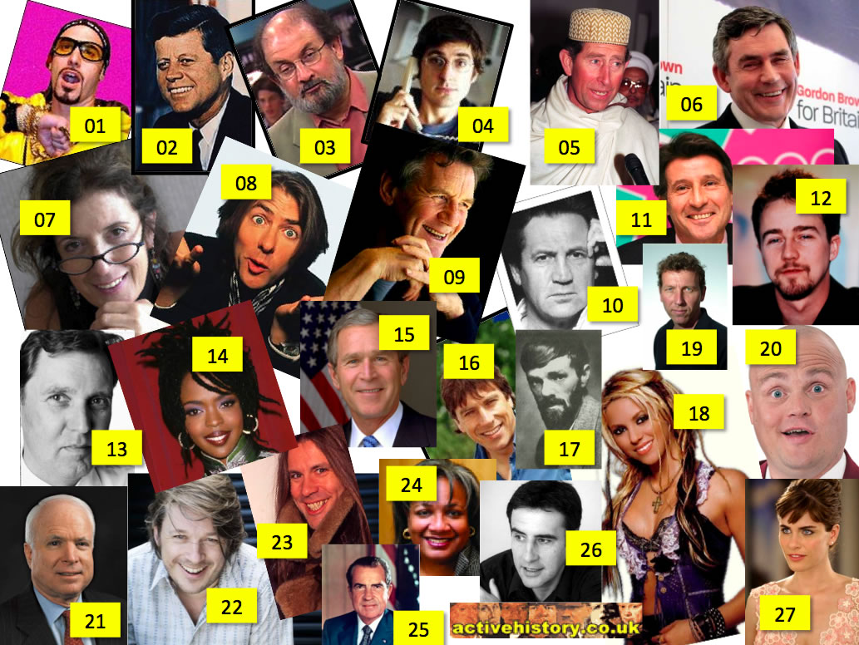
Future career options
The methods of investigation, study and research involved in History are very useful training for a variety of careers, from journalism to personnel management and law to entertainment
History teaches you to make informed judgements, to justify your arguments and to write in a concise and logical manner.
History develops the intrinsic skills of analysis, evaluation, interpretation and explanation, all of which are highly valued in the modern workplace.
All of these famous faces are History graduates!

Slide 10
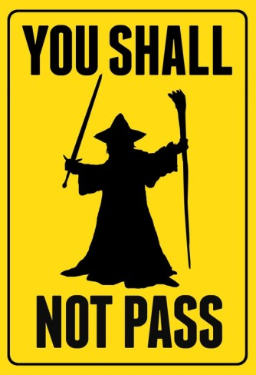
Entry Requirements
5 or above in GCSE History
Or, 5 or above in GCSE English if History has not been taken

Slide 11
“Any fool can make history, but it takes a genius to write it."
Oscar Wilde

