Slide 1
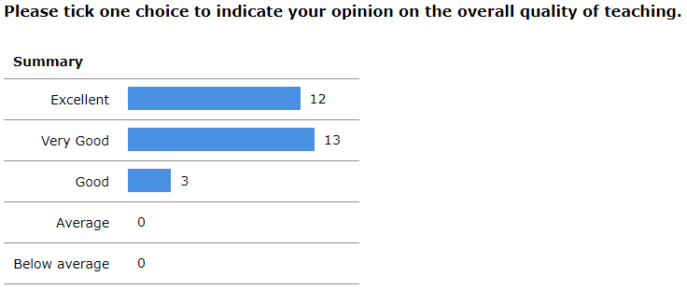

Slide 2
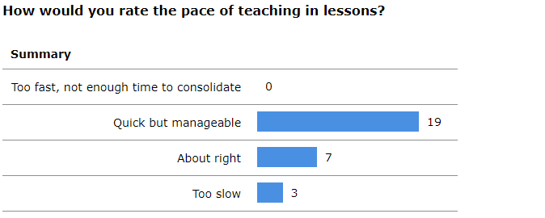

Slide 3
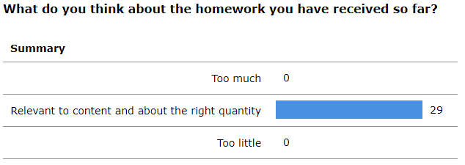

Slide 6
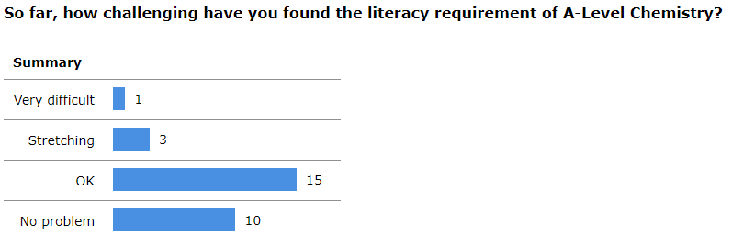

Slide 7
Comments from Current Yr 12 Students
Lots more mathematical content than in GCSE chemistry. Sometimes, I find it too much to fully understand in the lesson itself and so I rely quite heavily on personal consolidation at home.
Overall I am throughly enjoying Chemistry, even though I thought it would be the subject I would struggle most with. Organic chemistry so far has been where I feel most stretched as this is where most of the new content has been introduced to us, personally I feel that inorganic is just a build up from GCSE and a lot of applied maths.
It has very hard to grasp content at first because the content is taught so quickly and is much harder but it all makes sense when you go through the lesson again by yourself. At first it seemed very overwhelming with the amount of content and the style of exam questions but I have got much more comfortable with the teaching style and content as the weeks went by.
I've definitely enjoyed the depth of learning and going into more detail about things I already knew from GCSE. I also enjoy learning completely new things in organic that are certainly tricky but enjoyable nonetheless. It's a big step up from GCSE chemistry but so far I am really enjoying it.

