Slide 1
APPLYING TO CAMBRIDGE
Gina Stock
Bishop alumni, going in to second year History
Notes:
- Welcome to the application support webinar hosted by Downing College

Slide 2
THE APPLICATION PROCESS
Wait to hear about interview. Around 75% of Cambridge Applicants and 25% of Oxford applicants get offered an interview.
Do interview in early December – online most likely.
Hear back in mid January – can be put in Winter Pool. (What is Winter Pool?)
Choose course and college
Check ADMISSIONS ASSESMENT deadlines – all colleges have different requirements and some require you to sign up to do an admissions test so check this out
Apply – 15th October when UCAS is due, but you will have an internal deadline sooner. This includes personal statements, predicted grades, personal information and super-curricular courses e.g. I participated in a Sutton Trust history day and one at John’s College Oxford which I was able to put on the UCAS form itself. Can also put music grades/ D of E on UCAS form, instead of wasting personal statement words.
Cambridge only – SAQ form. Will ask specific questions about why you want to do the course and other circumstances during your A levels.

Slide 3
PERSONAL STATEMENT ADVICE
Include super-curricular activities you have done which prove your interest goes beyond the classroom.
Have a thread linking your activities together. E.g. this book inspired me to take this course, which got me thinking about this so I went and watched this lecture.
Don’t start with something cliché (easier said than done).
Make it readable.
Include extra curriculars (yet Oxbridge discourages it) as you are applying to 4 other unis. Link the extracurricular to a valuable skill for your course – e.g. leadership skills. I linked dance to the history of dance then history!
Potential supercurriculars:
Online Lectures (Ted talks, other university lectures)
Online courses (See FutureLearn for free courses ran by universities with masses of lectures and resources)
Open days relating to your subject
Sutton Trust Courses (specifically aimed at state school students and has a fabulous alumni network)
Books and Articles (Bishop should still have a Jstor login)
Work experience / volunteering (particularly for medicine)
Writing articles and submitting them to journals or essay competitions (Bishop Magazine!)
At Bishop, being head of your relevant society and being on the leadership team/ a reading partner helps!

Slide 4
INTERVIEW ADVICE
Wear something you are comfortable in, but most importantly are confident in. They are not the same thing!
Read as much as you can around your subject the week before. E.g. academic journals. Vast range of knowledge to pull from short term memory.
Make sure you have an answer to the question ‘What have you read since you submitted your application.’
If you have submitted essays or you wrote an admissions test, make sure you are ready to talk about it, and are ready to admit your mistakes in it. Don’t be afraid to notice a contradiction or flaw in your argument at any point.
Know your course. When they ask what interests you in first year specifically you need an answer.
Practice pre-reading. Be ready for absolutely masses and do not get freaked out about it – they were not expecting me to digest every detail of the 23 pages they gave me!
Take time to think. If you’re not sure, narrate your thinking process. ‘I’m not sure, but this is where my thoughts are initially leading me to…’
Don’t google or read your interviewers academic papers. Commenting on this is seen as a little too keen.
Don’t sit on the fence
At interview/ pre interview assessments:
Natural sciences/ engineering – stay familiar with A level content, determined which students understood the content rather than crammed into short term memory.
Sample papers are online, often on university websites.

Slide 5
CAMBRIDGE OR OXFORD?
HOW DO I PICK A COLLEGE?
Depends on your course.
PPE only available at Oxford, HSPS only at Cambridge.
Different combinations of degrees. E.g. Cambridge does not offer English and History, Oxford does.
STEM/Humanities is a myth.
Location. Central colleges often have accommodation way out of town that you might be put in.
Size – some are big, some are small.
Your course – some don’t offer some courses!
Architecture – some are classic, old style, whereas some are more modern.
Facilities – gyms, theatres, pools, chapels, bars.
Kitchens! – many, many Oxbridge colleges do not have ovens or freezers as they expect most students to eat in halls most days.
Accommodation – en suites, double beds.
Gowns

Slide 6
WHAT DO I NEED TO APPLY?
A passion for your subject
Good predicted grades
Confidence to succeed
To-do list:
Personal statement
SAQ (received immediately after submitting your UCAS)
Interview Prep
Admissions test & signing up
And that is all! Have confidence that you have what it takes.

Slide 7
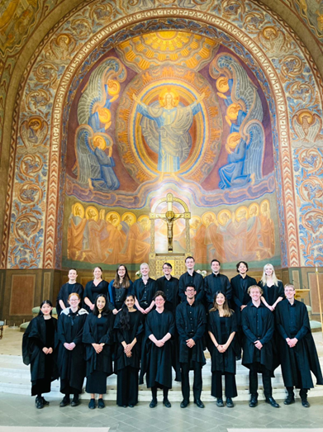
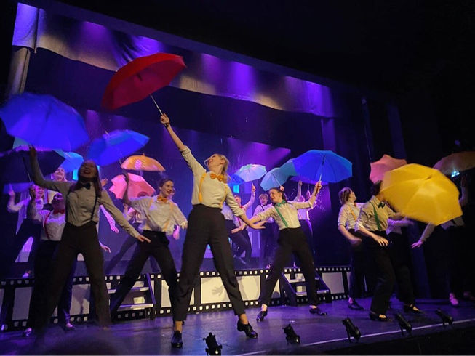
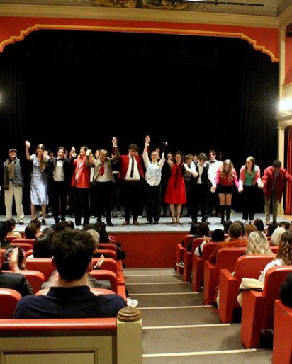
QUESTIONS!
Ask me about:
Specific Cambridge Colleges
My degree / my college
Life at Cambridge
Academic pressure of Cambridge
Advice for you on statements/interviews
Questions about admissions process/ winter and summer pools

