Slide 1
Medicine Applications 2023

Slide 2
UCAT 2023
University Clinical Aptitude Test
www.ucat.ac.uk

Slide 3
What is the UCAT?
Admissions test used in the selection process by a consortium of UK university medical and dental schools
The test assesses a range of mental abilities identified by university medical and dental schools as important
You sit the test in same year that you apply through UCAS
You can only sit the test once each year
2 hour, multiple-choice, computer-based test
Sat at your nearest Pearson VUE test centre

Slide 4
UCAT Universities (UK)
University of Aberdeen
Anglia Ruskin University
Aston University
University of Birmingham
University of Bristol
Brunel University London
Cardiff University
University of Central Lancashire
University of Chester
University of Dundee
University of East Anglia
Edge Hill University
University of Edinburgh
University of Exeter
University of Glasgow
Hull York Medical School
Keele University
Kent & Medway Medical School
King's College London
University of Leeds
University of Leicester
University of Liverpool
University of Manchester
University of Newcastle
University of Nottingham
Plymouth University
Queen Mary, University of London
Queen's University Belfast
University of Sheffield
University of Southampton
University of St Andrews
St George's, University of London
University of Sunderland
University of Surrey
University of Warwick
University of Worcester

Slide 5
Key Dates 2023
16 May | Registration opens Bursary Scheme and Access Arrangements open
20 June | Booking opens
10 July | Testing starts
19 September | Access Arrangements application deadline
21 September | Booking deadline
28 September | Last testing date
29 September | Bursary Scheme application deadline
16 October | UCAS application deadline
Early November | Results delivered to universities

Slide 6
Fees and Bursaries
Tests taken in the UK £70, Tests outside the UK £115 Bursaries that cover the full test fee are available to UK candidates from low-income households
You may be eligible if you (or your parent / guardian) receive: 16-19 Bursary; Free School Meals; Learner Support; EMA; Full Maintenance Grant or Special Support Grant; Income Support; Job Seeker's Allowance; Universal Credit; Employment & Support Allowance; Asylum Support
You can apply from 16 May and receive a bursary voucher to use when booking your test - check the Bursary Scheme page for full details

Slide 7
Access Arrangements
If you are normally entitled to extra time or other accommodations in your school / college exams due to a documented special educational need, disability or medical condition, you may be entitled to access arrangements when sitting the UCAT (25% extra time, rest breaks, etc.)
Applications for access arrangements (with supporting evidence) must be approved by the UCAT Office before you book your test
Likely to relate to dyslexia, dyspraxia, etc. but may apply to a range of other medical conditions
The Access Arrangements page of our website details the different accommodations we can support and the application process

Slide 8
Test Format
Verbal Reasoning
Decision Making
Quantitative Reasoning
Abstract Reasoning
Situational Judgement

Slide 9
Timings (UCAT)
Subtest | Questions | Timing
Verbal reasoning | 44 | 21 minutes
Decision making | 29 | 31 minutes
Quantitative reasoning | 36 | 25 minutes
Abstract reasoning | 50 | 12 minutes
Situational judgement | 69 | 26 minutes
Total Time |  | 115 minutes*
* Each subtest is preceded by a 1 minute instruction section.

Slide 10
21 minutes
44 questions
11 passages
Verbal Reasoning
The test assesses your ability to read and think carefully about information presented in passages and to determine whether specific conclusions can be drawn from information presented
You are not expected to use prior knowledge to answer the questions
Some questions assess critical reasoning skills, requiring you to make inferences and draw conclusions from information
For other questions you decide whether the statement provided follows logically from the information in the passage

Slide 11
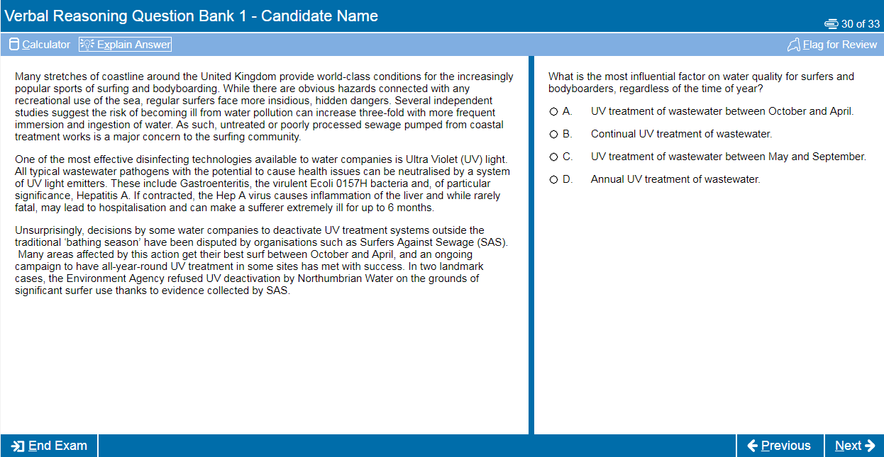

Slide 12
31 minutes
29 questions
Associated with tables, diagrams, text, charts or graphs
Decision Making
This subtest assesses the ability to apply logic to reach a decision or conclusion, evaluate arguments and analyse statistical information
There are a number of different question types including logical puzzles, syllogisms and Venn diagrams
Knowledge of specific mathematical or logical reasoning terminology is not required to answer any questions.
All questions are standalone and do not share data
You can make notes using a whiteboard / marker pen

Slide 13
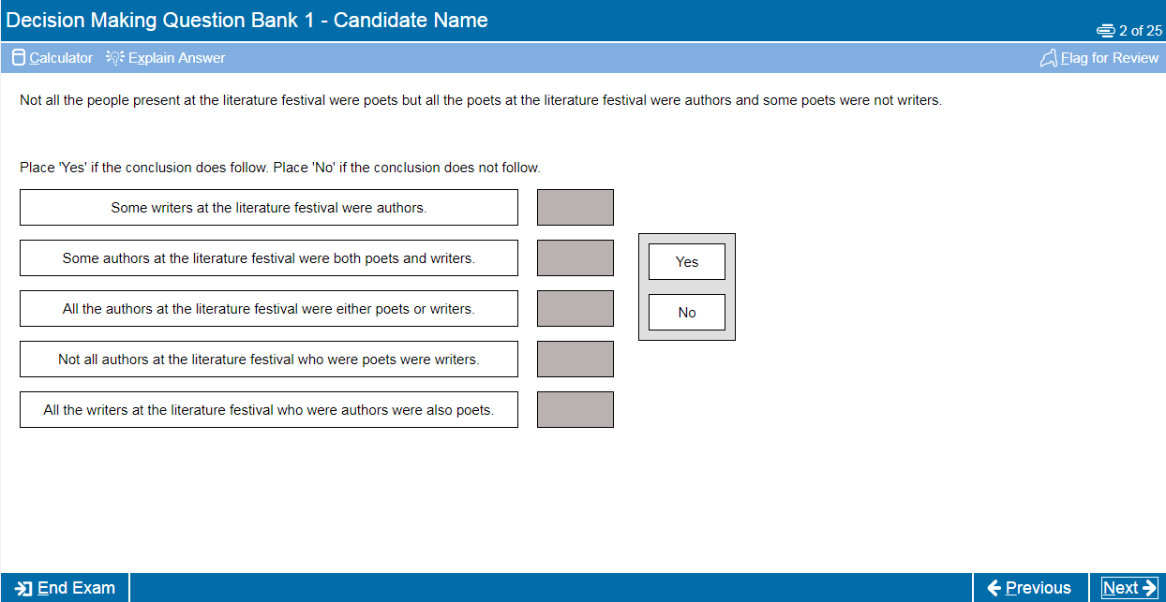

Slide 14
25 minutes
36 questions
Associated with tables, charts and/or graphs
Quantitative Reasoning
This subtest assesses your ability to use numerical skills to solve problems
It assumes familiarity with numbers, e.g. ratios, percentages, averages, fractions, etc.
However questions are less to do with numerical facility and more to do with problem solving
A basic calculator is available for use in this section
Although using mental maths may save you time
You can make notes using the whiteboard / marker pen provided

Slide 15
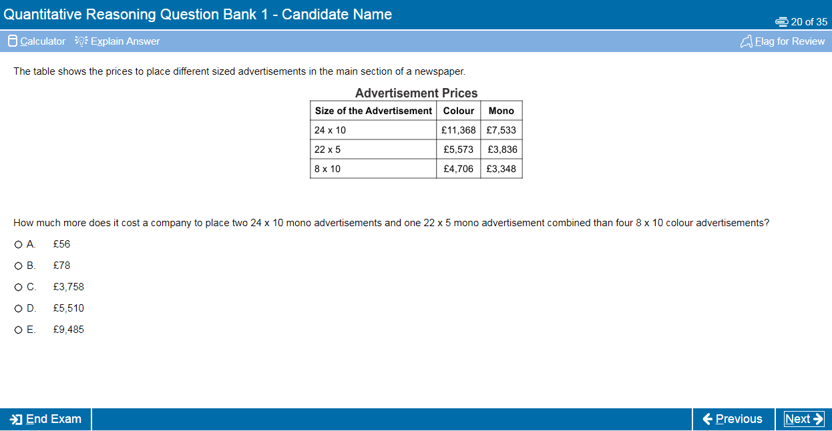

Slide 16
12 minutes
50 questions
Associated with numerous sets of shapes
Abstract Reasoning
The test assesses your ability to identify patterns amongst abstract shapes where irrelevant and distracting material may lead to incorrect conclusions
The test therefore measures your ability to change track, critically evaluate and generate hypotheses and requires you to query judgements as you go along
There are 4 different questions types in this test associated with a series of sets of shapes

Slide 18
26 minutes
69 questions
Various scenarios (with up to 6 associated questions)
Situational Judgement
The test measures your capacity to understand real world situations and to identify critical factors and appropriate behaviour in dealing with them
It assesses the key traits of integrity, perspective taking, team involvement, resilience and adaptability
Questions do not require medical or procedural knowledge
SJTs are used widely in medical selection, including selection of Foundation Doctors, GPs and other medical specialties

Slide 20
How should you prepare?
Although it is a test of aptitude rather than academic knowledge, you should still allow time to prepare thoroughly for the UCAT
We recommend you spend at least 25-30 hours preparing for the test
Start at least 4-6 weeks before your test date
Use the FREE resources available on the UCAT website (we have over 1,000 example questions)
Note - we do not endorse or recommend any commercial preparation materials and are not affiliated with these in any way

Slide 21
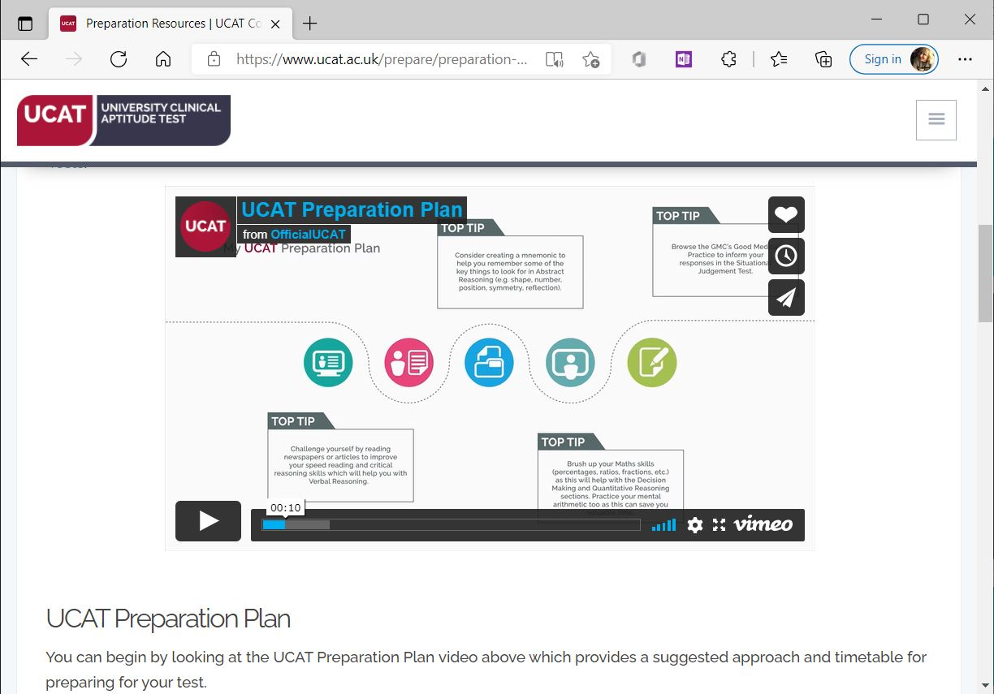
Practice Tests and Resources
Preparation Plan
Tour Tutorial
Question Tutorial
Question Banks
Practice Tests
Test Tools
Candidate Advice

Slide 22
Tips and Advice
Practise the test timings, try to answer all the questions, don’t leave blanks
Remember that no points are deducted for wrong answers so if you’re stuck use your best guess
Use the Flag and Review functions of the test effectively to manage your time
Use the official practice tests towards the end of your preparation to see where you need to manage your time more effectively

Slide 23
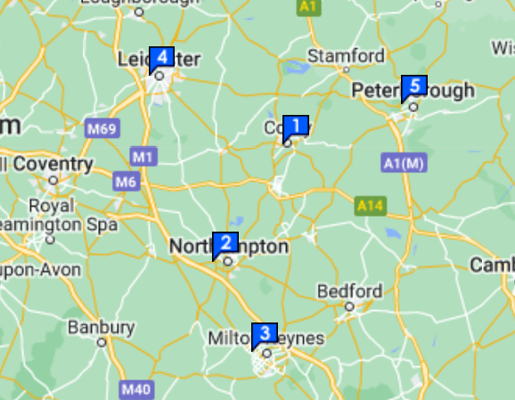
What Should You Consider When Booking Your UCAT?
Location – Think about which test centre is most convenient for you and if you’re going to need to travel, then make sure you will be ok getting there for the time you select.
Time of day – Think about what time of the day suits you best to take the UCAT as you’ll need to make sure you’re focused and feel ready to tackle the two hour test. If you are needing to travel to the test centre then maybe avoid anything too early as you don’t want to get stuck in rush hour!
Any holidays? – Make sure to check if you have any holidays booked in for the Summer before you book your UCAT and work out what works the best for you.

Slide 24
Test Day
Arrive at the Test Centre at least 15 minutes before you are due to start - if you are late you may not be allowed to test
Make sure you take the correct ID or you will not be allowed to sit the test
Read the Candidate Examination Rules carefully
Other people will be testing in the same room as you so you can ask for ear plugs to limit disturbance
If you experience any issues during your test you must notify the invigilator immediately

Slide 25
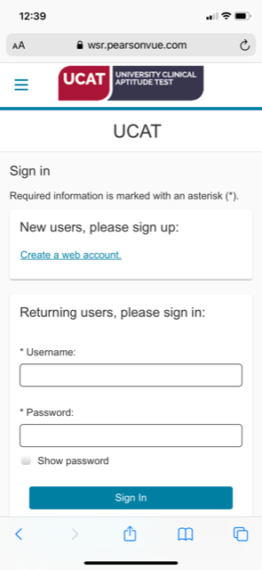
Scoring and Results
2500
(2022)
Your UCAT result will comprise of a total score of between 1200 and 3600, and a Banding for Situational Judgement
Results are available on the day of your test (from the test centre), and within 24 hours via your Pearson Vue account
Before you submit your UCAS application check how universities use the test, or you might be wasting an application
UCAT Score Report

Slide 26
Which Medical Schools Currently Use The BMAT Assessments?
There are 7 medical schools in the UK that currently use BMAT tests as part of their assessment criteria.
Brighton and Sussex
Imperial College London
Lancaster University
University College London (UCL)
University of Cambridge
Leeds University
University of Oxford
BMAT will be withdrawn by those medical schools currently using this as part of their admissions process, with effect from 2024-5.

Slide 27
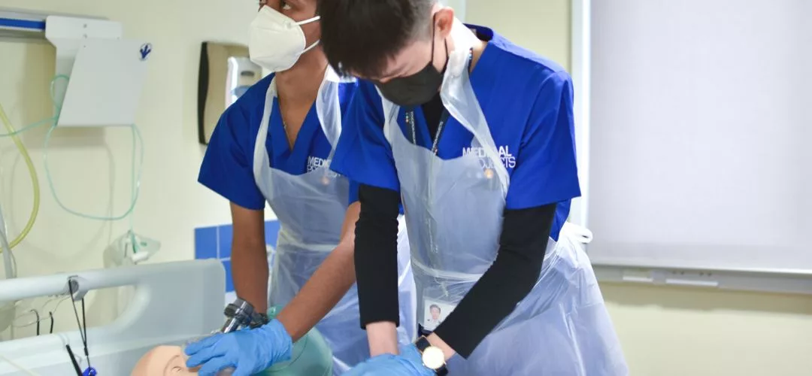
Medical Work Experience
It can be exceptionally difficult to find medical work experience in hospitals and GP surgeries, with it often being tricky to know exactly who to send your CV and cover letter to.

Slide 28
How Much Work Experience Do You Need To Do?
When it comes to medical work experience to support your Medical School application, quality over quantity is key. So don’t feel like you need to have weeks and weeks of shadowing doctors to ensure success.
Medical schools recognise how hard it can be to secure work experience within hospitals and GPs surgeries and rather than looking at how much work experience you have done, they’ll want to know what you have learnt from the experiences.
It’s also not essential to have work experience within a hospital, as long as you have been able to experience what it is like to work in a care-giving capacity.

Slide 29
Top Tips for Arranging Medical Work Experience
Any links to doctors/nurses? Immediate family / friendship circle connection to somebody who currently works in the healthcare industry
Get your parents to ask around where they work
Think about where you could travel to
Follow up face-to-face – if you’ve found that you’re not hearing back after emailing and calling where you would like to do some work experience, then try to go in and ask to speak to the person who coordinates their placements.
Consider volunteering –looked at very favourably by Medical Schools. The Royal Voluntary Service is a great place to start looking as they partner with hospitals and you can find out more here.
Think outside the box – Care homes, hospices, charity shops and charities supporting people with disabilities are great places to try. Working with young people is also a great way to support your Medical School application, so maybe consider if there are any after school clubs, sports teams or school holiday schemes that you could help with.

Slide 30
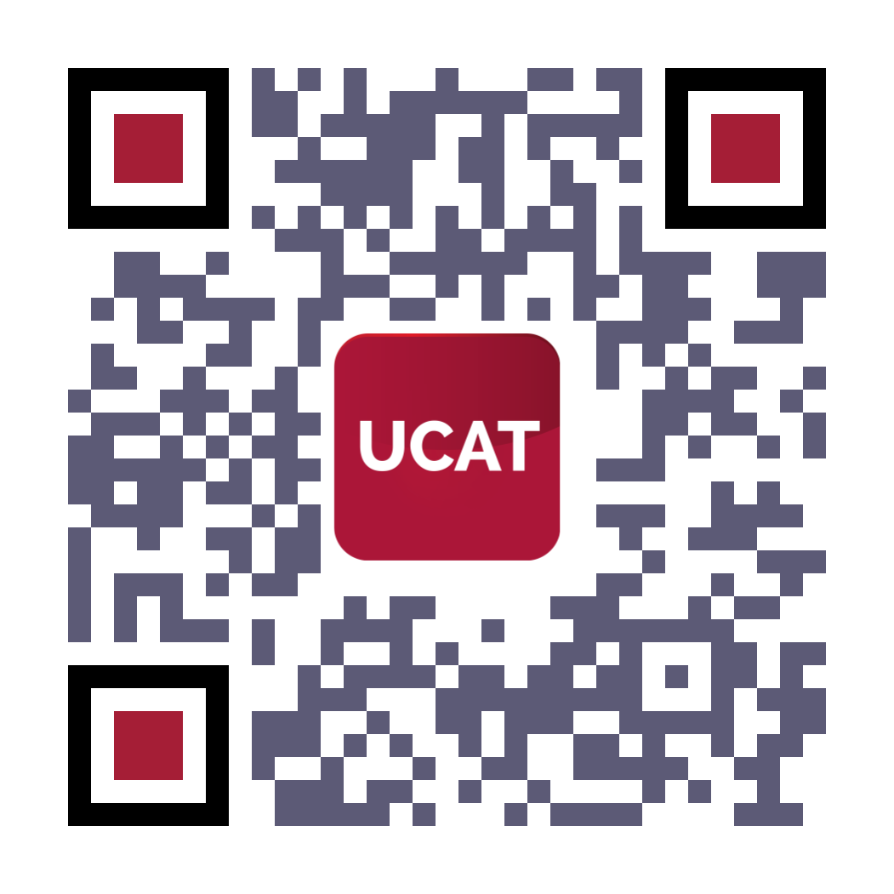
THANK YOU!
For more information visit the UCAT website: ucat.ac.uk or scan the QR code for our latest UCAT publication
Follow them on social media to see extra practice questions and important updates on the 2023 test cycle
@ucatofficial

