Slide 1
The A-Level Mindset
How to be successful at A levels

Slide 2
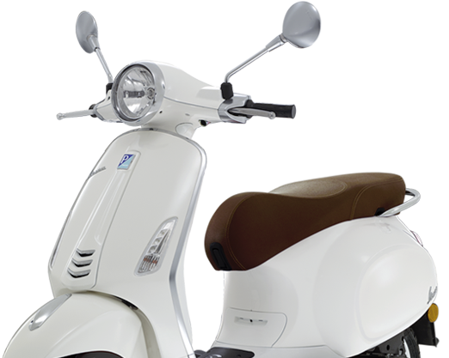
VESPA is the key to success at A Level
Having a Vision
Commitment to the Effort
Having Systems
Practice
Positive Mental Attitude
All of these can be practiced and learned and we will help and support you with this.
Bishop

Slide 3
Effort – how much hard work you do. Commitment to the Effort.
It’s not what you bring into the sixth form that counts, it what you do while you are here that matters! (read page 7)
Notes:
You have decided to come into the 6th Form at Bishop Stopford School. Why? Speed dating. You will have 30 seconds to answer the question that appears and then you must listen while you ‘date’ answers the next question.

Slide 4
Page 10 - Rate your effort on a scale of 1 to 10.

Slide 5
Did you choose 6?
Most people do!
This is quite a subjective judgement and often based on what you think
we want to hear or compared to your group of friends.

Slide 6
Simplest way is to measure how much independent study you are doing in terms of time. This includes: homework, research, wider reading, consolidation of previous learning, revision, practice questions, preparation for tests and so on.

Slide 7
You need to be proactive not reactive!
Completing tasks set be teachers only forms a small part of a successful student's private study.
Private study is more about setting yourself work.

Slide 8
How much private study should you be doing and measuring your effort against?
5 hours a week for each subject you do is a guide.
So if you do three A-level subjects that 15 hours a week private study!
Now rate yourself out of 10 based on hours of independent / private study.

Slide 9
Are you still a 6 now?

Slide 10
Resources Search Results | Net Sixth Form
BSS28 Year 12 Videos –
A foundation for Year 13 (4 minutes)
They talk about not being in school, you
are in school but still need to use your time
wisely in the same way.

Slide 11
Most people are the average of the 5 people they spend the most time with!!!!!! Are the people you spent your time with helping you or hindering you?
Students who surround themselves with hard working people get better grades!
Study, like any challenge, is as much about mastering yourself as it is about mastering the subject.

Slide 12
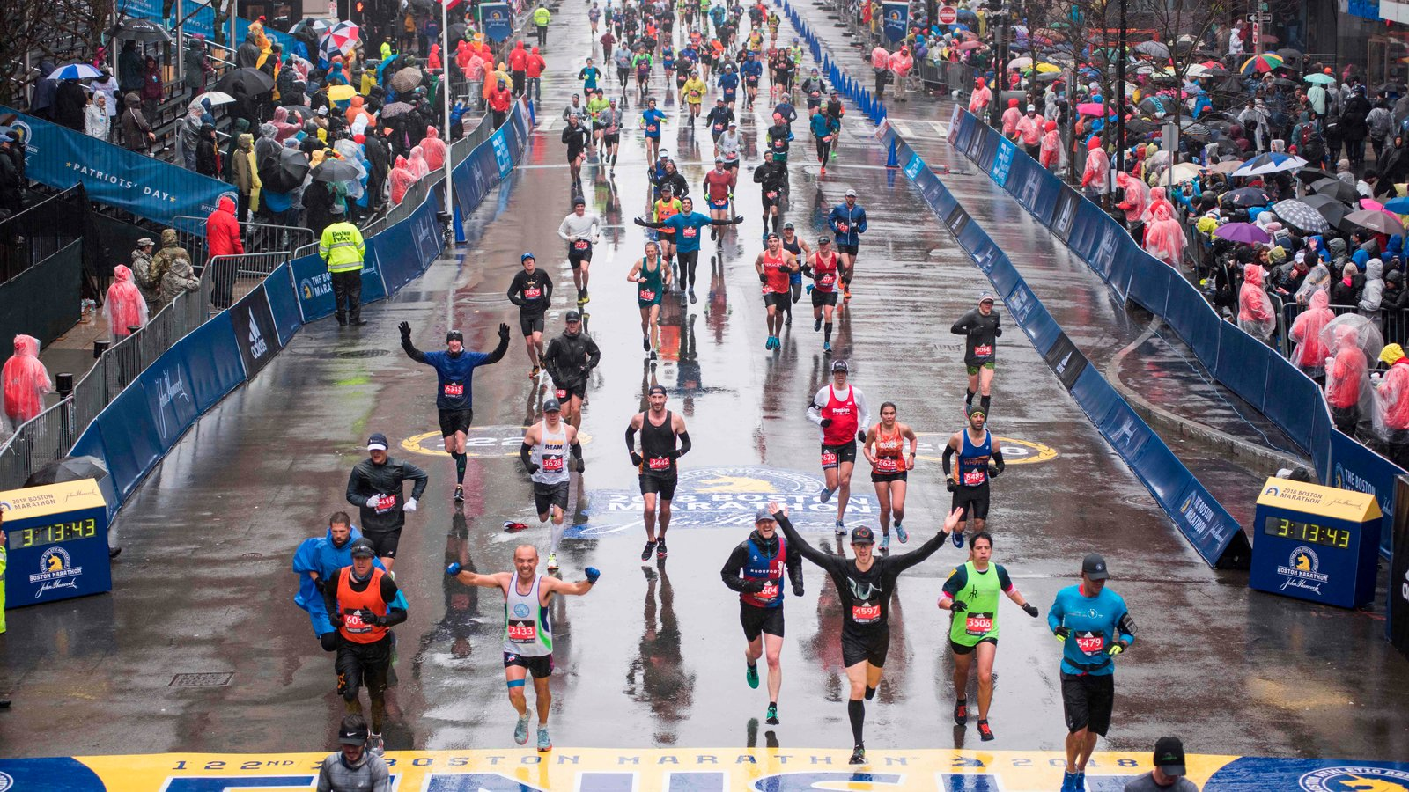
Don’t panic - You will have to train for this!!!!
You wouldn’t be able to just run a marathon without training!!

Slide 13
Where can you study in school?

Slide 14
The Common Room - RIGHT

Slide 15
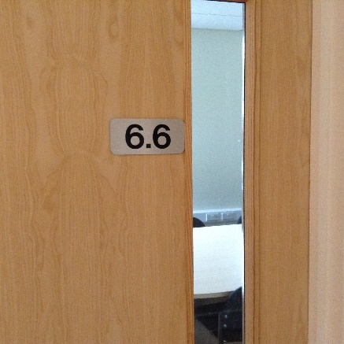
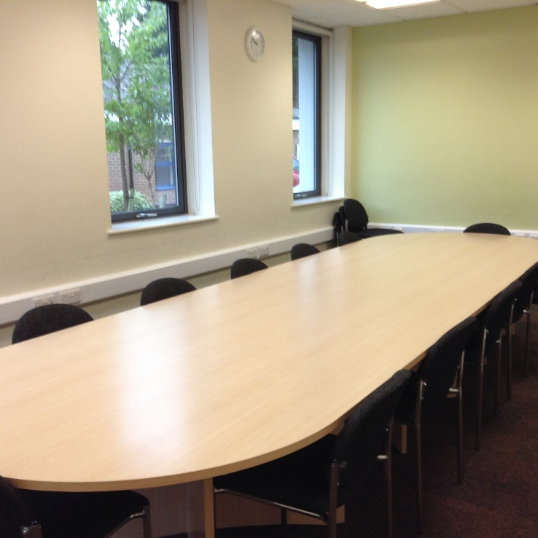
Seminar Rooms 6.6 and 6.5
These rooms may be used by individuals or groups during lessons time when they are free.

Slide 16
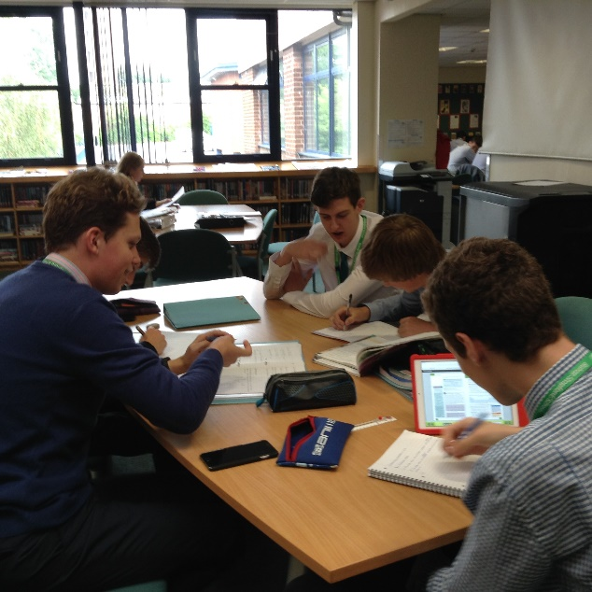
The School Library
6th Form students may use the school library for private study but this is a QUIET working environment.

Slide 17
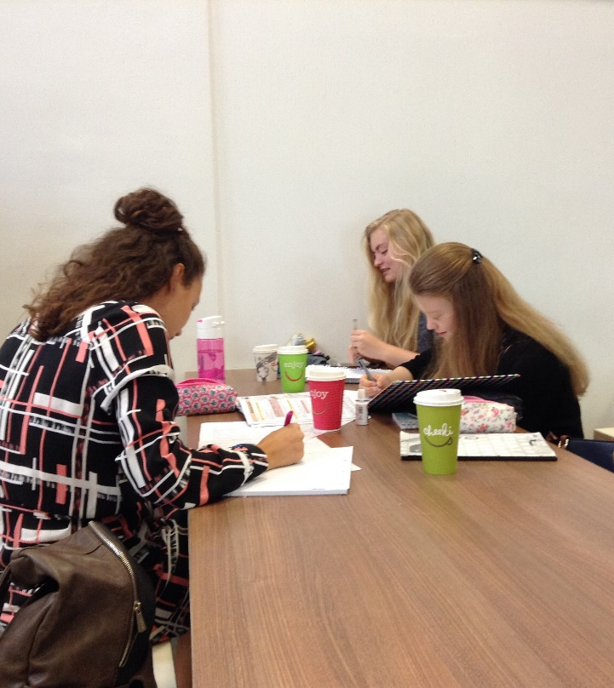
The Olive Grove
The Olive Grove (the school dining hall) may be used for private study, both the large whole school area and the 6th Form Coffee Bar during lesson times
However it must be vacated at midday in order for preparation for lunch.

Slide 18
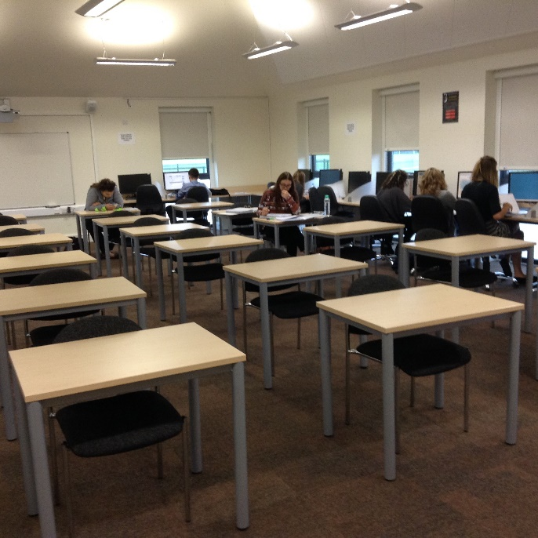
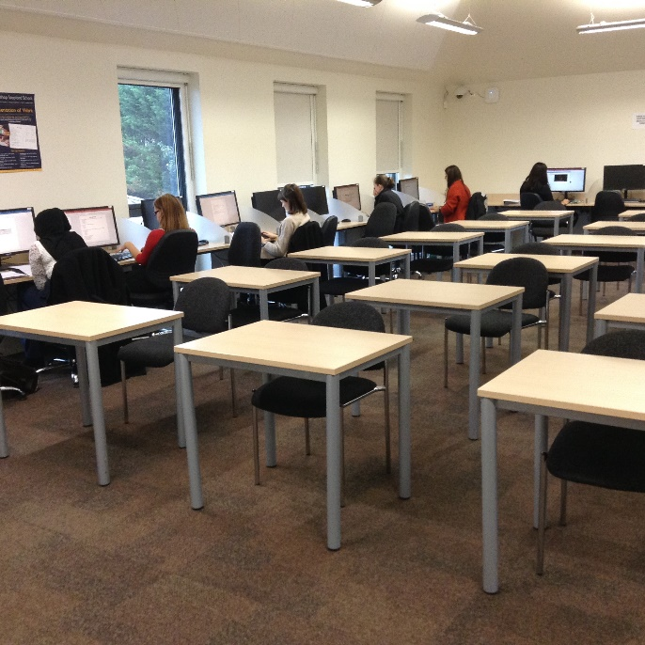
The 6th Form Study Centre
This is a SILENT working area. You will be asked to leave, by other students, if you are not silent.
The Study Centre is open from 8.00am to 5.00pm every day.

Slide 19
Free Rooms
These will have been emailed out to you.

Slide 20
It’s important to start forming good study habits and routines now
Triggers
You need to have a trigger, e.g. when lessons start and I am free I am going to go to the study centre.
Know
Know what you want to achieve in the time you have. Set yourself a task.
Reward
Reward yourself afterwards (not before!) – a cup of coffee, say well done to yourself.
Recognise
Recognise your blockers!!!!

Slide 21
RECOGNISING YOUR BLOCKERS (page 9)

Slide 22
THE 10 MINUTE RULE (page 10). Read this.
Try and do this over the next week and see if it helps you settle and study.

