Slide 1
Objectives for the Session
Outline the application process
Explain how to structure an effective personal statement

Slide 6
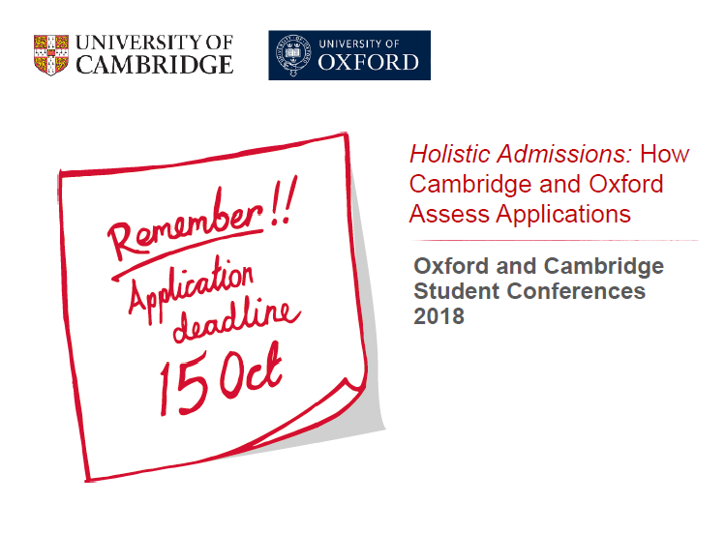
BSS deadline:
27th September 2021

Slide 7
Notes:
SAQ – Supplementary Application Questionnaire – Cam only – completed online

Slide 10
The Overall Success Rate (for 2021 entry)
Your chances of obtaining an offer from Oxford or Cambridge (before you have confirmed your course and college choice, sat your potential admissions test, and been invited up for interview) are roughly 17%
46,000 applicants chasing 8,000 places at the two universities
Cambridge offered places to 4,245 out of their 22,788 applicants (18.6%)
Oxford offered places to 3,932 out of 23,414 applicants (16.8%)

Slide 11
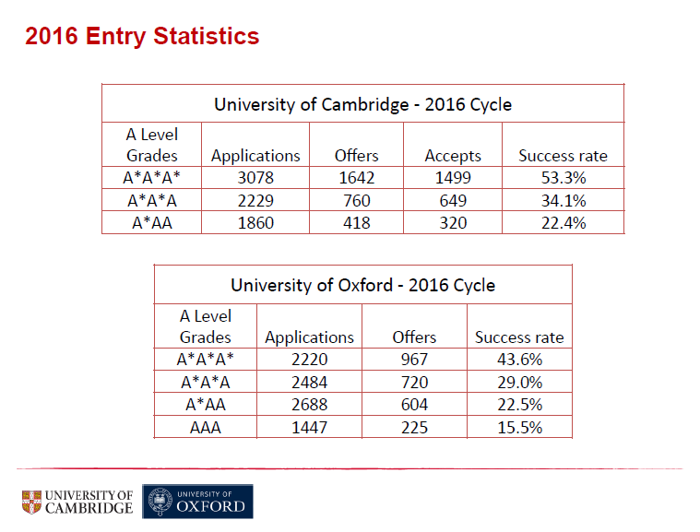

Slide 18
https://www.youtube.com/watch?v=giEHFXS-Vk4&t=3s
https://www.youtube.com/watch?v=8S4rTLibYQw&t=1s
https://www.youtube.com/watch?v=dUwN6GI-0EQ
https://www.youtube.com/watch?v=CXiQtJXTZSo

Slide 21
2021
4th November
Notes:
And UKCAT!

Slide 22
https://www.admissionstesting.org/for-test-takers/thinking-skills-assessment/tsa-cambridge/preparing-for-tsa-cambridge/
https://www.admissionstesting.org/for-test-takers/thinking-skills-assessment/tsa-oxford/preparing-for-tsa-oxford/

Slide 30
Societies

Slide 35
https://www.ucas.com/events/ucasdiscovery-demand-393976

