Slide 1
Introduction to medicine

Slide 2
What were going to cover
Admissions process
Entrance exams
Work experience
Personal statement
Interviews
Choosing where to apply
Course type/placements
Anatomy teaching
Life at medical school
Standard week in the life

Slide 3
Admissions process

Slide 4
Entrance exams: UCAT
Register in early June, book late June
Tests from August-September
Done in a center

Slide 5
UCAT
2-hour exam, 5 Sections
Verbal reasoning
Decision making
Quantitative reasoning
Abstract reasoning
Situational judgement
Scored out of 3600 (300-900 per section) and a band (1-4)

Slide 6
UCAT prep
I would recommend:
1 month medify
Week 1: Questions (untimed)
Week 2: Timed questions (Small batches)
Week 3:Timed questions/ section mocks
Week 4: Full mock/ section mocks

Slide 7
BMAT
Register through the school
No registration fee
Normally 1st September to register

Slide 8
BMAT
2-hour exam, 3 sections
Section 1:
Problem-solving, understanding arguments, data analysis and inference.
Section 2:
Application of GCSE level scientific/ mathematical knowledge
Section 3:
Select, develop and organise ideas, and communicate them in an essay
Scored from 1.0-9.0 (av. 5.0)

Slide 9
BMAT prep
Revise GCSE science/maths content for section 2
Practice answering questions in BMAT format
Use BMAT books or Medify for this
Write practice essays for section 3 under time pressure
Read BMAT specification and annotate this

Slide 10
Work experience
Can be clinical or not
Clinical- apply via websites/email
Other: Guides/scouts, care homes, charity events

Slide 11
Personal statement
Make a list, highlight your priorities
Make it easy to read- it doesn’t need to sound fancy
Don’t put in anything you wouldn’t be able to talk about at interview
If you’ve read a book, ensure you can talk about it
Reflect on what you’ve done and link this back to how it will assist you in pursuing medicine
Customer service job- acting in a professional manner and communicating effectively to solve problems
Volunteering at local youth group- responsibility, leadership skills and teamwork within leadership
Include academic aspects, people-focused aspects, any volunteering/work experience or substitutes and personal motivations to pursue medicine
Oxbridge personal statements should be mostly academic

Slide 12
Interviews
Try and stay calm
Practice as many questions as possible
Take part in mock interviews
Do your research on the university and the course
Remember that they want to give you a place, and that being stressed just shows that you care and that it’s perfectly normal. Be confident in the preparation you’ve done and try and enjoy the conversation and be yourself

Slide 13
Choosing where to apply

Slide 14
Course types
Traditional
3 pre-clinical(book learning) years
3 Clinical years
Integrated
Mix of both
Slowly include more clinical placements as course progresses
PBL(problem-based learning)
Lots of placement from the first year

Slide 15
Anatomy teaching
Dissection
Prosection
Style
Time dedicated

Slide 16
Life at medical school

Slide 17
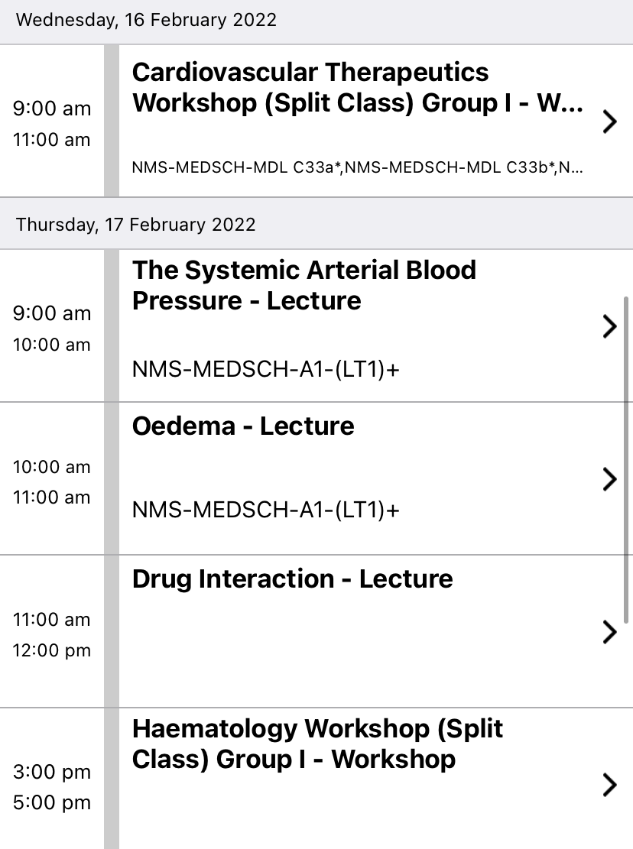
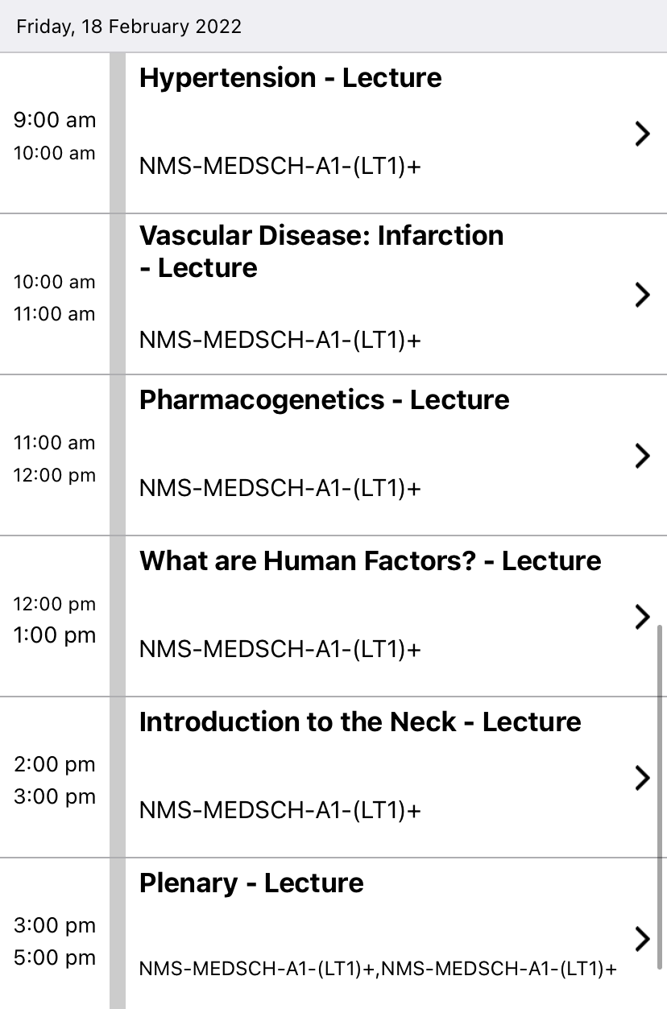
A typical week

Slide 18
Placements
GP
Hospital

Slide 19
Random extras
Medic portal
BMJ
Good medical practice
Gillick competence

Slide 20
Q&A

Slide 21
My contact details
Phone number: 07895710574
Instagram: ee.vaburke
Email: eva.e.burke@gmail.com

