Slide 1
Welcome

Slide 2
The A-Level Mindset
How to be successful at A-levels

Slide 3
Please write your name, form and teacher on the front of your booklet. I will keep these and give them out each week.

Slide 4
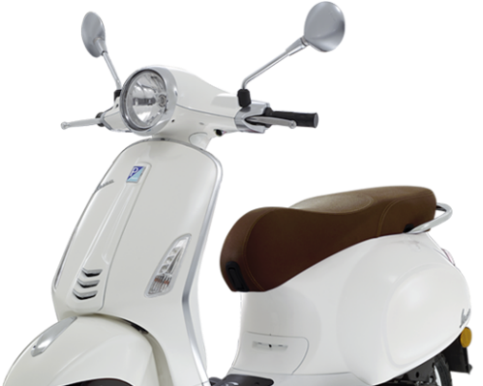
Having a Vision
Commitment to the Effort
Having Systems
Practice
Positive Mental Attitude
All of these can be practiced and learned and we will help and support you with this.
VESPA is the key to success at A-level

Slide 5
Lesson 1: Vision – knowing what you want to achieve
Notes:
You have decided to come into the 6th Form at Bishop Stopford School. Why? Speed dating. You will have 30 seconds to answer the question that appears and then you must listen while you ‘date’ answers the next question.

Slide 6
* Do you know what you want to achieve? * Why are you studying A levels? * What grades do you want to achieve in your A levels? * What careers are you interested in?

Slide 7
Resources Search Results | Net Sixth Form
BSS28 – Year 12 Videos - Having a goal that drives you (4 minutes)

Slide 8
In groups of two or three look at the questions on page 3 of your booklet and take it in turns to answer them as honestly as you can.

Slide 9
Over the next week think about your answers to the 20 questions. What is your Vision?

