Slide 1
Greek Theatre project

Slide 2
Your task
Create either a Greek theatrical mask, or a model of an amphitheatre.
Take pictures of what you create and send them to jbamford@bishopstopford.com and the best ones will be displayed in school and sent to the big people for recognition!

Slide 3
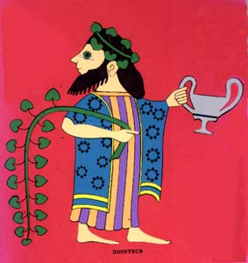
Ancient Greek theatre
Plays were performed in Ancient Greece to honour the God Dionysus.
Dionysus was the god of theatre and wine.
Watch this for more:
https://vimeo.com/164710800

Slide 4
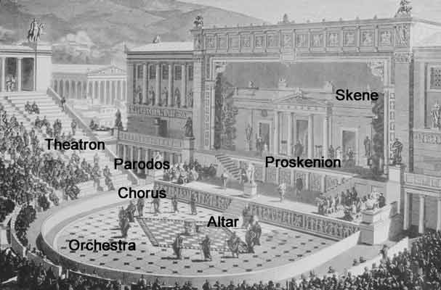
Greek theatres
Greek theatres were large and semi-circular, with rows of tiered seating.
The centre was circular with an altar dedicated to Dionysus.
The stage was raised within the circle – this shape made sure all the audience could see and helped amplify the sound.
Very important visitors would sit in the front seats.
Click the video to learn more!
I’m a video, click me!

Slide 5
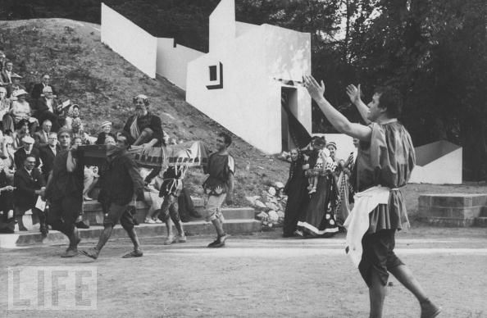
The plays
Women could attend the plays, but all the actors were men (even playing the parts of women!).
Some famous playwrights include: Aeschylus, Sophocles and Euripides (who wrote tragedies) and Aristophanes (who wrote comedies).

Slide 6
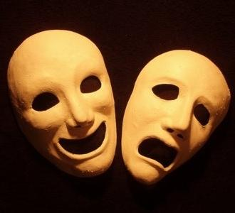
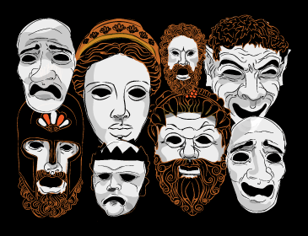
What was it like?
The audience would throw food and stones if they thought the acting wasn’t good enough!
The actors wore masks, bright colours for comedies and dark colours for tragedies.
You could see if someone was happy or sad by the shape of their mask.
The masks were made from fabric, stiffened with plaster.

Slide 7
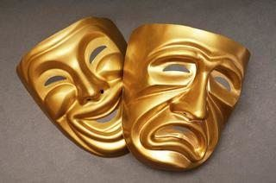
Origins of Greek Theatre
Greek theatre is the oldest form of theatre that we have record of.
Despite the fact that Greek theatre is twice as old as Christianity, it still looks remarkably similar to theatre today!
As you have a look at the pictures, try to note places that haven’t changed at all, there are actors, a stage, seats, audience, plays that are written are performed, tragedy and comedy are still major genres in theatre. So cool!

Slide 8
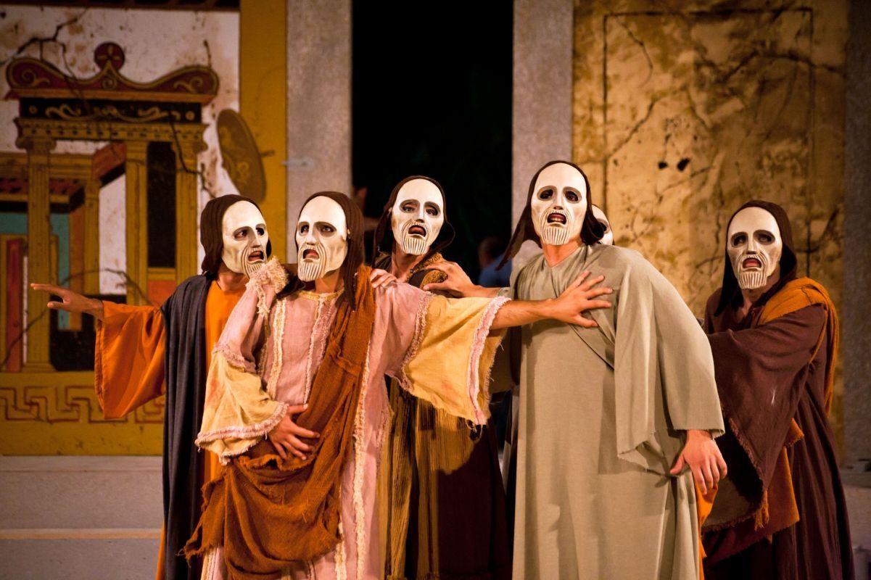
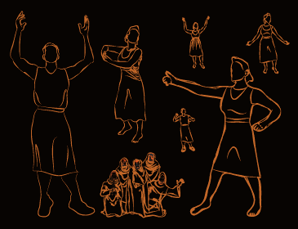
The Costumes
Most characters were dresses like ‘modern’ Greek people, robes and togas, colours used to represent different types of character.
The most important part of a Greek costume was the mask.

Slide 9
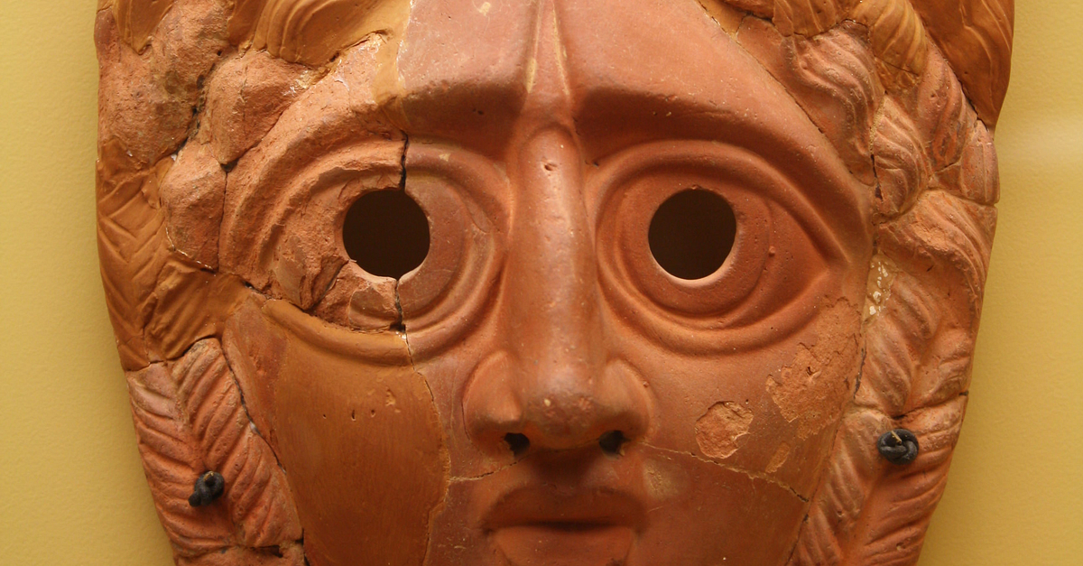
The Masks

Slide 10
The Mask
Greek masks were highly specialized. They acted as a kind of amplifier so the voice of the performer could reach everyone seated in the amphitheatre. The masks covered most of the actors head and had small mouth and eye openings. However, they were made of organic materials such as stiffened linen, wood, leather or cork. Because the materials used to make them were decomposable, no original masks exist today.
Both the actors and chorus wore masks

Slide 11
Want to do the mask option?
Some websites to help you:
https://www.wikihow.com/Make-Greek-Theatre-Masks#:~:text=Make%20a%20mask%20from%20paper%20m%C3%A2ch%C3%A9.&text=Take%20a%20couple%20strips%20of,the%20shape%20of%20a%20mask.&text=Leave%20the%20paper%20m%C3%A2ch%C3%A9%20for%20a%20couple%20hours%20to%20let%20it%20dry.
https://www.activityvillage.co.uk/make-a-greek-mask

Slide 12
Want to do the amphitheatre option?
Websites to help:
https://www.timetrips.co.uk/model_theatre_instr.htm
https://claraandmacy.com/blogs/news/building-a-roman-amphitheatre

Slide 13
Remember to send me pictures of what you’ve done!
jbamford@bishopstopford.com

Slide 14
Want a challenge? Watch this prezi video
https://prezi.com/ijdp58grvhtg/greek-theatre-drama-project/

