Slide 1
The A-Level Mindset
How to be successful at A-levels

Slide 2
Systems – having processes in place to ensure deadlines are met and work is organised.
Notes:
You have decided to come into the 6th Form at Bishop Stopford School. Why? Speed dating. You will have 30 seconds to answer the question that appears and then you must listen while you ‘date’ answers the next question.

Slide 3
Meeting deadlines
A deadline is the final date something can be completed, not the date you have to do it on!!!!
Plan ahead.
Expect the unexpected.
Complete work well before a deadline.

Slide 4
Things to consider……
The longer the day goes on, the more self-control problems you will have.
Snack don’t binge!
Try and do a Weekly Review - every week set a side 1 hour to review what you have done in the previous week in each subject. This is 15-20 minutes per subject.
Check your notes and that everything is there and in order, what work needs completing, what task can you set yourself?
What are your priorities for the week ahead?

Slide 5
The Weekly Review
Studies show that students who regularly review their learning, identifying areas of strength, areas to work on and know their deadlines and next steps to get there, are more likely to be successful AND LESS STRESSED!
How you do this is up to you but one thing that students have used and adapted is found on pages 11-12.

Slide 6
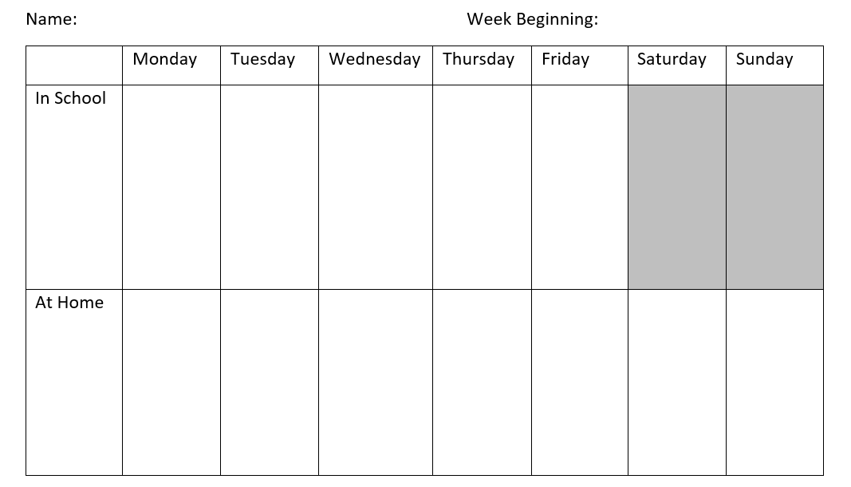
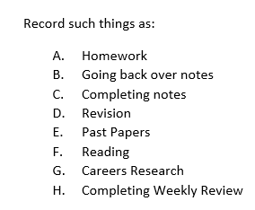
Part A

Slide 7
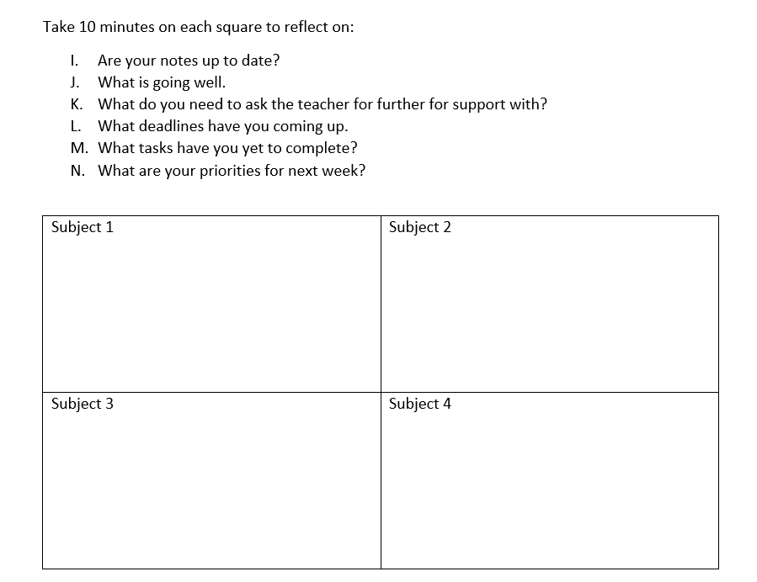
Part B

Slide 8
Page 13 – The Eisenhower Matrix
Have a look at this to help you ensure everything is done when it should be.

