Slide 1
Mathematics A Level

Slide 2
Why choose Maths at A-level?
A-level Mathematics is one of the most widely accepted and respected subject choices by universities and is likely to enhance your options rather than close them down.
A-Level Mathematics opens doors to many future university and career options.
It pairs very well with other subjects such as the Sciences or Economics
It is a challenging A-Level that will improve your level of problem solving and reasoning. It models Mathematics in real life situations, such as projectile motion, population growth and data analysis of weather.
The applications are limitless!

Slide 3
Structure of the course
Specification: Edexcel 9MA0
Year 12/13:
Pure $\left(\frac{2}{3}\right)$
Statistics $\left(\frac{1}{6}\right)$
Mechanics $\left(\frac{1}{6}\right)$
Exams in Year 13. Each exam is 100 marks.
Pure 1 – 2 hours
Pure 2 – 2 hours
Statistics/Mechanics – 2 hours
Head of Subject: Mr Ready sready@bishopstopford.com

Slide 4
Pure Mathematics
Students will study
Proof
Algebra, Functions and Graphs
Coordinate Geometry
Sequences and Series
Trigonometry
Calculus: Differentiation and Integration
Numerical Methods
Vectors

Slide 5
Statistics
Students will study:
Statistical Sampling
Data Presentation and Interpretation
Probability
Statistical Distributions
Statistical Hypothesis Testing
Students will become familiar with a Statistical Data Set and part of the examination will relate to this.

Slide 6
Mechanics
Students will study:
Quantities and Units in Mechanics
Kinematics
Forces and Motion
Newton’s Laws
Moments

Slide 7
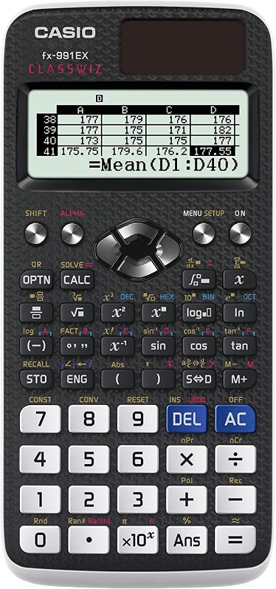
Calculators
Calculators will be allowed in all exams and the ability to use them for more sophisticated calculations will be tested.
We require students to purchase the Casio fx-991EX Classwiz.
Click the picture for an amazon link.
We will make an order when back in school,
however you may wish to order this now to start
getting used to it.

Slide 8
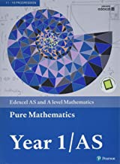
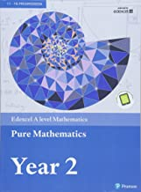
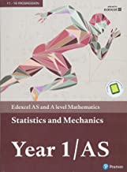
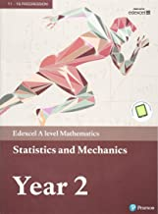
Textbooks
Students will be expected to purchase their own textbooks which should be brought to every lesson.
We will make an order when back in school, however you may wish to order these now (click on each picture for an amazon link).
We use both the Year 1 and 2 textbooks in Year 1, so we expect students to purchase both.

Slide 9
Methods of study
Worked examples
Formula sheet
Practice
More practice!
Consolidation
Past exam questions
Assessments
Maths Help

Slide 10
Future career options
Mathematics A-Level is widely respected and is transferrable to many other A-Level subjects, such as Physics, Chemistry and Economics
Being able to apply logic and reasoning is a sought after employability skill, which has its roots firmly in Maths.
Accountancy, finance, business, economics, engineering, research all require able mathematicians.

Slide 11
Entry Requirements
7 or above in GCSE Mathematics
Before studying the course, students are strongly advised to complete summer work to consolidate GCSE knowledge. This can be found here.
Students will sit a test early in Term 1 in order to help assess whether they are able to cope with the demands of A-Level.

Slide 12
“The highest form of pure thought is in Mathematics"
Plato

