Slide 1
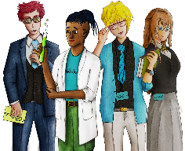
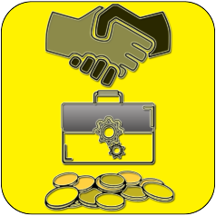
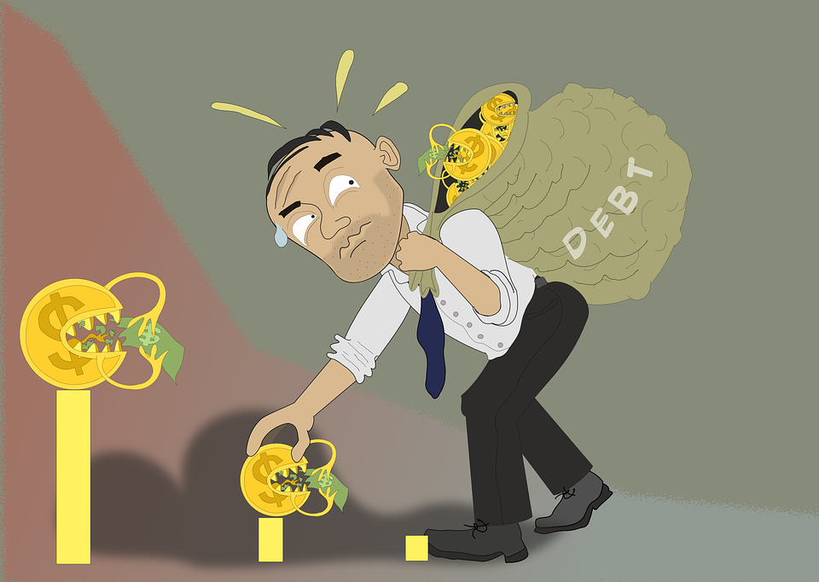
What is Debt?
Knowledge, Skills & Actions
To know the range of credit options available to adults
To understand the seriousness of debt and how to overcome it
To know the difference between priority debts and non-priority debts
3 Minutes
Discuss all the possibilities of why someone might end up in debt.
Who could come knocking if you do not pay off your debts?
New Vocabulary
Debt, Interest, Crisis Loan, Repayments, Interest, Loan Sharks, Overdraft
Tasks
Notes:
TEACHER NOTES & IDEAS
Remind students of the learning journey (What theme you are doing – Possibly recap what they can remember from last lesson.
ATTRIBUTION AND COPYRIGHT
– All icons and logos for Cre8tive Curriculum are created Inhouse by Michael Gillman ©
All images are sourced correctly – mainly through the following sites
either Premium licence at https://www.freepik.com/ or www.Pixabay.com or https://www.pixelscrapper.com/help
Some image have purchased also.
Factual information is not copyrighted.
Where information has been taken from reliable 3rd party websites – it is done so for analytical purposes in small pieces of text and for educational purposes.
Always check the content of any lesson and videos linked before teaching to ensure suitability for your classroom and your school
Further Terms and Condition regarding Copyright and our terms of use can be found on our website here https://cre8tiveresources.com/terms-of-use/

Slide 2
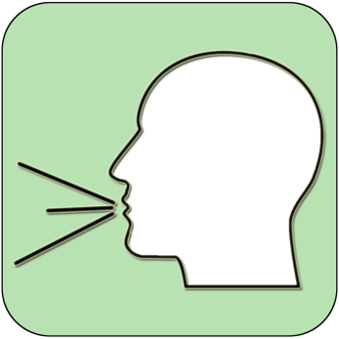
REFERENCE SLIDE
Teamwork
New Vocab
Discussion task
Play video
NEW
VOCABULARY
DISCUSSION TASK
THE LAW
EXPLAINED
TEAMWORK TASK
PROJECT
WORK
PLAY
VIDEO
Thoughts
Research
Extension
task
Tasks
Problem
solving
TASKS
EXTENSION
TASK
THOUGHTS
FURTHER RESEARCH
HOMEWORK
PROBLEM SOLVING
Feelings
Copy
information
Revision
Design Task
ASSESSMENT OPPORTUNITY
FEELINGS
REVISION
TASK
DESIGN
TASK
COPY INFORMATION
SENSITIVE ISSUE
WARNING
Notes:
TEACHER NOTES & IDEAS
This is a teacher reference slide - Icons will be used throughout Cre8tive Curriculum lessons to denote what students can do.
Could be printed and laminated on A3 and stuck up in the classroom

Slide 3
PSHE
Show respect
By listening
Not interrupting
Only 1 person talking at a time
Be open and honest but no personal comments – Discussions will be about ‘general situations’
Don’t make assumptions about people’s values, attitudes, behaviours, life experiences or feelings
PSHE CLASSROOM RULES
DEALING WITH SENSITIVE TOPICS
SAFEGUARDING YOUR WELFARE & HAVING YOUR INTERESTS AT HEART
You don’t have to say things about yourself if you don’t want to (You have the right to pass)
There are no stupid questions. A question box for anonymous Questions
It’s OK to get things wrong
Have a non-judgemental approach. No put downs and challenge the opinion not the person
Enjoy the lesson, Challenge your perceptions and understand how to seek further advice and support
Use the agreed appropriate Language (Avoid slang terms)
Conversations stay in the room unless it is a safeguarding issue
Don’t show the fact you are embarrassed through silliness
Notes:
TEACHER NOTES & IDEAS
Reinforce ground rules at the start of every new topic / new term
Adapt this set of rules to suit your classroom and your teaching.
Display your agreed PSHE classroom rules in a prominent place so students have a constant reminder and when/if a student breaks a rule you can use as a prompt to get them back on track.
If behavior is an issue revisit the ground rules – Use raffle tickets , positive behavior management (look for the good behavior)
Reward the behavior you want to see, be consistent and fair with students.
Create a classroom charter with the students (optional)

Slide 4
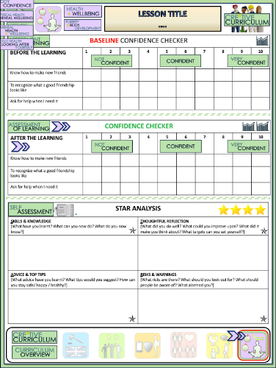
What is debt?
BASELINE CONFIDENCE CHECKER
BEFORE THE LEARNING | 1 | 2 | 3 | 4 | 5 | 6 | 7 | 8 | 9 | 10
I understand the impact getting into debt can have on myself and my family
I can identify priority and no-priority debts
I know how to access reliable advice on debt counselling
Complete a baseline assessment of where you think you are at for this lesson
(Discussion or complete sheet)
2 Minutes
I’m not confident at all
I’m getting more confidence
Confident
Very
confident
Super
confident
Notes:
TEACHER NOTES & IDEAS
This could be done by writing a number down in the books
Show of fingers in the air. /Red amber Green Cards
Quick Partner Discussion
Print off the Assessment Opportunity Sheet – Fill in the Baseline Confidence Checker

Slide 5
DEBT AND SOCIETY
READING
CAN I HAVE FOUR VOLUNTEERS TO READ OUT PLEASE
1
1
As soon as you borrow money you are in debt – until you have paid it back in full including interest. The problems start when you cannot meet the agreed repayments.
2
2
We live in a society were borrowing money is considered normal. Credit companies push borrowing by offering you more and more credit. Often they don’t consider whether you can pay it back.
3
3
Debt problems can affect your ability to borrow money in the future, e.g. debts could prevent you from being able to get a mortgage. The media often portray people being in debt as a result of careless spending and buying too much on credit
4
4
There is a lot of influence from advertising and pressure from other people to wear the right clothes, to have the latest gadgets and to keep up with the latest trends. Some debts have less consequences than others. For example a student debt does not have to be paid until you have a decent income.
Notes:
A list of licenses for the images used in this presentation can be found here: https://creativecommons.org/licenses/

Slide 6
How easy can it be to get into debt?
Play video
What thinking is needed? Next steps? Where are we now?
What is wrong? Is it safe? Can it be done?
Pursuit of Happiness and Debt
How did the family get into debt?
Would you have done anything differently?
THINKING
JUDGEMENT
THINKING HATS
Did you know?
How do I feel about this? What don’t I like about this? What do I like about this?
Can something be done? New ideas?
What are the solutions/ suggestions?
Pressure to borrow money can lead to problems if you don’t know exactly what you’re doing.
FEELINGS
CREATIVITY
2 Minutes
Notes:
TEACHER NOTES & IDEAS
If the Video is short it may be worth playing it twice – 1st time let students watch carefully and 2nd time have students complete one or two of the hats
Short of Time – Play the video and Answer A few of the hats afterwards as a class
N.B This is a generic slide and sometimes the hats may not be appropriate for the video clip (if so delete or change accordingly to suit)
N.B Always check the video link is age appropriate to your class before showing student in the lesson.

Slide 7
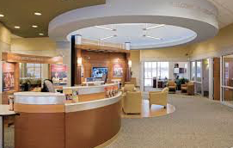
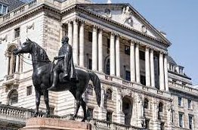
MATCH THE PHOTO TO THE LABEL
A
B
C
D
E
F
European Central Bank
Royal Mint
Bank Branch
Mortgage
Interest Rates
Bank Manager
Debt arrangement
Bank of England
Financial Flow
Notes:
A list of licenses for the images used in this presentation can be found here: https://creativecommons.org/licenses/

Slide 8
MATCH THE PHOTO TO THE LABEL
A
B
C
A: Bank Branch–
The banks retail location where it offers a wide array of services to its customers
C: Royal Mint – Produces new UK Coins and notes
B: Interest Rates
D
E
F
F: European central Bank–
The central bank for the Euro Zone (19 EU Countries)
D: Bank of England Acts as the governments Bank and has a wide range of responsibilities
E: Mortgage – A loan from the bank to purchase a property
European Central Bank
Royal Mint
Bank Branch
Mortgage
Interest Rates
Bank Manager
Debt arrangement
Bank of England
Financial Flow
Notes:
Copyright Attributes:
BACKGROUND IMAGE - GraysonArthur2017
TOP LEFT AND RIGHT - Natalia Medd
A list of licenses for the images used in this presentation can be found here: https://creativecommons.org/licenses/

Slide 9
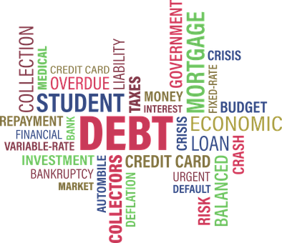
Did you know?
Avoid any money mule schemes. These involve someone agreeing to allow their bank account to be used by someone else, in return for money. Often criminal Gangs will exploit vulnerable people and their bank accounts for the proceeds of crime and money laundering
Discussion
Task
Which of these words do you understand?
Which do you not?

Slide 10
Prioritising different types of debt
Non-Priority – Pay last
Not paying these is still serious but wont impact your health or housing or land you in prison straight away
Priority – Pay off first
Not paying these could lead to court action or severe impact on health or housing
Rent arrears
Mortgage arrears
Unpaid Electricity Bill
Unpaid Council Tax
Unpaid Gas bill
Missed Unsecured loan repayments
Store Card
Credit Card
Catalogue credit
Money owed to parents
Notes:
TEACHER NOTES & IDEAS

Slide 11
Ways to borrow
Overdraft
Credit Card
Bank Loan
Credit union
Friends and Family
Store card
Payday Loans ☹
Catalogue
Self-help co-operative or community bank whose members save so that they can borrow money when they need to at a low interest rate.
These loans usually have a lower rate of interest than other types of loan. You normally borrow a fixed amount, repayable by set monthly instalments over an agreed period of time
The loans they offer are often for small amounts over short time periods. These loans are relatively easy to obtain, but interest rates are very high. This should be agreed with the bank before you do it to avoid any penalty charges
A card often owned by a bank or other financial organisation. You can use this card in any store that accepts it. It provides credit (debt) and you can pay back as much or as little as you want. It will charge you interest on unpaid amounts each month
Is usually interest free although the catalogue company may charge interest for more expensive items being paid for over a longer period. You may pay more in the long run.
The loans they offer are often for small amounts over short time periods. These loans are relatively easy to obtain, but interest rates are very high. Many like Wonga have been in the news for sky high interest rates
A card linked to a particular shop or store E.G Debenhams. They provide credit when you cannot get it anywhere else. Normally they charge a much higher rate of interest if you do not pay off the balance each month
When you borrow this way they don’t normally charge you interest. If you don’t pay the money back it can cause problems between family members, or you may lose a friend.
TASKS
1. Match up the method of borrowing with the correct definition
2. Explain why methods of borrowing are important to those on low income or who live payslip to payslip
Payday Loans

Slide 12
ANSWERS - Ways to borrow
Credit union
Bank Loan
Overdraft
Credit Card
Self-help co-operative or community bank whose members save so that they can borrow money when they need to at a low interest rate.
These loans usually have a lower rate of interest than other types of loan. You normally borrow a fixed amount, repayable by set monthly instalments over an agreed period of time
The loans they offer are often for small amounts over short time periods. These loans are relatively easy to obtain, but interest rates are very high. This should be agreed with the bank before you do it to avoid any penalty charges
A card often owned by a bank or other financial organisation. You can use this card in any store that accepts it. It provides credit (debt) and you can pay back as much or as little as you want. It will charge you interest on unpaid amounts each month
Catalogue
Payday Loans ☹
Store card
Friends and Family
is usually interest free although the catalogue company may charge interest for more expensive items being paid for over a longer period. You may pay more in the long run.
The loans they offer are often for small amounts over short time periods. These loans are relatively easy to obtain, but interest rates are sky high. Many like Wonga Have been in the news for sky high interest rates
A card linked to a particular shop or store E.G Debenhams. They provide credit when you cannot get it anywhere else. Normally they charge a much higher rate of interest if you do not pay off the balance each month
When you borrow this way they don’t normally charge you interest. If you don’t pay the money back it can cause problems between family members, or you may lose a friend.

Slide 13
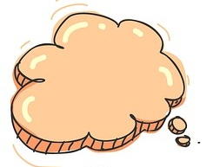
Debt
Secured loan against your house
In secured loan
(possibly a parent guarantor)
Secured loan against your car or other valuable asset
Loan shark!
Other ways to loan money
Illegal money lender
Credit agreement
Did you know?
Unmanageable debt is a debt is when someone has borrowed money from a person or organisation, and cannot afford to pay it back.
Declaring bankruptcy
(this costs money and has a serious impact on your credit rating and ability to do things in the future but can wipe your debts clean)
Notes:
TEACHER NOTES & IDEAS

Slide 14
COMPARING BORROWING METHODS – USE THE INTERNET OR RESOURCES YOUR TEACHER HAS PROVIDED
Method of Borrowing money | Description | Advantages | Disadvantages
Secured Loan (House or Car)
Loan Shark
Agreed overdraft with the bank
Friends and family
Borrowing on a credit card

Slide 15
Sent lots of ‘red letters’ reminding you of your debt in the post
Could cause mental health problems
Debt collectors could come knocking on your door
You could be asked to leave your property or forced out by the courts
Tasks
Create a wall of consequences of what could happen if you didn’t pay off your debts

Slide 16
Never be tempted by a loan shark!
Did you know?
. Statistics show that well-off people use the most credit. People with less income usually face the most debt problems because often they are charged more to borrow money
8 Minutes
Why those low-cost car loans aren't as cheap as they seem: The hidden charges and penalty fees sales staff don't tell you about
Play video
What facts do I know? What else do I need to know? What do I want to know?
How do I feel about this? What don’t I like about this? What do I like about this?
Can something be done? New ideas?
What are the solutions/ suggestions?
What thinking is needed? Next steps? Where are we now?
What is wrong? Is it safe? Can it be done?
INFORMATION
FEELINGS
CREATIVITY
THINKING
JUDGEMENT
Watch the video and answer the questions below
What happened to Mike?
Why did he turn to a loan shark?
What can we learn from Mike’s experience?
What could Mike have done instead?
Tasks
Notes:
TEACHER NOTES & IDEAS

Slide 17
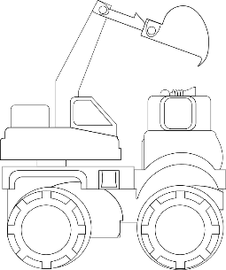
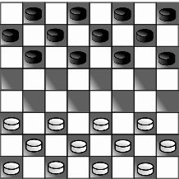
WHAT DO YOU THINK?
Talking points
I think that …
I don’t think… is right because…
My opinion is…
I would argue the same because…
I disagree with… because
Building on what ….
An alternate way of looking at this is…
I sort of agree, however….
In my view…
I would challenge what… said because …
“All debt is bad. If you can’t afford something you should go without!”
?
AGREE
ALTERNATE IDEA
DEVELOP
Disagree
Challenge
Alternative
Idea/option
DISAGREE
Develop
CHALLENGE
Notes:
TEACHER NOTES & IDEAS
Ask students what they think of this image (collection of images)
Reveal the talking points after some discussion time
To provoke discussion with a quiet class – play devils advocate
Challenge a student to a debate

Slide 18
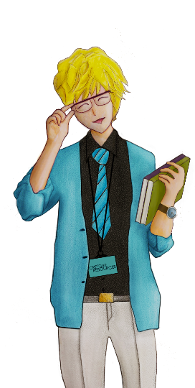
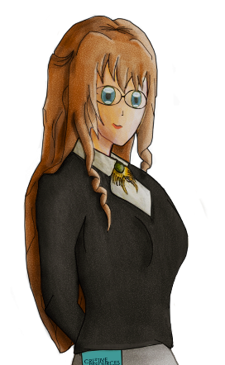
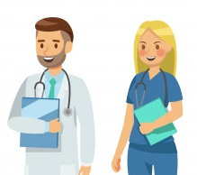
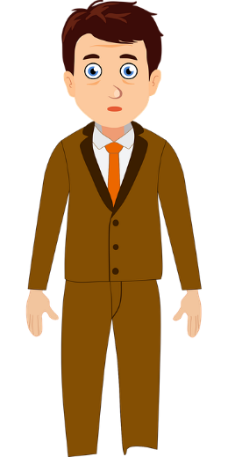
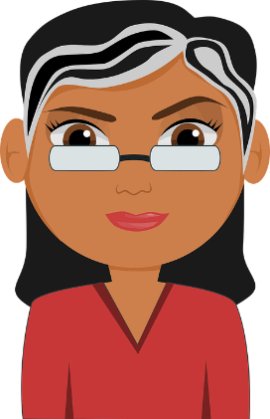
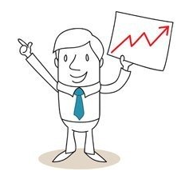
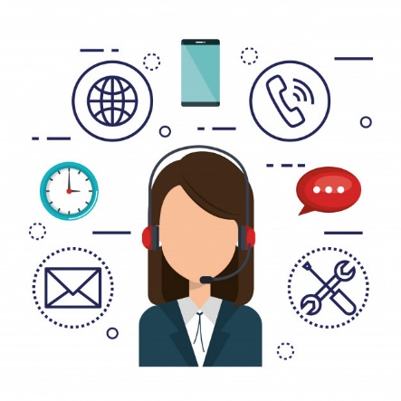
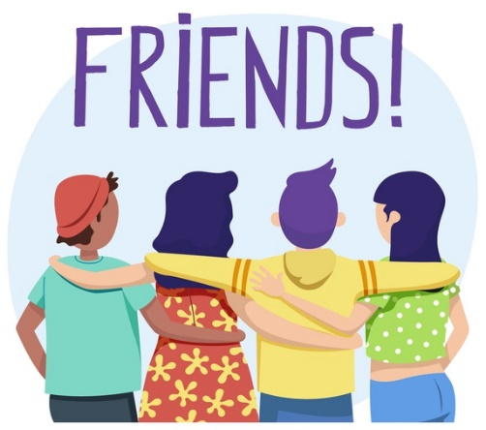
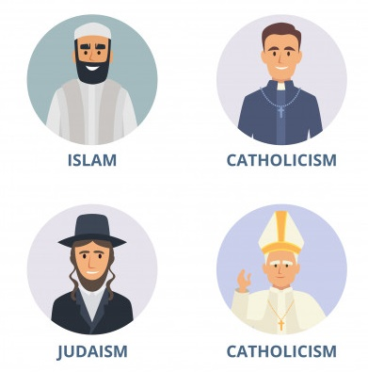
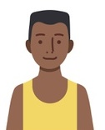
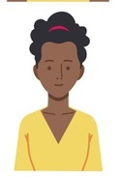
Could any of these people help you with your debt problems?
Medical Professionals
Bank Manager
Citizens Advice Bureau
Debt Advisor
Debt Counselling
Discuss with a partner which of these groups of people can offer:
Reliable help and support on this issue (How do you access this support? Try to be specific within each group of people
Someone to talk to and give you moral support and help you make the right decision
Charities & Specialist Support Services
Friends
Local Religious Leaders
Trusted Family Members

Slide 19
Confidence Checker
AFTER THE LEARNING | 1 | 2 | 3 | 4 | 5 | 6 | 7 | 8 | 9 | 10
I understand the impact getting into debt can have on myself and my family
I can identify priority and no-priority debts
I know how to access reliable advice on debt counselling
Complete the confidence checker of where you think you are at for this lesson (Discussion or complete sheet)
3 Minutes
Notes:
TEACHER NOTES & IDEAS
This could be done by writing a number down in the books – Compare to the start of the lesson
Show of fingers in the air or use Red Amber Green Cards
Quick Partner Discussion & reflect on before the lesson and progress made
Print off the Assessment Opportunity Sheet – Fill in the Confidence Checker / Compare with the baseline
Author Attribution :https://pixabay.com/en/traffic-lights-traffic-light-phases-2147790/

Slide 20
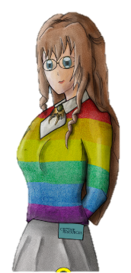
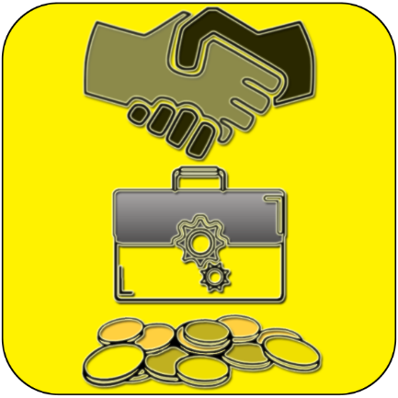
FOR MORE INFORMATION ABOUT THE TOPICS COVERED IN THIS UNIT WE WOULD ADVISE ONE OF THE BELOW: SPEAK TO YOUR PARENTS/GUARDIANS OR HEAD OF YEAR, TRUSTED ADULT OR FRIEND IF YOU HAVE ANY CONCERNS ABOUT YOURSELF OR SOMEONE YOU KNOW – IT IS ALWAYS IMPORTANT TO TELL SOMEONE!
Enjoy the lesson, Challenge your perceptions and understand how to seek further advice and support
SPECIFIC FURTHER INFORMATION ON THIS TOPIC CAN BE FOUND HERE:
Direct Debtline telephone 01323 635999 www.directdebtline.com
National Debtline telephone 0808 808 4000 www.nationaldebtline.co.uk
Financial Services Authority www.fsa.gov.uk
Office of Fair Trading www.oft.gov.uk
Financial Ombudsman Service www.financial-ombudsman.org.uk
UK Credit Repair www.ukcreditrepair.co.uk
2 Minutes
Notes:
TEACHER NOTES & IDEAS
Teachers should add in specific local signposting to charities, careers organisations / Connections or Careers officer at school. If RSE topics the local NHS services in their area
Add / adapt or remove any suggested sites.
Print this slide and leave on door notice board after the lesson

Slide 21
I know if I need further
support or help I could
speak to…. or contact…
Before I could/would say
and do ... but now I feel I
am able to say
Before I only knew ...
now I also know ...
I supported others by…
One thing I didn’t
realise was… now I know that…
The key words for
this lesson are…
I always knew ... but now
I can see how it connects to…
The most important thing I
have learnt today is…
I’m really proud of the
way I have…
I used to feel ...
but I now feel ..
One assumption of
mine that was
challenged was…
I would like to learn…
A question I
would like to
ask is…
Before I thought that ...
but now I realise..
Today I have tried to…
Next lesson I would like to..
Before I would have done…
Now I will …
Before I would have
said ... but now I will say…
2 Minutes
A problem I overcame
today was…
Notes:
TEACHER NOTES & IDEAS
: Have students pick either 1/2/3 tickets depending on their ability and tell a partner
Pick a few students at random to feedback to the class
As students leave the room have them tell you their reflection on the way out

