Slide 1
See the bigger picture
Copy
title
Knowledge, Skills & Actions
Watch this video to understand what we mean by “See the bigger picture”
• Being aware of the relationship between career and the natural environment
• Being aware of the relationship between career, community and society
• Being aware of the relationship between career, politics and the economy
3 Minutes
What do you think the biggest challenge facing our environment is?
New Vocabulary
Natural environment, society, politics, economy
Tasks
Notes:
TEACHER NOTES & IDEAS
Remind students of the learning journey (What theme you are doing – Possibly recap what they can remember from last lesson.
ATTRIBUTION AND COPYRIGHT
CDI ICONS HAVE COME FROM THE CDI FRAMEWORK WITH PERMISSION AND CAN BE FOUND HERE https://www.thecdi.net/New-Career-Development-Framework
– All other icons and logos for Cre8tive Curriculum are created Inhouse by Michael Gillman ©
All images are sourced correctly – mainly through the following sites
either Premium licence at https://www.freepik.com/ or www.Pixabay.com or https://www.pixelscrapper.com/help
Some image have purchased also.
Factual information is not copyrighted.
Where information has been taken from reliable 3rd party websites – it is done so for analytical purposes in small pieces of text and for educational purposes.
Always check the content of any lesson and videos linked before teaching to ensure suitability for your classroom and your school
Further Terms and Condition regarding Copyright and our terms of use can be found on our website here https://cre8tiveresources.com/terms-of-use/

Slide 2
See the big picture
?
1
How can politics affect careers?
2
How can the environment influence careers?
3
What other world changes could affect careers and jobs?
4
With the rise in technology, what jobs do you think, can’t be replaced by tech?
Notes:
TEACHER NOTES & IDEAS
These are the reflection questions from the video – You could either pause on the video or show this slide
Pair and Share
Whole Class Feedback
Use mini white boards
Open up discussions

Slide 3
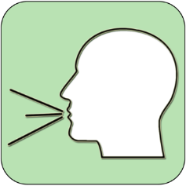
REFERENCE SLIDE
Teamwork
New Vocab
Discussion task
Play video
NEW
VOCABULARY
DISCUSSION TASK
THE LAW
EXPLAINED
TEAMWORK TASK
PROJECT
WORK
PLAY
VIDEO
Thoughts
Research
Extension
task
Tasks
Problem
solving
TASKS
EXTENSION
TASK
THOUGHTS
FURTHER RESEARCH
HOMEWORK
PROBLEM SOLVING
Feelings
Copy
information
Revision
Design Task
ASSESSMENT OPPORTUNITY
FEELINGS
REVISION
TASK
DESIGN
TASK
COPY INFORMATION
SENSITIVE ISSUE
WARNING
Notes:
TEACHER NOTES & IDEAS
This is a teacher reference slide - Icons will be used throughout Cre8tive Curriculum lessons to denote what students can do.
Could be printed and laminated on A3 and stuck up in the classroom

Slide 4
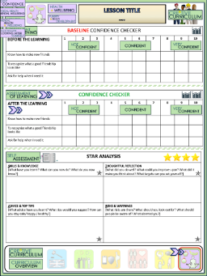
See the bigger picture
BASELINE CONFIDENCE CHECKER
BEFORE THE LEARNING | 1 | 2 | 3 | 4 | 5 | 6 | 7 | 8 | 9 | 10
I understand why I need to view the bigger picture when thinking about my career.
I understand the links between my career, community and environment.
I understand the links between my career, politics and the economy.
Complete a baseline assessment of where you think you are at for this lesson
(Discussion or complete sheet)
2 Minutes
I’m not confident at all
I’m getting more confidence
Confident
Very
confident
Super
confident
Notes:
TEACHER NOTES & IDEAS
This could be done by writing a number down in the books
Show of fingers in the air. /Red amber Green Cards
Quick Partner Discussion
Print off the Assessment Opportunity Sheet – Fill in the Baseline Confidence Checker

Slide 5
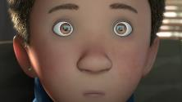
Why do we consider the bigger picture?
Your career is all about you, right? So why are we considering the bigger picture?
The decisions we make, and the actions we take, affect everyone and everything around us.
This includes:
This may seem like a small choice, but all our choices (big and small) have an impact on others. This can be a positive or negative impact.
4 Minutes
Watch this video to consider how our actions affect those around us:
Our society
Our environment
Our
economy
Our local community
Our government
Task
In partners, discuss:
What happened when he decided to play with the dog?
Was this a positive choice?
Who was impacted by this choice?
Our friends
Even our pets!
Our family
3 Minutes
Notes:
TEACHER NOTES

Slide 6
See the big picture
What is the natural environment?
One of the most important things we can impact is the natural environment around us.
The natural environment includes things like:
Natural Environment: all living and non-living things occurring naturally, meaning not artificial or man made.
Our environment
Water
Task
3 Minutes
In partners, discuss:
When was the last time you made a choice that positively impacted the natural environment?
When was the last time you made a choice that negatively impacted the natural environment?
Air
Plants
Animals
Notes:
TEACHER NOTES

Slide 7
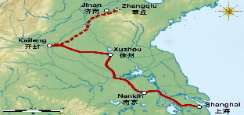
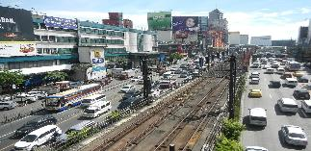
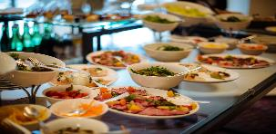
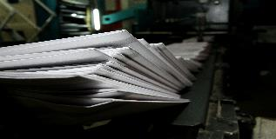
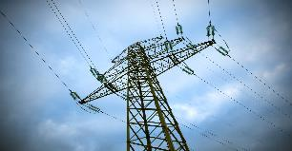
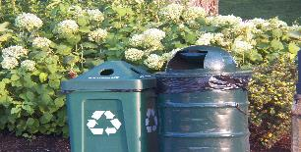
See the big picture
How do our career choices impact the natural environment?
When you choose which job role you want to do in the future, there will be several elements that will impact the natural environment. This includes:
1. Where you work
2. How you get to work
3. What you buy on the way
4. What you have for lunch
5. Your employer’s values
6. How much you print
7. How much electricity you use
8. What job you do
9. How your employer gets rid of waste
Notes:
TEACHER NOTES

Slide 8
1. Where you work
2. How you get to work
3. What you buy on the way
4. What you have for lunch
5. Your employer’s values
6. How much you print
7. How much electricity you use
8. What job you do
9. How your employer gets rid of waste
Task
10 Minutes
On a piece of paper, write 1-9 down the left hand side.
For each one of the choices, write an example of a choice that would be positive for the natural environment and negative for the natural environment.

Slide 9
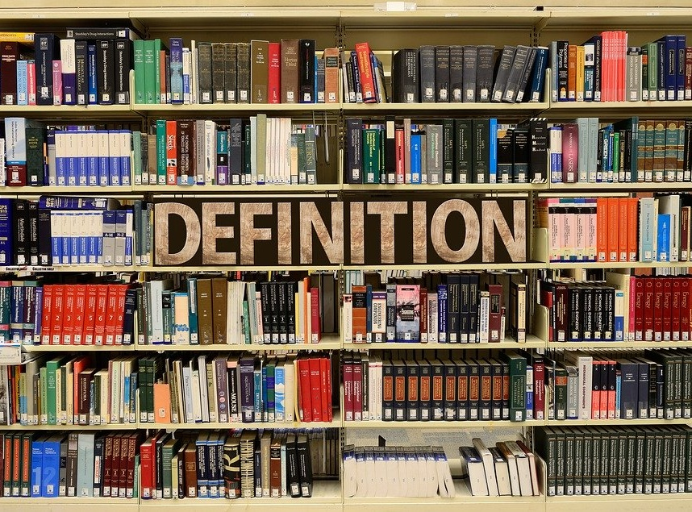
Key Term Definitions
With a partner, come up with a definition for the following Key Terms
a) Community
b) Society
[Click to reveal]
A
[Click to reveal]
B
A community is a social unit with common interests such as religion, values or identity. Communities may share a sense of place situated in terms of a geographical area or in virtual space through communication platforms.
A society can mean two things, either people living together in an ordered community or an organisation/club formed for a particular purpose or activity.

Slide 10
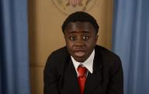
What else should we consider when deciding on our career?
We have considered how our career choices will impact the wider natural environment, but what about considerations a little closer to home – the choices that impact our community and society?
In this video, Kid President explains how we can make choices:
5 Minutes
Task
10 Minutes
Community
The choices you make impact your community because there may be young people who look up to you and are inspired by your choices.
Society
The choices you make can drive change for those around you, within all the societies your part of.
You have the ability to make positive change.
Write down what change you would like to see in the world. Then make a list of the choices you can make to help inspire this change.
Notes:
TEACHER NOTES

Slide 11
See the big picture
What else should we consider when deciding on our career?
So far, we have looked at how our choices impact the natural environment, our community, our society and others around us (even our pets!).
Now we’re going to consider how our choices impact politics and the economy.
Politics: the activities associated with the governance of a country or area, especially the debate between parties having power.
Economy: the state of a country or region in terms of the production and consumption of goods and services and the supply of money.
By choosing to work in politics, you are putting yourself in a position of power that will allow you to make positive change on a national, or even global, level.
Everyone person in the UK who works has tax deducted from their wages, this goes to the government to help fund things like the NHS, local government and state pensions.
If we all chose not to work, the economy would be in crisis because it would be paying out more money that it has coming in.
Notes:
TEACHER NOTES

Slide 12
Confidence Checker
AFTER THE LEARNING | 1 | 2 | 3 | 4 | 5 | 6 | 7 | 8 | 9 | 10
I understand why I need to view the bigger picture when thinking about my career.
I understand the links between my career, community and environment.
I understand the links between my career, politics and the economy.
Complete the confidence checker of where you think you are at for this lesson (Discussion or complete sheet)
3 Minutes
Notes:
TEACHER NOTES & IDEAS
This could be done by writing a number down in the books – Compare to the start of the lesson
Show of fingers in the air or use Red Amber Green Cards
Quick Partner Discussion & reflect on before the lesson and progress made
Print off the Assessment Opportunity Sheet – Fill in the Confidence Checker / Compare with the baseline
Author Attribution :https://pixabay.com/en/traffic-lights-traffic-light-phases-2147790/

Slide 13
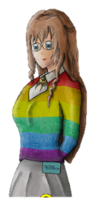
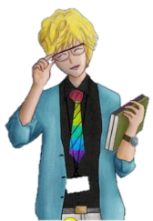
FOR MORE INFORMATION ABOUT THE TOPICS COVERED IN THIS UNIT WE WOULD ADVISE ONE OF THE BELOW: SPEAK TO YOUR PARENTS/GUARDIANS OR HEAD OF YEAR, TRUSTED ADULT OR FRIEND IF YOU HAVE ANY CONCERNS ABOUT YOURSELF OR SOMEONE YOU KNOW – IT IS ALWAYS IMPORTANT TO TELL SOMEONE!
Enjoy the lesson, Challenge your perceptions and understand how to seek further advice and support
SPECIFIC FURTHER INFORMATION ON THIS TOPIC CAN BE FOUND HERE:
https://www.citizensadvice.org.uk
https://vinspired.com – young peoples volunteering charity
https://www.ncsyes.co.uk 15-17 Year olds National Citizen Service
https://nationalcareersservice.direct.gov.uk/ Explore career opportunities
https://www.startprofile.com/ - Explore your dream Job!
2 Minutes
Notes:
TEACHER NOTES & IDEAS
Teachers should add in specific local signposting to charities, careers organisations / Connections or Careers officer at school. If RSE topics the local NHS services in their area
Add / adapt or remove any suggested sites.
Print this slide and leave on door notice board after the lesson

Slide 14
I know if I need further
support or help I could
speak to…. or contact…
Before I could/would say
and do ... but now I feel I
am able to say
Before I only knew ...
now I also know ...
I supported others by…
One thing I didn’t
realise was… now I know that…
The key words for
this lesson are…
I always knew ... but now
I can see how it connects to…
The most important thing I
have learnt today is…
I’m really proud of the
way I have…
I used to feel ...
but I now feel ..
One assumption of
mine that was
challenged was…
I would like to learn…
A question I
would like to
ask is…
Before I thought that ...
but now I realise..
Today I have tried to…
Next lesson I would like to..
Before I would have done…
Now I will …
Before I would have
said ... but now I will say…
2 Minutes
A problem I overcame
today was…
Notes:
TEACHER NOTES & IDEAS
: Have students pick either 1/2/3 tickets depending on their ability and tell a partner
Pick a few students at random to feedback to the class
As students leave the room have them tell you their reflection on the way out

