Slide 1
Politics A Level

Slide 2
Why choose Politics at A-level?
Politics is stimulating, challenging and rewarding. It can totally change your view of the world. Let us be really honest – there has never been a better time to study this subject, so much is happening here and in the USA. There is never a dull moment!
In our course we investigate the politics of the UK and the USA. Looking at the systems of government in both countries and analysing how democratic they are.

Slide 3
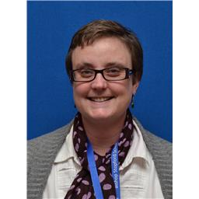
Structure of the course
Specification: Edexcel 9PLO
Year 12:
Unit 1 UK Politics (9PLO/01)
Unit 2 UK Government (9PLO/02)
Year 13:
Unit 3 Comparative Politics (USA option) (9PLO/3A)
Exams for units 1,2 and 3 will be taken at the end of Year 13
All papers have equal weighting and there is no coursework.
Head of Subject: Mrs Wilson pwilson@bishopstopford.com

Slide 4
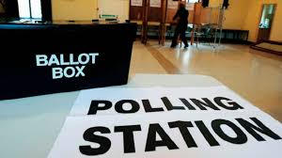
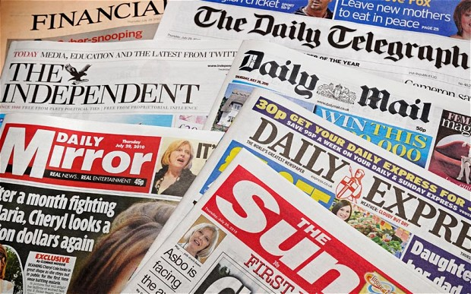
Unit 1: UK Politics
Are our elections in the UK democratic?
Do our political parties represent us?
Do pressure groups in the UK make any real difference?
Do news channels report neutrally on Politics?
Does social media influence how we vote?
Do newspapers have less influence on our voting behaviour in the digital age?

Slide 5
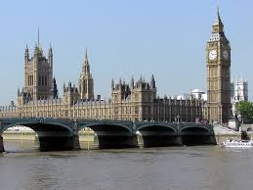
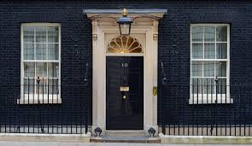
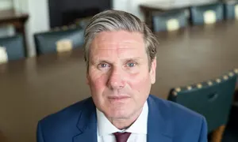
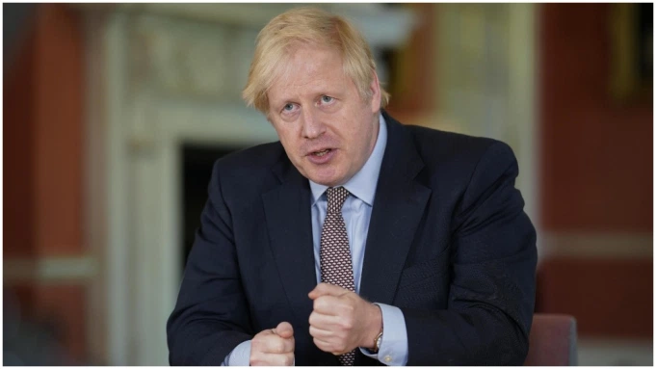
Unit 2: UK Government
How representative is are the Houses of Parliament?
Do advisors in Downing Street have too much power?
To what extent does the Supreme Court uphold rights of the citizens?
How powerful is the Prime Minister in the UK?
Do opposition parties really hold the government to account?

Slide 6
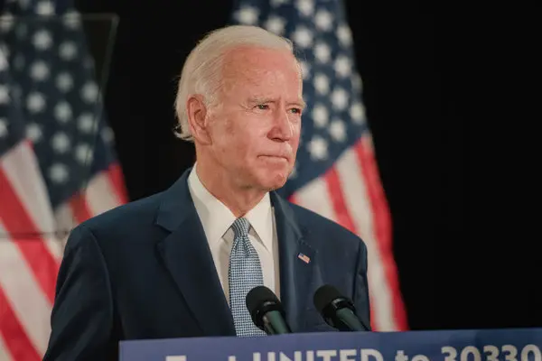
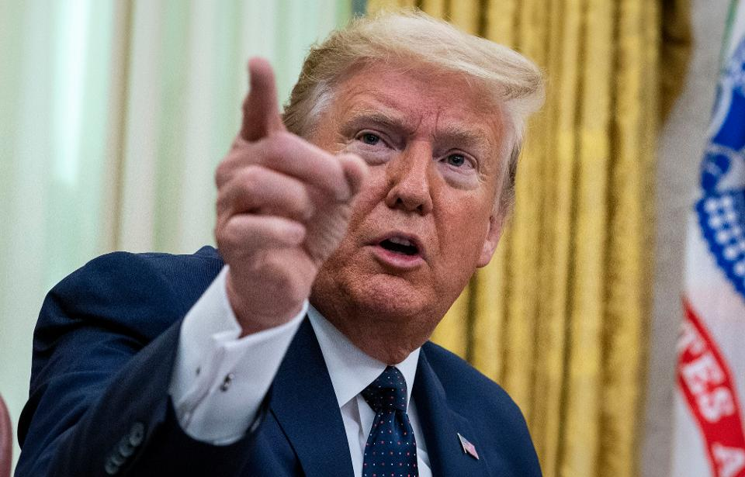
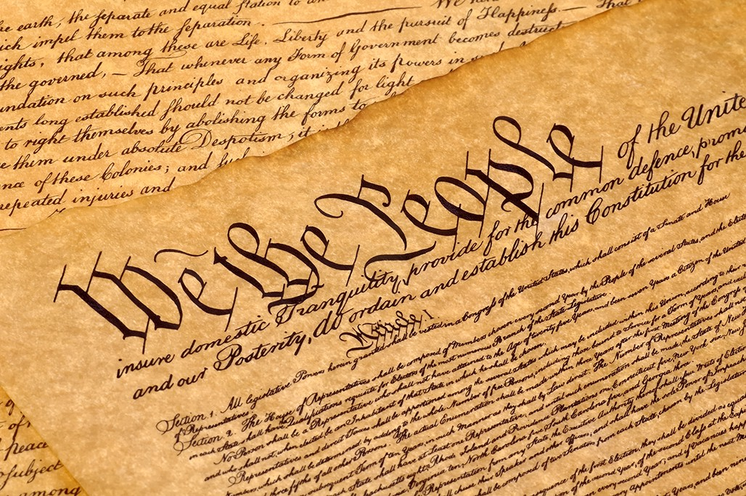
Unit 3: Comparative Politics with the USA
How effective has the US constitution been in supporting civil rights in the US?
To what extent does finance play a part in US elections?
How powerful is the President of the USA?
Who should have the most say in the running of the US? National government or the individual states?
Is the US Constitution still fit for purpose?

Slide 7
Methods of study
Reading
Note taking
Discussions
Presentations
Document analysis
Essay writing
Trips

Slide 8
Future career options
The methods of investigation, study and research involved in Politics are very useful training for a variety of careers, from journalism to personnel management and law to entertainment
Politics teaches you to make informed judgements, to justify your arguments and to write in a concise and logical manner.
Politics develops the intrinsic skills of analysis, evaluation, interpretation and explanation, all of which are highly valued in the modern workplace.

Slide 9
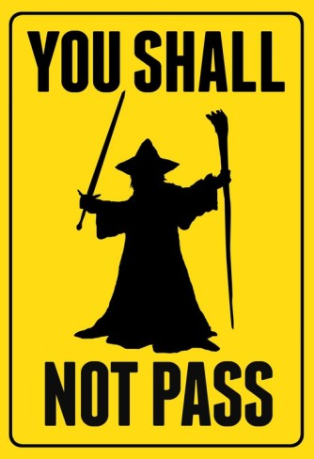
Entry Requirements
5 or above in GCSE English and a Humanities subject.

Slide 10
