Slide 1
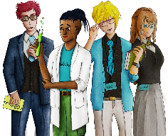
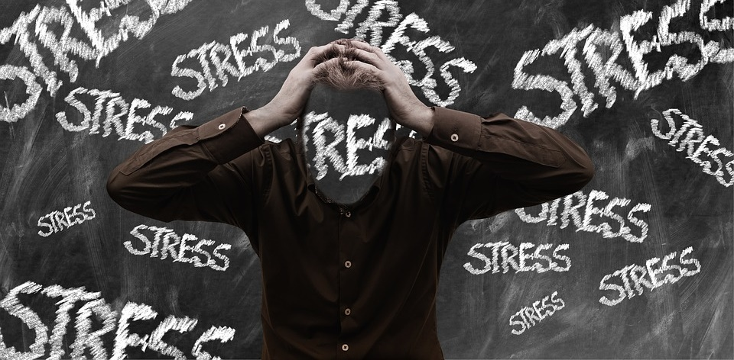
2 Hour Lesson
Exam Stress & Relaxation
Copy
title
Knowledge, Skills & Actions
To understand the science behind ‘flight’ ‘Fright’ or ‘Freeze’ responses to stress
To recognise that stress is only beneficial in the short term and over the long term can effect you physically and emotionally
To understand how to manage stress and relaxation
3 Minutes
Do you know what makes you stressed?
Is stress good or bad?
How could you tell if you or a friend is experiencing stress?
What would you like to know about dealing with exam stress?
New Vocabulary
Relaxation, stress and calmness Para-sympathetic, Cortisol, Hormones, Meditation, Yoga, Diet
Tasks
Notes:
TEACHER NOTES & IDEAS
Remind students of the learning journey (What theme you are doing – Possibly recap what they can remember from last lesson.
ATTRIBUTION AND COPYRIGHT
– All icons and logos for Cre8tive Curriculum are created Inhouse by Michael Gillman ©
All images are sourced correctly – mainly through the following sites
either Premium licence at https://www.freepik.com/ or www.Pixabay.com or https://www.pixelscrapper.com/help
Some image have purchased also.
Factual information is not copyrighted.
Where information has been taken from reliable 3rd party websites – it is done so for analytical purposes in small pieces of text and for educational purposes.
Always check the content of any lesson and videos linked before teaching to ensure suitability for your classroom and your school
Further Terms and Condition regarding Copyright and our terms of use can be found on our website here https://cre8tiveresources.com/terms-of-use/

Slide 2
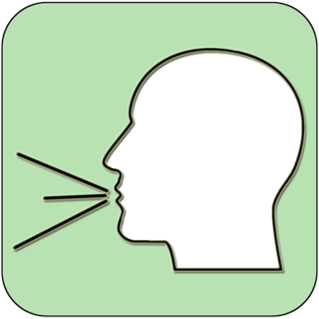
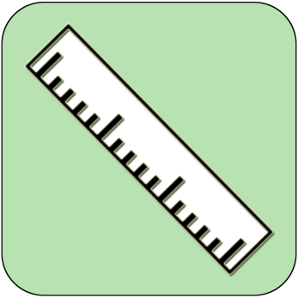
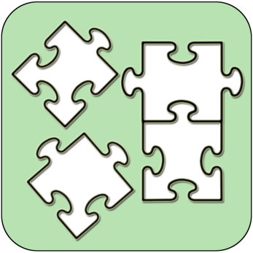
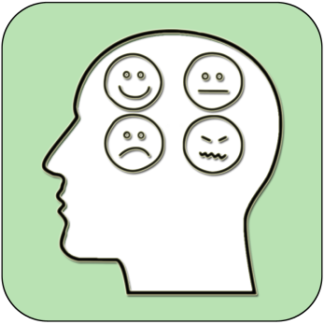
REFERENCE SLIDE
Teamwork
New Vocab
Discussion task
Play video
NEW
VOCABULARY
DISCUSSION TASK
THE LAW
EXPLAINED
TEAMWORK TASK
PROJECT
WORK
PLAY
VIDEO
Thoughts
Research
Extension
task
Tasks
Problem
solving
TASKS
EXTENSION
TASK
THOUGHTS
FURTHER RESEARCH
HOMEWORK
PROBLEM SOLVING
Feelings
Copy
information
Revision
Design Task
ASSESSMENT OPPORTUNITY
FEELINGS
REVISION
TASK
DESIGN
TASK
COPY INFORMATION
SENSITIVE ISSUE
WARNING
Notes:
TEACHER NOTES & IDEAS
This is a teacher reference slide - Icons will be used throughout Cre8tive Curriculum lessons to denote what students can do.
Could be printed and laminated on A3 and stuck up in the classroom

Slide 3
PSHE
Show respect
By listening
Not interrupting
Only 1 person talking at a time
Be open and honest but no personal comments – Discussions will be about ‘general situations’
Don’t make assumptions about people’s values, attitudes, behaviours, life experiences or feelings
PSHE CLASSROOM RULES
DEALING WITH SENSITIVE TOPICS
SAFEGUARDING YOUR WELFARE & HAVING YOUR INTERESTS AT HEART
You don’t have to say things about yourself if you don’t want to (You have the right to pass)
There are no stupid questions. A question box for anonymous Questions
It’s OK to get things wrong
Have a non-judgemental approach. No put downs and challenge the opinion not the person
Enjoy the lesson, Challenge your perceptions and understand how to seek further advice and support
Use the agreed appropriate Language (Avoid slang terms)
Conversations stay in the room unless it is a safeguarding issue
Don’t show the fact you are embarrassed through silliness
Notes:
TEACHER NOTES & IDEAS
Reinforce ground rules at the start of every new topic / new term
Adapt this set of rules to suit your classroom and your teaching.
Display your agreed PSHE classroom rules in a prominent place so students have a constant reminder and when/if a student breaks a rule you can use as a prompt to get them back on track.
If behavior is an issue revisit the ground rules – Use raffle tickets , positive behavior management (look for the good behavior)
Reward the behavior you want to see, be consistent and fair with students.
Create a classroom charter with the students (optional)

Slide 4
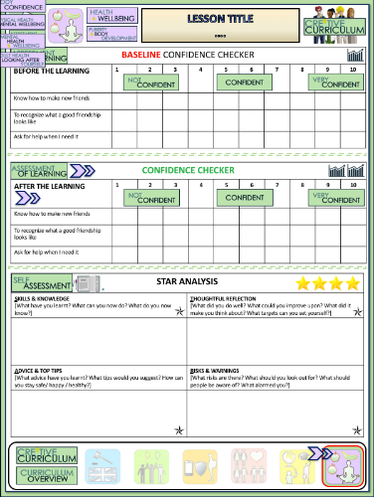
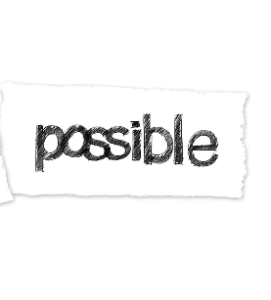
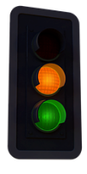
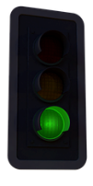
Exam Stress & Relaxation
BASELINE CONFIDENCE CHECKER
BEFORE THE LEARNING | 1 | 2 | 3 | 4 | 5 | 6 | 7 | 8 | 9 | 10
I can identify the symptoms of stress
I know range of ways to deal with any exam stress I have
I understand how different amounts of stress can impact my performance and ability to think clearly
Complete a baseline assessment of where you think you are at for this lesson
(Discussion or complete sheet)
2 Minutes
I’m not confident at all
I’m getting more confidence
Confident
Very
confident
Super
confident
Notes:
TEACHER NOTES & IDEAS
This could be done by writing a number down in the books
Show of fingers in the air. /Red amber Green Cards
Quick Partner Discussion
Print off the Assessment Opportunity Sheet – Fill in the Baseline Confidence Checker

Slide 5
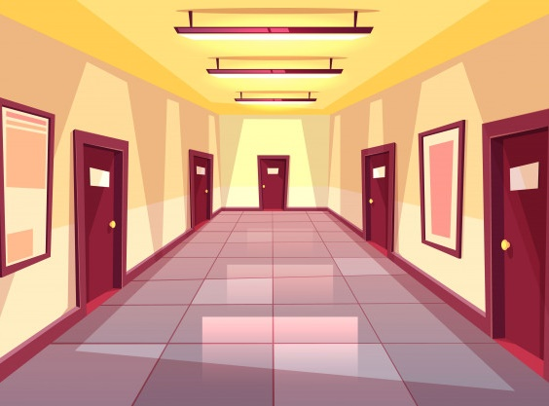
A tiger walks in the room!
What is your response?

Slide 6
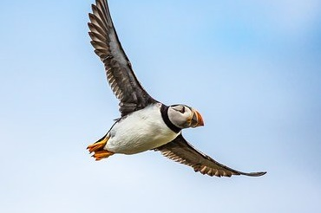
A tiger walks in the room and what is your response?
‘FLIGHT’
‘FIGHT’
‘FREEZE’

Slide 7
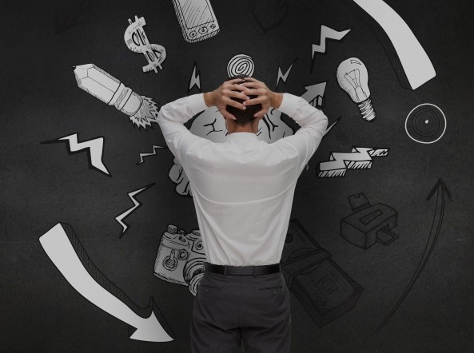
Stress is an automatic response to dealing with challenges.
When we stress, our bodies are flooded with hormones that raise heart rate, blood pressure, boost energy and prepare for ‘fight, flight or Freeze’
Over time, too much stress can become a serious issue, making someone unwell.
The right amount of stress is good for us as it helps to motivate us to perform well in sport or exams or to even get out of bed in a morning
What are some examples of short-term stress in your life?
What are some examples of long-term stress in your life?
What extra stresses might adults have that students don’t have?

Slide 8
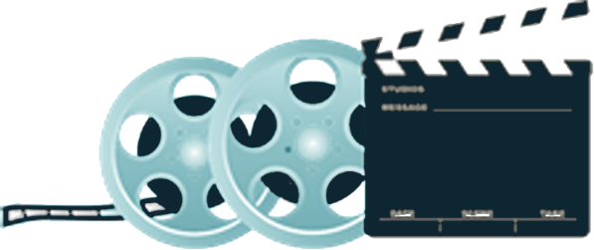
STRESS & HOW IT CAN IMPACT YOUR LIFE
4 Minutes
Life Noggin Clip:
How Much Stress Can Kill You?
Play video
Task
Why is it important to be able to manage stress in your life?
Why is it so important to not let stress get in the way of your learning and living?
What strategies do you think are the most useful to use when dealing with stress?
Notes:
TEACHER NOTES & IDEAS

Slide 9
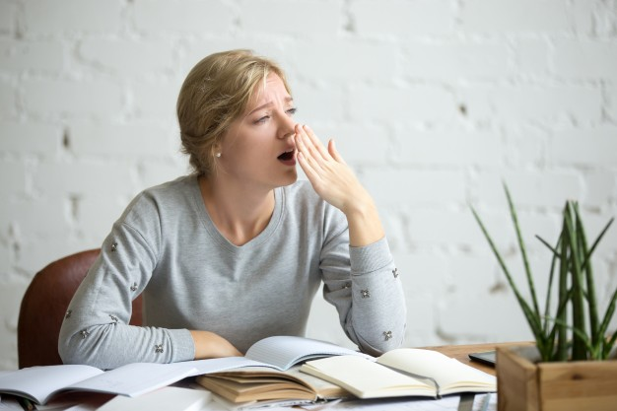
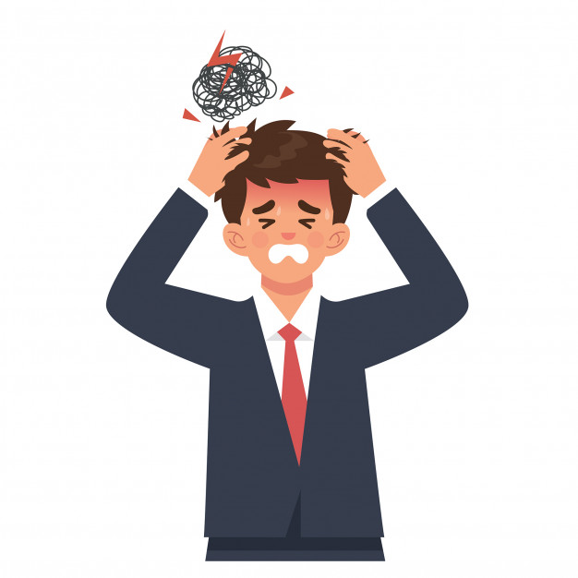
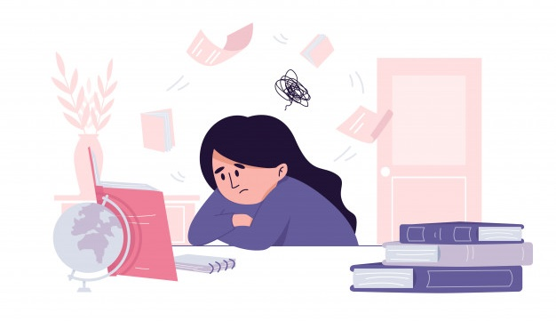
A
B
C
D
E
F
Have you ever felt like any of these pictures when revising?
What could someone do to help themselves in this situation?

Slide 10
LEAGUE TABLE OF STRESSES ACCORDING TO ONE UK STUDY – (EXCLUDING SOCIAL MEDIA)
BOYS
1.Pressure to be macho
2. Image
3.Girls-acting cool in front of them
4.Class mates – bullies
5.Competition
GIRLS
1.Exams, coursework
2.Parents imposing restrictions
3.Friendships – arguments
4.Peer pressure, what to wear
5.Being organised
[Click to Reveal]
No. 1
[Click to Reveal]
No. 2
[Click to Reveal]
No. 3
What do you think the top five are for boys and girls of secondary school age?
What do you notice about the differences between boys and girls?
[Click to Reveal]
No. 4
[Click to Reveal]
No. 5
[Click to Reveal]
No. 1
[Click to Reveal]
No. 2
[Click to Reveal]
No. 3
[Click to Reveal]
No. 4
[Click to Reveal]
No. 5

Slide 11
STRESS BALLS
Rule 1: Take a piece of paper tear into three pieces
Rule 2: Write down on each piece something that stresses you out
Rule 3: Screw all three up into individual balls and throw them in the teachers bin
What happens when the bin fills up?
How can we deal with this issue (stress)?
Everyone has a different capacity to deal with stress

Slide 12
What makes exams so stressful?

Slide 13
What might the signs of getting stressed in an exam be?
INCREASED BLOOD PRESSURE
SWEATING
INCREASED HEART RATE
A) If you had the ‘Fight’ ‘Flight’ or ‘Freeze’ reactions to revising for an exam what would be the different outcomes?
B) If you had these reactions during an actual exam what might be the three different outcomes?
Fight
Flight
Freeze

Slide 14
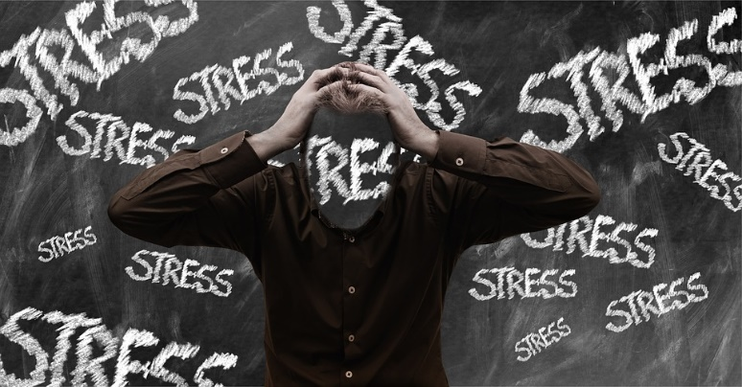
Science behind ‘Fight’ ‘Flight’ or ‘Freeze’
Did you know?
Circulating emotions will create long term physical responses which affect our para-sympathetic nervous system – stress response – persistent stress creates illness
Para-sympathetic nervous system is responsible for managing our hormone output. Constant overloading emotions on our nervous system releases the stress inducing hormone – Cortisol – which puts strain on our body, this is the hormone released when we need to ‘fight, flight or freeze’ . Any of these actions needs the body to have more blood and oxygen to the muscles, lungs and brain and less to our other organs and endocrine system (hormone producing, signaling and releasing system in our bodies).
Too much of this reaction in the body creates an imbalance. The endocrine system is producing too much of one hormone – Cortisol. This causes the body to be in a state of permanent stress or high alert.
This creates tension in the body as the body is always ready to run (flight), fight (fight) or contract its muscle system to stay stuck in a freeze position (freeze). Major organs are having their blood supply slowed down constantly which restricts the ability to work at optimum function sending a mixture of messages to the brain.
Excess Cortisol hormone in the body also leaves the brain confused. We need to move our bodies, create a cardiovascular reaction, increase our volume of oxygen in our blood, increase the output of our cardiovascular system to make all the organs work a bit harder to clear out the excessive hormones.

Slide 15
Recognising some of the physical symptoms of stress
Difficulty in sleeping or waking up
Constant tiredness
Forgetting things
Unexplained aches and pains
Poor appetite
Loss of interest in activities
Increased anxiety
8. Increased heart rate 9. Migraines & headaches 10. Blurred vision and/or dizziness 11. Comfort eating 12. Drinking too many caffeinated/energy drinks
13. Run down immune system
14 Generally feeling ‘run down’.
Have you ever had some of these?
Which of these are easier to identify than others?
Have you ever spotted any of these in your friends?

Slide 16
How can you prevent too much stress from building up?
It’s all about creating positive coping strategies:
Organising oneself with a (study) schedule – making set times for different subjects
Study – if you plan in time to study and stick by it then you won’t need to stress that you don’t have enough time
The thing is to be disciplined with anything you do (or at least plan to do)
‘Discipline is choosing between what you want now with what you want most’
– Abraham Lincoln

Slide 17
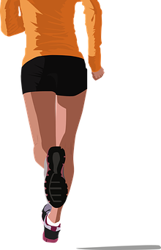
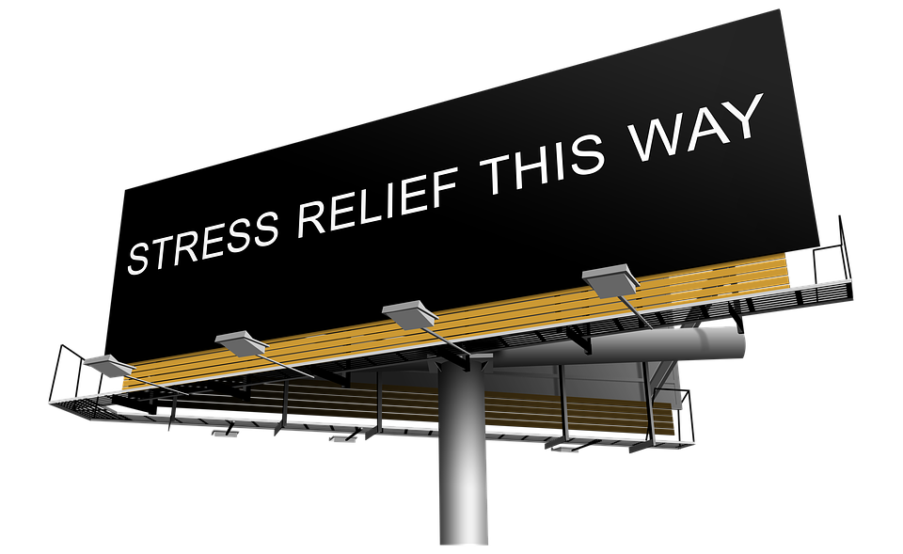
Exercise helps the body process stress (Cortisol) –
Cortisol – the hormone responsible for the stress response in the body is broken-down in the body and passed through the waste organs and sweated or excreted.
Excess of non useful compounds have been eliminated and removed, the body is functioning at a higher level. That’s why mood is improved, sleeping is deeper, cells are restored and self confidence is improved.
Did you know?
Stress can be a positive force. If you are worried about an exam you may be more likely to study. BUT too much stress over a prolonged period can be harmful to our health and well being. Stress in your life needs to be balanced by relaxation.
Would this method work for you?
How likely are you to do this when you are feeling stressed?
Scale 1 – Not likely --------- 10 Very likely

Slide 18
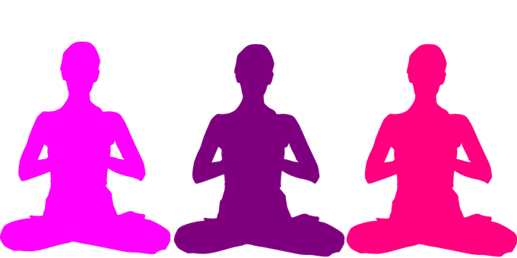
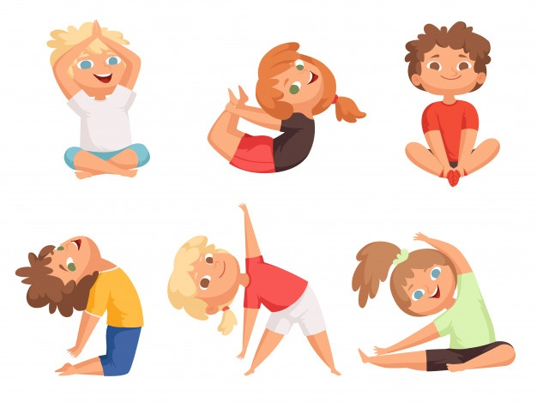
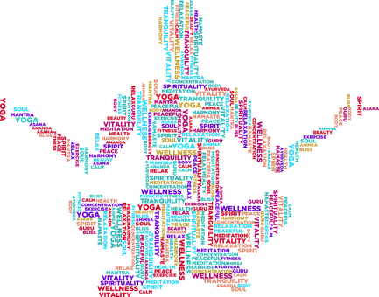
Yoga/mindfulness/meditation –
All 3 disciplines are centralized in the theme of bringing our minds attention to the body. When we are aware of the body then we can be in a more of a relaxed state (para-sympathetic nervous system).
To be in our para-sympathetic nervous system means for our stress response to be at a low. Our body feels safe and relaxed. No need for our senses to be on alert.
Would this method work for you?
How likely are you to do this when you are feeling stressed?
Scale 1 – Not likely --------- 10 Very likely

Slide 19
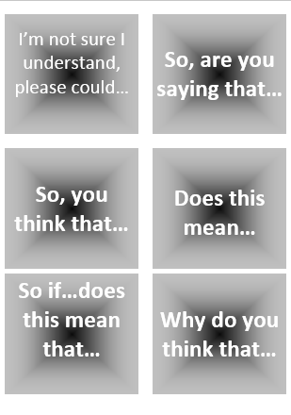
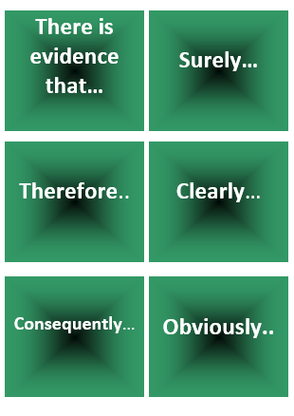
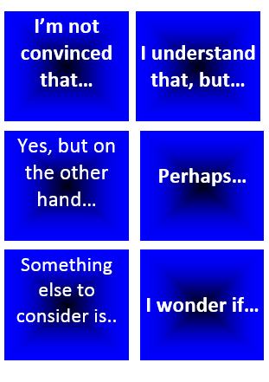
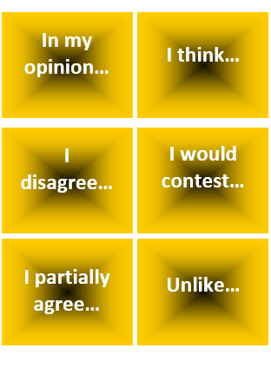
“Revising for an exam is often more stressful than taking the exam itself”
Start with this card….
Or these cards….
Task 1: Discuss / Debate with your partner your own personal views towards this statement /idea
Extension: Can you think of specific examples of recent events that would support this statement and other specific examples that would go against this statement.
Discussion task
2-3 Minutes
Notes:
TEACHER NOTES & IDEAS
Pair student sup and have them use the sentence starter prompts on the board to help them (each colour represents a different set of prompts E.G Challenge, agree, build upon etc.)
-Arrange for two confident students (or two pairs of students) to come to the front and have a debate challenge off with a timer
-Challenge a student to debate you (allow them to pick whether they will argue for the statement or against it)

Slide 20
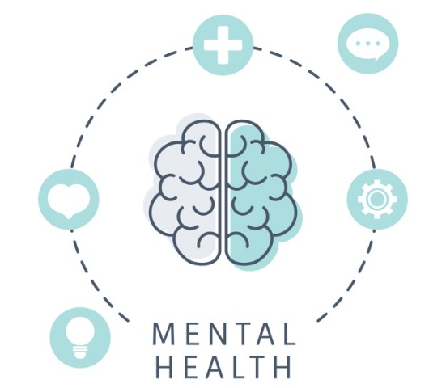
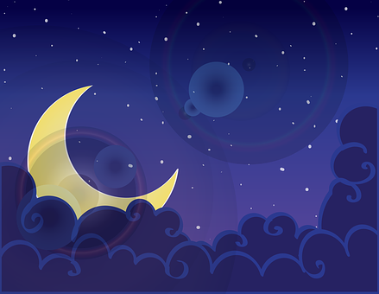
Relaxation/processing – taking time to relax is one of the best ways for the body to store information - once we have put it in a few times!!
The mind needs time to process so once you’ve had a big study session then switch off and I mean switch off – no computer games or phone. So no more screen time.
Relax with a walk, hobby, yoga, meditation or reading, it’s the quiet time the body needs then the information can be filed away.
Would this method work for you?
How likely are you to do this when you are feeling stressed?
Scale 1 – Not likely --------- 10 Very likely

Slide 21
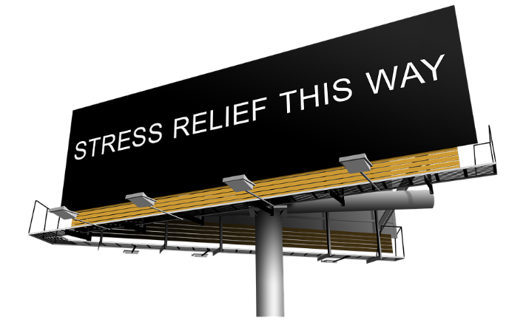
Yoga – is moving and stretching your body but with consciousness awareness of how your body is reacting.
This is learnt by firstly being aware of your breath. This is done by counting your breath (every 4) or saying to yourself breathing in, breathing out. If you are practicing yoga with a video tutorial or a yoga teacher generally they will tell you when to breathe in out to help with certain yoga postures.
Being aware of your breath puts your conscious mind into a focus state and has your brain concentrating on this one thing.
Then your subconscious (the other part of your brain responsible for keeping your body systems operating without you having to give thought to) can speak to you about how your body is feeling.
Is it tight, is it tired, does it have loads of energy today? These physical questions can be asked in yoga but as you relax into the practice more emotional feelings may come up and reasons for your stress may be more clear to you.
You are aware of your breath. or what it needs. Normally through movements that connect the body and mind together with synchronization of the breath. Asking your mind to think about where the breath is and how it feels in that area of the body and how it helps the body to move or stretch more is taking you mental activity off random thoughts. It calms the mind down
Would this method work for you?
How likely are you to do this when you are feeling stressed?
Scale 1 – Not likely --------- 10 Very likely

Slide 22
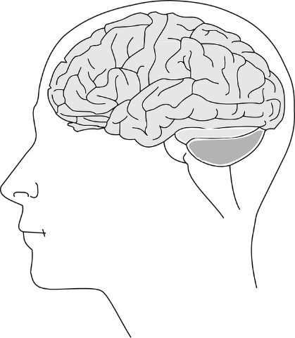
The ‘sciency’ part of yoga
It calms the mind down because your breath is deeper and slower, your diaphragm becomes less tense (dome-shaped muscle under lungs that expands and contracts) releasing the hormone of nitric oxide to be released which expands the blood vessels, increasing blood flow and allows the body to function better the same way exercise can.
Meditation is the action of sitting (but can also be standing or walking) were we purposely take note of just our breathe (minimum 2-3 minutes up to 4-6 hours daily. Dependent on If you are a beginner or a monk). This time were are solely allowing the mind to recognise the breath. Not paying any attention to our thoughts is allowing our brains to process and compartmentalize the information it has been processing (mostly information from the recent past but also all of our life). It’s like letting your phone or computer have a rest when you have been constantly using it and its hot. Think of it as a reset for your mind. If you are doing this every day you can become very organised in your mind – think of it like if you cleaned your room a little every day – how tidy would that be!

Slide 23
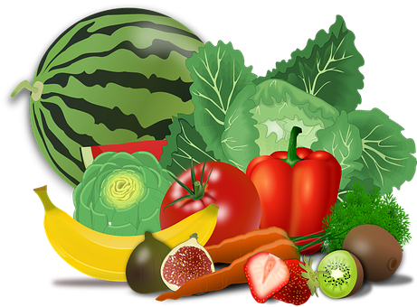
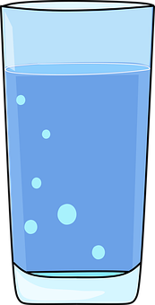
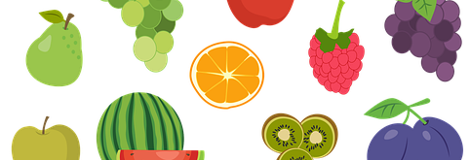
Healthy meals – healthy ingredients
Good fats for the brain
Fats help nerve connections
We have a lot of nerve connections in our brains
Oily fish, avocado, nuts – especially walnuts helps our brains and they look like a brain!
Fruits and veg supplying us with macronutrients we need – vitamins and minerals – magnesium, potassium
We need these macronutrients to keep our muscles feed, our organs functioning, our blood pumping, to help with hormone production.
The body is a complex machine and needs lots of tiny nutrients to function and all this is found on our food.
Would this method work for you?
How likely are you to do this when you are feeling stressed?
Scale 1 – Not likely --------- 10 Very likely

Slide 24
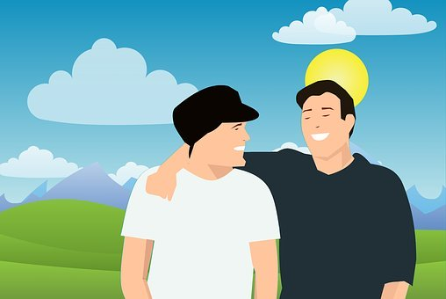
Talking openly and honestly to people you trust –
When we open up about our fears and our worries to someone we trust the problem feels halved just in the action of telling someone something.
Thoughts can spin around in our heads and circulate. Voicing them out in the open and into reality makes them feel less heavy. They can feel not so note worthy.
Sometimes that can be the end of the fear and worry.
Just being listened to can help the problem go away.
When you hear a though come out it can sometimes sound a lot smaller than your mind has made it to be and you can solve the issue out yourself,
Would this method work for you?
How likely are you to do this when you are feeling stressed?
Scale 1 – Not likely --------- 10 Very likely

Slide 25
HOW CAN BREATING HELP IN EXAMS?
Breathe deeply, until sweet air extinguishes the burn of fear in your lungs and every breath is a beautiful refusal to become anything less than infinite. – D. Antoinette Foy
Breathing deeply – Oxygenating our body helps it function optimally allowing the body to relax every time we take a deep breath.
Breathing is the greatest pleasure in life. – Giovanni Papini
Inhale the future, exhale the past. – Author Unknown
The trick to life is to just keep breathing. Johnny Lung
Breathe. Let go. And remind yourself that this very moment is the only one you know you have for sure.
– Oprah Winfrey
Would this method work for you?
How likely are you to do this when you are feeling stressed?
Scale 1 – Not likely --------- 10 Very likely

Slide 26
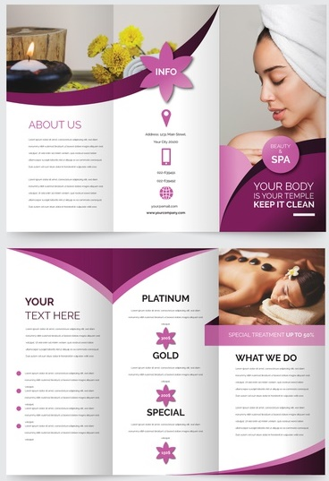
Get into small teams of 3
Imagine you are running a drop down day for student who need to deal with their own exam stress and anxiety about exams
Design a leaflet to advertise the day to Y11 Students and what each of the five sessions would focus on
Extension: Research, plan and deliver one of those sessions
(PowerPoint Format)
Success Criteria:
SUCCESS CRITERIA
Define Stress, Relaxation and mindfulness
Explain negative impacts stress can have
Explain how a small amount of stress can be positive
Explain the five sessions
Facts and Statistics
A Basic overview of the day
__ Minutes
Notes:
TEACHER NOTES & IDEAS
Always share success criteria with students before you set the task and evaluate the task – Students need to know what you are looking for.
If you have done this task before with another class show your new class a WAGOLL (What a good one looks like)

Slide 27
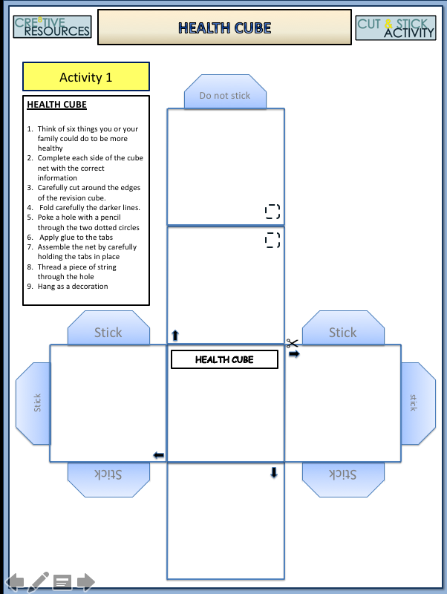
HEALTH CUBE
Tasks
Think of six things you or your family could do to be more healthy
Ensure the central cube face is the most important idea / suggestion you have
Complete each side of the cube net with a different way to be healthy.
Carefully cut around the edges of the revision cube.
Fold carefully the darker lines.
Apply glue to the tabs
Assemble the net by carefully holding the tabs in place
Notes:
TEACHER NOTES & IDEAS

Slide 28
Confidence Checker
AFTER THE LEARNING | 1 | 2 | 3 | 4 | 5 | 6 | 7 | 8 | 9 | 10
I can identify the symptoms of stress
I know range of ways to deal with any exam stress I have
I understand how different amounts of stress can impact my performance and ability to think clearly
Complete the confidence checker of where you think you are at for this lesson (Discussion or complete sheet)
3 Minutes
Notes:
TEACHER NOTES & IDEAS
This could be done by writing a number down in the books – Compare to the start of the lesson
Show of fingers in the air or use Red Amber Green Cards
Quick Partner Discussion & reflect on before the lesson and progress made
Print off the Assessment Opportunity Sheet – Fill in the Confidence Checker / Compare with the baseline
Author Attribution :https://pixabay.com/en/traffic-lights-traffic-light-phases-2147790/

Slide 29
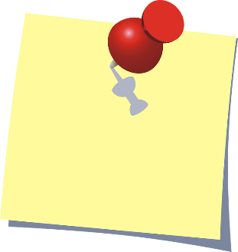
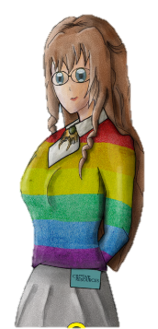
FOR MORE INFORMATION ABOUT THE TOPICS COVERED IN THIS UNIT WE WOULD ADVISE ONE OF THE BELOW: SPEAK TO YOUR PARENTS/GUARDIANS OR HEAD OF YEAR, TRUSTED ADULT OR FRIEND IF YOU HAVE ANY CONCERNS ABOUT YOURSELF OR SOMEONE YOU KNOW – IT IS ALWAYS IMPORTANT TO TELL SOMEONE!
Enjoy the lesson, Challenge your perceptions and understand how to seek further advice and support
SPECIFIC FURTHER INFORMATION ON THIS TOPIC CAN BE FOUND HERE:
https://www.childline.org.uk Has support for=growing up – Boys & Girls
https://kidshealth.org/#cattake-care Information on a variety of topics
VISIT WWW.NHS.UK/LIVE-WELL (ADVICE TO HELP YOU MAKE THE BEST CHOICES ABOUT YOUR HEALTH AND WELLBEING)
VISIT WWW.BE-BEAUTIFUL-ONLINE.CO.UK (FREE HEALTHY EATING PLANS)
2 Minutes
Notes:
TEACHER NOTES & IDEAS
Teachers should add in specific local signposting to charities, careers organisations / Connections or Careers officer at school. If RSE topics the local NHS services in their area
Add / adapt or remove any suggested sites.
Print this slide and leave on door notice board after the lesson

Slide 30
I know if I need further
support or help I could
speak to…. or contact…
Before I could/would say
and do ... but now I feel I
am able to say
Before I only knew ...
now I also know ...
I supported others by…
One thing I didn’t
realise was… now I know that…
The key words for
this lesson are…
I always knew ... but now
I can see how it connects to…
The most important thing I
have learnt today is…
I’m really proud of the
way I have…
I used to feel ...
but I now feel ..
One assumption of
mine that was
challenged was…
I would like to learn…
A question I
would like to
ask is…
Before I thought that ...
but now I realise..
Today I have tried to…
Next lesson I would like to..
Before I would have done…
Now I will …
Before I would have
said ... but now I will say…
2 Minutes
A problem I overcame
today was…
Notes:
TEACHER NOTES & IDEAS
: Have students pick either 1/2/3 tickets depending on their ability and tell a partner
Pick a few students at random to feedback to the class
As students leave the room have them tell you their reflection on the way out

Slide 31
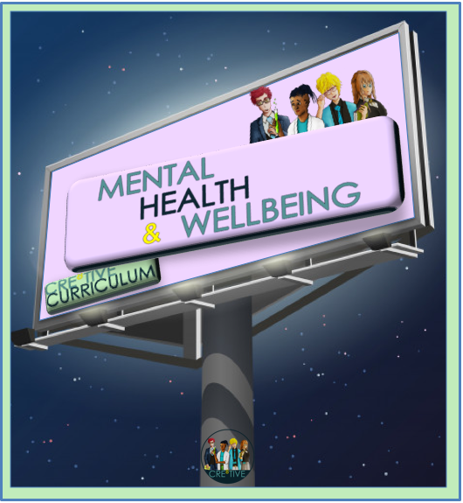
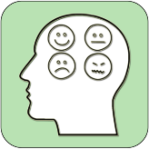
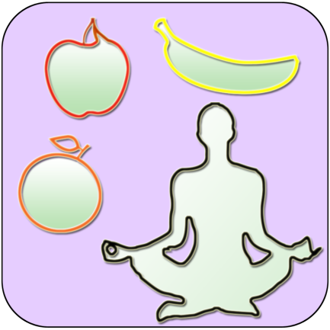
REFER TO MINDFULNESS POWERPOINT
Time for a little something extra?
?? Minutes
Notes:
TEACHER NOTES
Time for something extra?
Pick an activity or reflection question from the mindfulness and wellbeing PPT or add the activity you want on to the end of this PowerPoint before you start the lesson (or use as a starter)

