Slide 1
Year 6 into 7 Science Quiz
Find 12 obscure science questions you can quiz yourself and your family with!

Slide 2
Before you do the quiz how good are you at making observations? Check out the video.

Slide 3
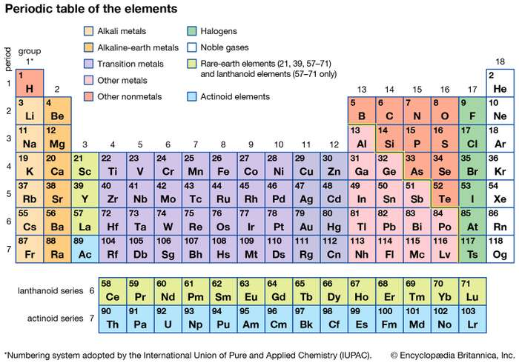
1 ) What are the only two letters not to appear on the official Periodic Table?
A ) Q and J
B ) Q and Z
C ) Z and J

Slide 4
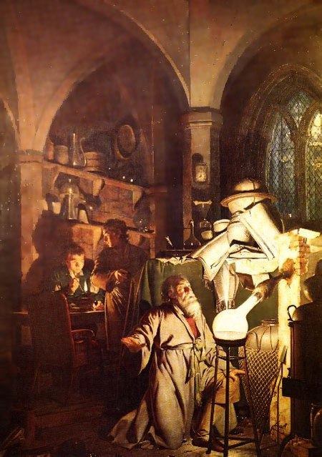
2 ) Many early “alchemists” were convinced that it was possible to turn lead into gold. What did they think they needed in order to do this?
A ) The Philosopher’s Stone
B ) The Goblet of Fire
C ) The Order of the Phoenix

Slide 5
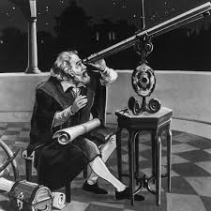
3 ) In the early 17th century, based on his observations with a telescope, Galileo Galilei attacked the church and their belief that:
A ) The earth was flat.
B ) The sky was a large dome with holes through which heaven could be seen.
C ) The earth was at the centre of the universe.
D ) There are no other planets.

Slide 6
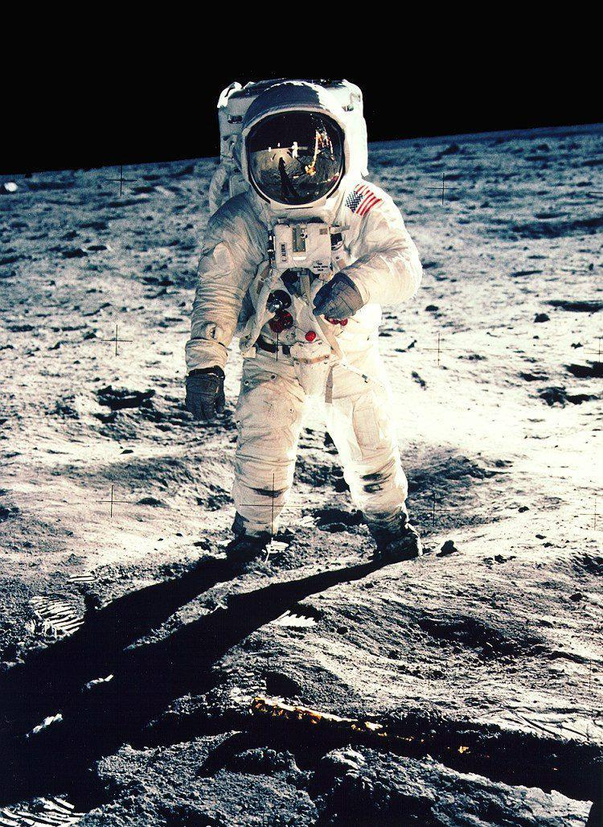
4 ) How many people have walked on the moon?
A ) 12
B ) 14
C ) 16

Slide 7
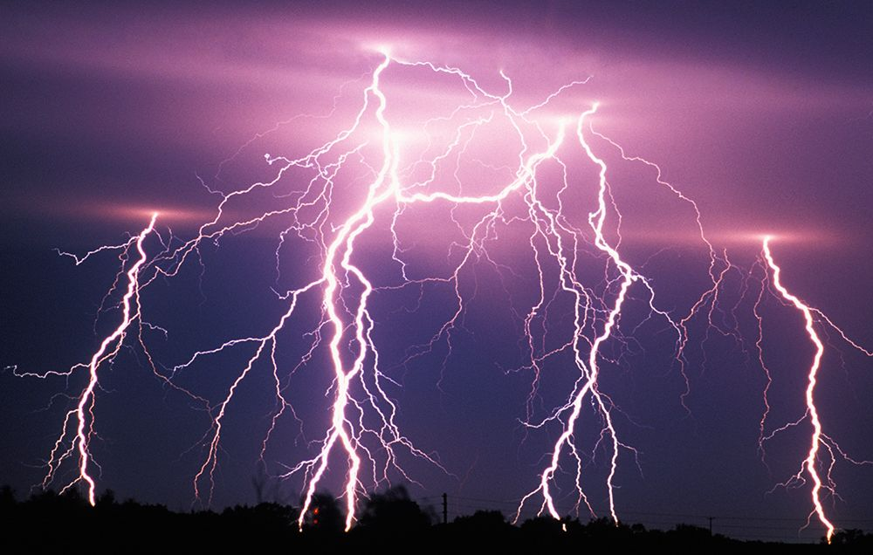
5 ) If the time between seeing a lightning flash and hearing the resulting thunder is five seconds, approximately how far away was the lightning?
A ) 100 metres
B ) 1 mile
C ) 10 miles

Slide 8
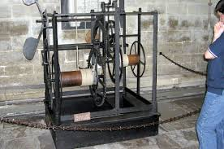
6 ) Many scientists have been interested in the study of time. In which cathedral can you find the world’s oldest mechanical clock?

Slide 9
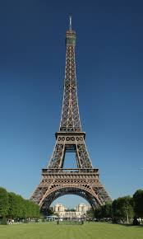
7 ) When solids are heated the particles move apart, we say the object expands. How much taller is the Eiffel Tower in Summer than it is in Winter?
A ) 17mm
B ) 17cm
C ) 17m

Slide 10
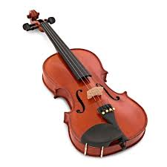
8 ) Which famous scientist said “If I were not a physicist, I would probably be a musician. I often think in music. I live my daydreams in music. I see my life in terms of music.... I do know that I get most joy in life out of my violin."
A ) Marie Curie
B ) Isaac Newton
C ) Albert Einstein

Slide 11
9 ) The earliest work about how features are inherited was carried out by Gregor Mendel. What was his full-time job?
A ) Doctor
B ) Teacher
C ) Monk
D ) Baker

Slide 12
10 ) The study of fossils tells us what life was like many millions of years ago and helps us to understand how it evolved. What type of fossil is a coprolite?
A ) Fossilised brain
B ) Fossilised blood
C ) Fossilised poo

Slide 13
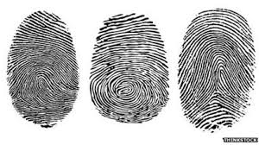
11 ) Finger printing has been used to identify individuals for over 100 years (even identical twins have different finger prints). What has recently been proposed by scientists as an alternative method of identification?
A ) Measurement of ear dimensions
B ) Measurement of nose dimensions
C ) Tongue Printing

Slide 14
12 ) What types of organism do entomologists study?
A ) Insects
B ) Viruses
C ) Snakes

Slide 15
Let’s see how you’ve got on…

Slide 16
1 ) What are the only two letters not to appear on the official Periodic Table?
Q and J
Z is used in the chemical symbols for Zinc and Zirconium – can you find these two elements on the Periodic Table?

Slide 17
2 ) Many early “alchemists” were convinced that it was possible to turn lead into gold. What did they think they needed in order to do this?
The Philosopher’s Stone
The alchemists also believed that it could be used for rejuvenation (to become younger again) and to achieve immortality (to live forever).

Slide 18
3 ) In the early 17th century, based on his observations with a telescope, Galileo Galilei attacked the church and their belief that:
The earth was at the centre of the universe.
This was revolutionary at a time when most people believed the Earth was in the central position. In 1616, he was forbidden by the church from teaching or spreading these ideas.

Slide 19
4 ) How many people have walked on the moon?
12
The first moon landing took place in 1969 and the final landing occurred in 1972.

Slide 20
5 ) If the time between seeing a lightning flash and hearing the resulting thunder is five seconds, approximately how far away was the lightning?
1 mile
Light travels much faster than sound, approximately 1 million times faster.

Slide 21
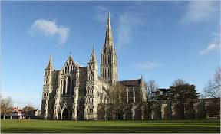
6 ) Salisbury Cathedral - The world’s oldest working mechanical clock was made of iron. The clock has no face and was designed only to strike hours.

Slide 22
7 ) When solids are heated the particles move apart, we say the object expands. How much taller is the Eiffel Tower in Summer than it is in Winter?
17 cm.
It is important to look at the units that are written beside a value.
How many mm are there in 1cm?
How many cm are there in 1m?

Slide 23
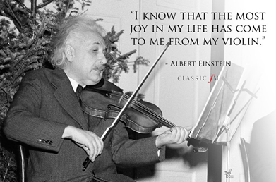
8 ) Which famous scientist said “If I were not a physicist, I would probably be a musician. I often think in music. I live my daydreams in music. I see my life in terms of music.... I do know that I get most joy in life out of my violin."
Albert Einstein

Slide 24
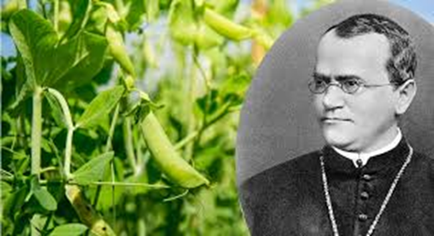
9 ) The earliest work about how features are inherited was carried out by Gregor Mendel. What was his full-time job?
Monk - He is now called the "Father of Genetics”.

Slide 25
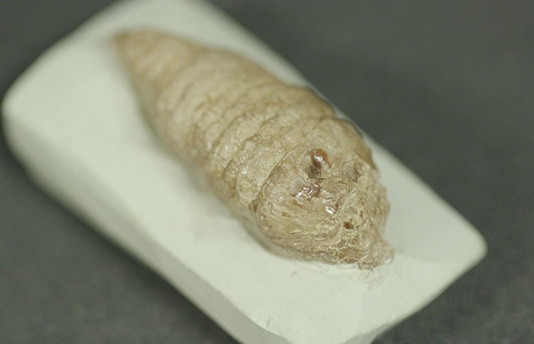
10 ) The study of fossils tells us what life was like many millions of years ago and helps us to understand how it evolved. What type of fossil is a coprolite?
Fossilised poo - By looking at the shape and size of coprolites, as well as where they were found, scientists can work out what kind of animal the droppings might have come from. Coprolites can also contain clues about an animal's diet.

Slide 26
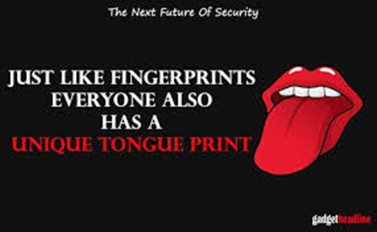
11 ) Finger printing has been used to identify individuals for over 100 years (even identical twins have different finger prints). What has recently been proposed by scientists as an alternative method of identification?
Tongue Printing

Slide 27
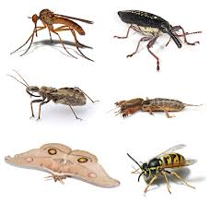
12 ) What types of organism do entomologists study?
Insects
There are lots of “-ologies”. Ecology is the study of the interaction between organisms and their environment. You will study this in your biology lessons.
Hamburgerology is a course of study introduced by McDonald's to train people to work in its fast food restaurants!

