Slide 1
Life as a Medical Student

Slide 2
A bit about Rosie
Bishop Stopford School 2011 – 2018
University of Birmingham Medical School 2018 – 2024
Health Management and Leadership BMedSci 2021 – 2022

Slide 3
A bit about Christian
Bishop Stopford School 2010 – 2017
University of Birmingham Medical School 2017 – 2024
Leave of absence 2017- 2018
Clinical Sciences (Cardiovascular Sciences) BMedSci 2021 - 2022

Slide 4
Changes to application process?
We applied 7/8 years ago – things may have changed!
Read university websites, use online resources (In2MedSchool, Medify, Medic Portal)
More up to date advice from Bishop alum: https://bishopstopford.fireflycloud.net/sixth-form/considering-medicine--dentistry--veterinary

Slide 5
Today’s talk
Application Process
Life at Medical School
Doctoring

Slide 6
1.
Application process

Slide 7
Things to consider
About you
Academic achievements (GCSE’s, A levels)
Aptitude tests (UCAT, BMAT)
Personal statement (Work experience, extra curricular)
About the university
Course type (traditional, integrated, PBL)
Course requirements
City
Interview style

Slide 8
Why medicine?
“Good” reasons
Enjoyment of science and working with others
Variation
Ongoing development
“Bad” reasons
Family/Teacher pressure
Financial gain
Status

Slide 9
Rosie’s experience
GCSE’s; 7A*’s, 4A’s
A Levels; 2A*’s (Chemistry & Biology), 1A (Mathematics)
UCAT; 1st decile
BMAT; I can’t remember but I did ok

Slide 10
Rosie’s experience
What type of course? Traditional or Integrated
Where did I want to live? City-based, not London
How did I choose where to apply? Just where I wanted to go, not where I was going to get in…

Slide 11
Rosie’s experience
University of Birmingham: Interview -> Accepted
University of Cambridge: Interview -> Rejection
University of Cardiff: Rejection
University of Edinburgh: Rejection

Slide 12
Rosie’s experience
University of Birmingham: Interview -> Accepted
University of Cambridge: Interview -> Rejection
University of Cardiff: Rejection
University of Edinburgh: Rejection
Important to apply smart!!!!!

Slide 13
Christian’s experience
GCSE’s; 11A*’s
A Levels; 3A*’s (Chemistry, Biology, Maths)
Not sure on either UCAT or BMAT

Slide 14
Christian’s experience
What type of course? Traditional
Where did I want to live? City away from home
How did I choose where to apply? Looked around many, chose places where I think I’d enjoy living

Slide 15
Christian’s experience
University of Birmingham: Interview -> Accepted
University of Sheffield: Interview -> Rejection (waiting list?)
University of Leeds: Interview -> Rejection
University of Newcastle: Rejection

Slide 16
Let’s talk about
Aptitude tests
Work experience
Personal statement
Interviews
Academics

Slide 17
Aptitude tests
People say you can’t prepare… you can
Free online tests
Medify (this has increased in price since I used it)
Books (there are caveats to this)
Courses?
UCAT – book early

Slide 18
Work experience
Medical: Hospital, GP & others (not the most important!)
Voluntary: Care homes etc. (try to make this long term)
Paid work: Retail, Hospitality etc.
The main question to answer is: what did you learn/gain from this?
work.experience@nhft.nhs.uk
03000 270 683

Slide 19
Personal statement
Work experience
Extra reading: Books, articles
Academic extra curricular: MedSoc, other societies, tutoring, reading partners
Other extra curricular: sports, performing arts (you might not have much space for this – keep it brief!)

Slide 20
Personal statement
Avoid cliches and sweeping statements
Do not list your achievements; explain what you gained from your experiences and how they will help you
Remember you are still developing your skills – you have 5 years of medical school before you are ready to be a doctor!

Slide 21
Interview
You need to have done what you have said on your personal statement
You are being “interviewed” the whole day
Think about the obvious questions: why do you want to do medicine? Why do you want to come to this university?
Things to know:
Course structure
Current medical issues

Slide 22
Interview
MMI Interview:
Each station is individual – if you mess up one, it won’t affect the others
Panel Interview:
Take your time – you have 25/30 minutes to talk to your interviewers

Slide 23
Grades
A levels:
Remember to keep working throughout the year; consistent revision will put you in good stead
Use mark schemes to revise
Predicted grades are important for some medical schools: be realistic but fight your corner!

Slide 24
Overwhelmed?
And breathe…
Applying to medical school can be a stressful and overwhelming time
Lean on your family, friends and teachers for support
Everyone applying is going through the same thing!
If you are really put off by the work that goes into the application process, medicine might not be for you!

Slide 25
2.
Life at medical school

Slide 26
A day in the life (Years 1-2)
Lots of 9am lectures (you will have more contact hours than your flatmates!)
Very dependent on the course! For me I had ~25 hours of lectures per week + seminars & anatomy sessions
GP placement once every fortnight
2 sets of exams (January & Summer) + coursework

Slide 27
A day in the life (Years 3-5)
Hospital Placement & GP
Lectures
Bedside teaching
Clinical skills
Self directed learning: taking histories, examinations
Additional modules (e.g. EBM)
Coursework (e.g. audits, essays)
Exams: MCQs and OSCE’s

Slide 28
Additional opportunities
Intercalation
Audit and QIP
Research
MedSoc societies
Elective

Slide 29
Work hard…
It’s ok to feel overwhelmed at the start!
Consistency is key
Use older year notes
Figure out what the best way is for you to take notes; what works best for you won’t be the same as your friends
Exam season is extremely stressful – you just have to get through it

Slide 30
… Play Hard
It is so important to make sure medicine isn’t your whole life!
Carry on a new hobby or pick up something new
Develop your friendships; they will become your family
Make sure you enjoy your time at university!

Slide 31
So you want to be a Doctor?

Slide 32
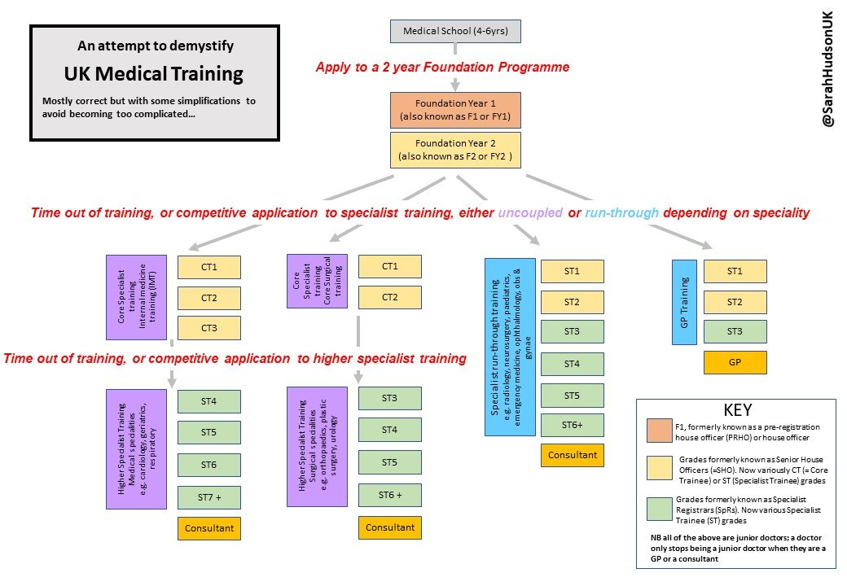
Training Pathway

Slide 33
Foundation years – Rota example

Slide 34
Any Questions?
There are no stupid questions!
cdmitchell7@btinternet.com

