Slide 1
A Level PE

Slide 2
The Course
All A Level PE courses have been re-written in 2016
They are all linear, which means you sit final exams at the end of the course rather than modules
The exam board is AQA

Slide 3
Theory Content

Slide 4
Non-Exam Assessment (Coursework)

Slide 5
Section 1 – Applied Anatomy and Physiology
Cardio-respiratory system
Neuromuscular system
Musculo-skeletal system
Energy systems

Slide 6
Section 2 – Skill Acquisition
Skills, continuums and transfer of skills
Impact of skill classification
Theories of learning
Guidance and feedback
Memory models – information processing

Slide 7
Section 3 – Sport and Society
Pre-industrial sports
Industrial and post-industrial sports
Post World War II
Impact of sport on society and society on sport

Slide 8
Section 4 – Exercise Physiology and Biomechanics
Diet and nutrition
Training methods
Injury prevention
Biomechanical principles
Levers, motion

Slide 9
Section 5 – Sport Psychology
Personality and attitudes
Arousal, anxiety, aggression
Motivation
Social facilitation
Group dynamics
Goal setting
Attribution theory
Confidence
Leadership
Stress management

Slide 10
Section 6 – Sport and Society and Technology
Physical activity and sport
Elite performers
Ethics in sport (Violence in sport, drugs, the law)
Commercialisation
The role of technology

Slide 11
Non-exam Assessment (NEA) – Performance Aspect
It is marked out of 45 – split into 3 areas of assessment 1,2 and 3.
Students can be assessed in the role of player/performer or in the role of coach—they cannot be assessed as an official.
Students assessed in one activity in the full sided version of that activity only.
Students can only be assessed in activities listed in the specification—we cannot accept requests for activities not included in the specification.
All students should provide appropriate video footage
Students are assessed internally and moderated externally

Slide 12
Marking grid example

Slide 13
NEA – Performance Analysis
This is a written coursework, which can be based on your own performance or someone else
It is marked out of 45;
Analysis (identify and explain two weaknesses)– 20 marks
Evaluation (explanations for weaknesses and corrections using theoretical knowledge) – 25 marks
This is marked internally and then moderated externally

Slide 14
The assessments

Slide 15
Attitude
What is very important is that you need to arrive to PE with a ‘can do’ attitude, and be prepared to throw yourself into every task
Many theory tasks can be taught through practical activities in lessons so get yourself involved
You will be given some homework where it adds to your learning but the expectation is that you will complete some self-directed study in your own time without being asked (re-write notes, consolidate, create revision resources etc.)

Slide 16
Reflection on this year’s results…
The best candidates were;
Organised (brought everything they need to every lesson)
Get a separate folder for each area and lots of dividers
Bring plenty of different coloured pens, highlighters etc.
Always have plenty of paper
Keep your notes in good condition and in the correct order, you will be revising nearly 2 years work
Handed in very well organised practical evidence
Reliable (completed their homework on time, to a high standard, excellent attendance, asked for work if they missed a lesson)
Involved (got involved in tasks, asked/answered questions, weren’t afraid to be ‘wrong’)
Team players (worked well with other people, supported their peers, happy to collaborate)

Slide 17
Taster Lesson Physiological Factors Affecting Performance

Slide 18
Lesson Objective
To be able to identify the type of joints found in the arm and movement produced.

Slide 19
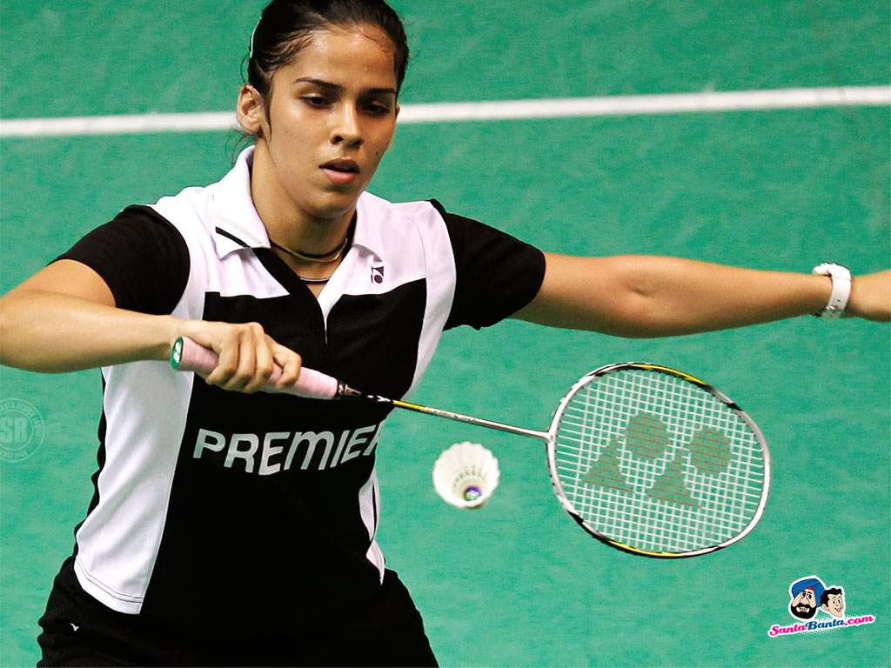
Joints in the Arm – what are they?

Slide 20
Joints in the Arm
Shoulder
Elbow
Wrist

Slide 21
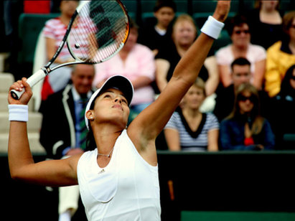
The Elbow Joint (Hinge Joint)
Movement Possible
Flexion (bent at elbow) and Extension (straight at elbow)

Slide 22
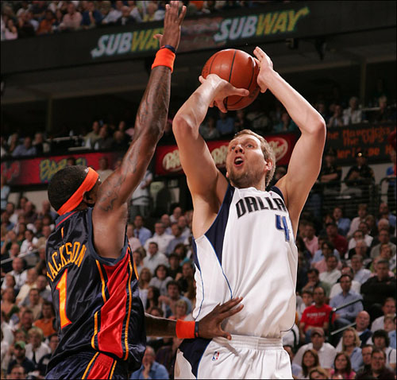
Wrist Joint
(Condyloid Joint)
Movement Possible
Flexion (forward at wrist) and Extension (straight or backwards at wrist)

Slide 23
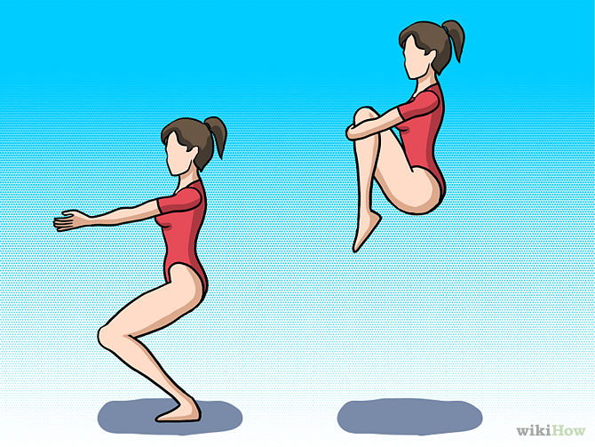
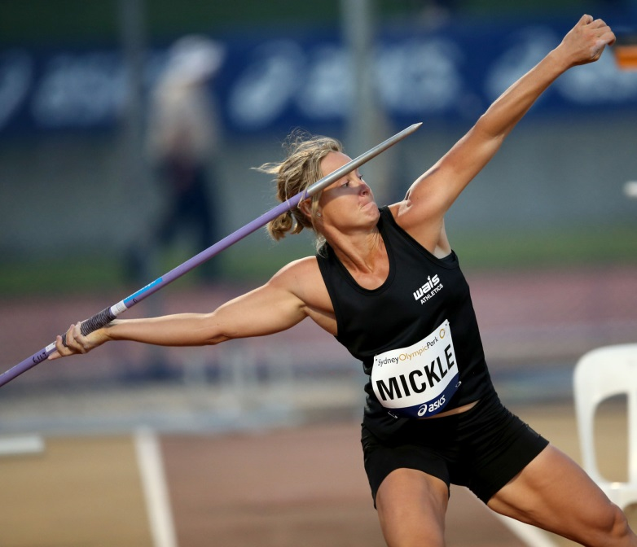
The Shoulder Joint
(Ball and Socket Joint)
Movement Possible
Flexion Extension
(arms forward at shoulder) (arm backwards at shoulder)

Slide 24
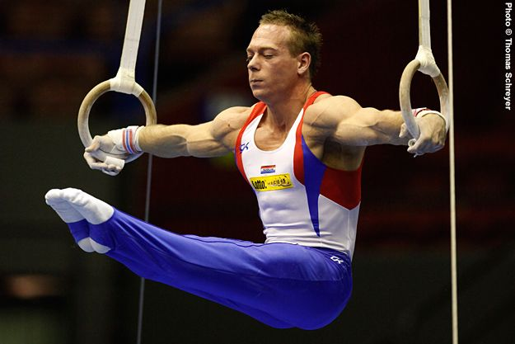
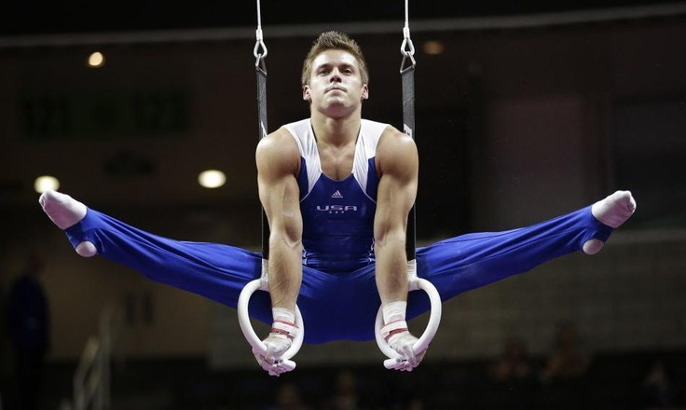
The Shoulder Joint
(Ball and Socket Joint)
Movement Possible
Abduction (arms away) Adduction (arms to middle)

Slide 25
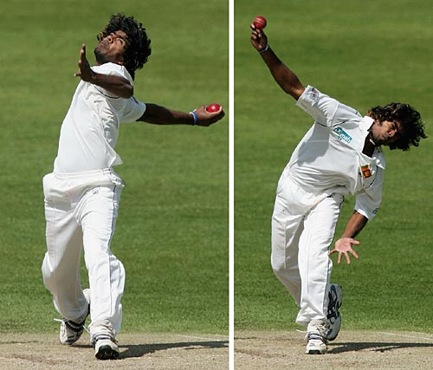
The Shoulder Joint
(Ball and Socket Joint)
Movement Possible
Circumduction (arm rotates all the way round)

Slide 27
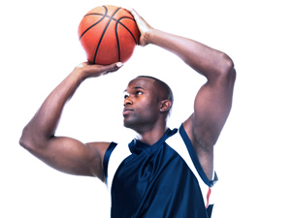
For the shooting arm…….
What type of joint is the elbow?
What movement is occurring at the elbow?
What type of joint is the wrist?
What movement is occurring at the wrist?
What type of joint is the shoulder?

Slide 28
For the shooting arm…….
What type of joint is the elbow? Hinge
What movement is occurring at the elbow? Flexion
What type of joint is the wrist? Condyloid
What movement is occurring at the wrist? Extension
What type of joint is the shoulder? Ball and Socket

Slide 29
For the throwing arm…….
What type of joint is the shoulder?
What movement is occurring at the shoulder?
What type of joint is the elbow?
What movement is occurring at the elbow?
What movement is occurring at the wrist?

Slide 30
For the throwing arm…….
What type of joint is the shoulder? Ball and Socket
What movement is occurring at the shoulder? Extension
What type of joint is the elbow? Hinge
What movement is occurring at the elbow? Extension
What movement is occurring at the wrist? Extension

Slide 31
Socio-cultural Issues in Physical Activity and Sport

Slide 32
 | Date
First University Boat Race
First rules for Cricket issued
First FA Cup competed for
First Wimbledon
Uruguay win the first World Cup
First Modern Olympic Games held in Athens
London hosted their first Olympic Games
London hosted their second Olympic Games
London hosted their third Olympic Games
Henry VIII played real tennis
England won the World Cup at Football
Overarm bowling allowed in cricket
First ‘Ashes’ series
World War 1 ends
World War 2 ends
Rugby Football Union (RFU) founded
Compulsory Schooling for all children
Eton School founded
Try to fill in the dates; give yourself 5 points if you are within 5 years either side, 10 points if you are within 1 year either side (or correct)

Slide 33
 | Date
First University Boat Race | 1829
First rules for Cricket issued | 1774
First FA Cup competed for | 1863
First Wimbledon | 1877
Uruguay win the first World Cup | 1930
First Modern Olympic Games held in Athens | 1896
London hosted their first Olympic Games | 1908
London hosted their second Olympic Games | 1948
London hosted their third Olympic Games | 2012
Henry VIII played real tennis | 1510
England won the World Cup at Football | 1966
Overarm bowling allowed in cricket | 1864
First ‘Ashes’ series | 1883
World War 1 ends | 1918
World War 2 ends | 1945
Rugby Football Union (RFU) founded | 1871
Compulsory Schooling for all children | 1870
Eton School founded | 1440

Slide 34
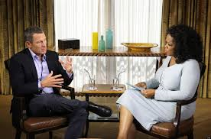
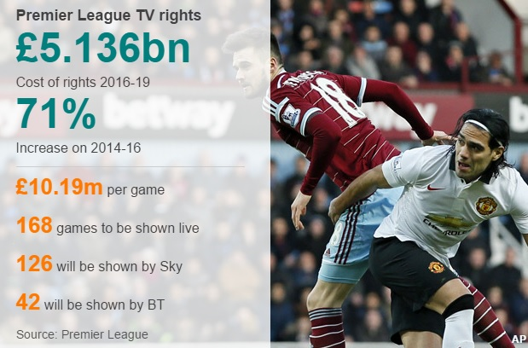
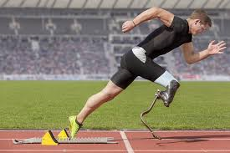
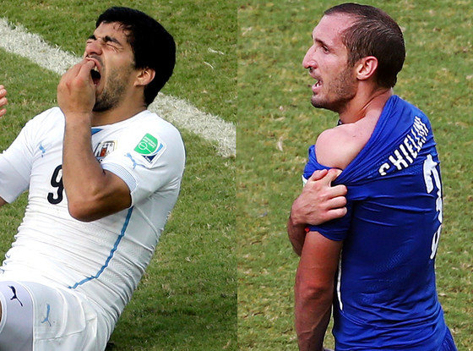
What is going on here (how is your knowledge of contemporary sporting issues….?)

Slide 35
Lance Armstrong won the Tour de France 7 times, after having overcome cancer throughout his body and brain
He was one of the most drug-tested athletes around
He always passed and was supposedly clean
However, one of his teammates outed him as a drugs cheat and he went on the Oprah Winfrey show (the biggest talk show host in America) to confess all
He was stripped of all his titles and is now disgraced

Slide 36
This is the amount of money the Premier League receives from the various TV companies for the right to show their games
It was about £45m in the late 80’s
This shows one of the reasons why there is so much money at the top level of English football and why so much of the game is run as a business, with the huge potential financial gains you an achieve

Slide 37
This represents the importance of technology in sport
There are a number of ways technology and sport science impacts sport, in terms of performance, safety, training, analysis of performers and performances
This particular piece of technology is called a ‘springlite’ prosthetic leg and it’s enabled some disabled performers to perform competitively in athletics and in some cases, compete with able bodied athletes

Slide 38
The infamous Luis Suarez biting incident on Giorgio Chiellini
Violence has been a part of sport for hundreds of years
We look at the various causes (provocation, emotional intensity, nature of the game), effects of violence, solutions (Suarez got a 4 month ban for this particular incident)

Slide 39
Psychological Factors Affecting Performance

Slide 40
Information Processing
Have a read through this article, then have a go at the game at the bottom
https://www.teachpe.com/sports-psychology/information-processing
http://www.bbc.co.uk/science/humanbody/sleep/sheep/reaction_version5.swf

