Slide 1
Green Careers & the Economy
Copy
title
Knowledge, Skills & Actions
To understand what green careers are.
To consider how this effects the national and global economy.
To consider how we can prepare for the changes green careers will present.
3 Minutes
They say money makes the world go round. But there has to be other important things, right? Speak to the person next to you and discuss what else is important to you. There are no right answers!
New Vocabulary
Green economy, green careers, career resilience
Tasks
Notes:
TEACHER NOTES & IDEAS
Remind students of the learning journey (What theme you are doing – Possibly recap what they can remember from last lesson.
ATTRIBUTION AND COPYRIGHT
CDI ICONS HAVE COME FROM THE CDI FRAMEWORK WITH PERMISSION AND CAN BE FOUND HERE https://www.thecdi.net/New-Career-Development-Framework
– All other icons and logos for Cre8tive Curriculum are created Inhouse by Michael Gillman ©
All images are sourced correctly – mainly through the following sites
either Premium licence at https://www.freepik.com/ or www.Pixabay.com or https://www.pixelscrapper.com/help
Some image have purchased also.
Factual information is not copyrighted.
Where information has been taken from reliable 3rd party websites – it is done so for analytical purposes in small pieces of text and for educational purposes.
Always check the content of any lesson and videos linked before teaching to ensure suitability for your classroom and your school
Further Terms and Condition regarding Copyright and our terms of use can be found on our website here https://cre8tiveresources.com/terms-of-use/

Slide 2
REFERENCE SLIDE
Teamwork
New Vocab
Discussion task
Play video
NEW
VOCABULARY
DISCUSSION TASK
THE LAW
EXPLAINED
TEAMWORK TASK
PROJECT
WORK
PLAY
VIDEO
Thoughts
Research
Extension
task
Tasks
Problem
solving
TASKS
EXTENSION
TASK
THOUGHTS
FURTHER RESEARCH
HOMEWORK
PROBLEM SOLVING
Feelings
Copy
information
Revision
Design Task
ASSESSMENT OPPORTUNITY
FEELINGS
REVISION
TASK
DESIGN
TASK
COPY INFORMATION
SENSITIVE ISSUE
WARNING
Notes:
TEACHER NOTES & IDEAS
This is a teacher reference slide - Icons will be used throughout Cre8tive Curriculum lessons to denote what students can do.
Could be printed and laminated on A3 and stuck up in the classroom

Slide 3
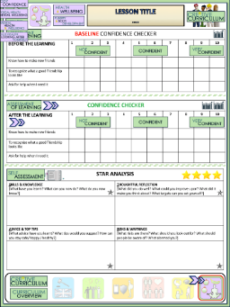
Green Careers & the economy
BASELINE CONFIDENCE CHECKER
BEFORE THE LEARNING | 1 | 2 | 3 | 4 | 5 | 6 | 7 | 8 | 9 | 10
I know what green careers are.
I can explain the effects of green careers on the national and global economy.
I understand how to prepare for green careers.
Complete a baseline assessment of where you think you are at for this lesson
(Discussion or complete sheet)
2 Minutes
I’m not confident at all
I’m getting more confidence
Confident
Very
confident
Super
confident
Notes:
TEACHER NOTES & IDEAS
This could be done by writing a number down in the books
Show of fingers in the air. /Red amber Green Cards
Quick Partner Discussion
Print off the Assessment Opportunity Sheet – Fill in the Baseline Confidence Checker

Slide 4
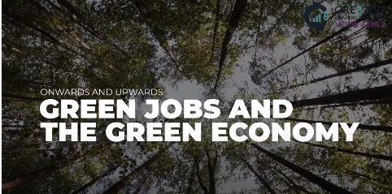
What are green careers?
As well as thinking about the green skills we need to create a sustainable future, we must also consider what careers will be helpful to building a greener future.
Watch this video to learn more about green careers:
2.5 Minutes
Green Jobs & the Green economy
TASK
8 Minutes
In partners, answer the four questions at the end of the video (pause at 2 mins 20 seconds). Write your answers down and be ready to share them with the read of the class.
Notes:
TEACHER NOTES & IDEAS

Slide 5
Myth vs Reality
Here are some common myths that we hear when discussing Green Careers:
TASK
10 Minutes
In your partners, discuss each of these statements and decide which you agree with and which you feel are incorrect.
If you feel they are incorrect, why? What is wrong about them? What do you think the reality might be?
Be read to discuss your answers with the class.
The Green Economy will result in new environmental industries.
The Green Economy will only create jobs in new industries, like green manufacturing.
Only professionals with highly technical expertise will be able to find jobs in the green economy.
Since some sectors in green economy go through rapid changes, green careers are high risk.
Notes:
TEACHER NOTES & IDEAS

Slide 6
Myth vs Reality
Here is the reality behind each statement…
The Green Economy will result in new environmental industries.
The green economy is the expansion of both new and existing environmental work. As part of the need for more people in green careers, professionals must combine environmental expertise with other skills, like business planning.
The Green Economy will only create jobs in new industries, like green manufacturing.
Only professionals with highly technical expertise will be able to find jobs in the green economy.
Since some sectors in green economy go through rapid changes, green careers are high risk.
Notes:
TEACHER NOTES & IDEAS

Slide 7
Myth vs Reality
Here is the reality behind each statement…
The Green Economy will result in new environmental industries.
The top 2 areas for new jobs in the green economy are actually established environmental industries:
Environmental protection
Resource conservation
Green careers will be important in all industries, from Fashion to Engineering to Business.
The Green Economy will only create jobs in new industries, like green manufacturing.
Only professionals with highly technical expertise will be able to find jobs in the green economy.
Since some sectors in green economy go through rapid changes, green careers are high risk.
Notes:
TEACHER NOTES & IDEAS

Slide 8
Myth vs Reality
Here is the reality behind each statement…
The Green Economy will result in new environmental industries.
Many green employers are looking for workers who can integrate environmental knowledge into a wider range of business areas.
In fact, the top two competencies' employers have said they’re looking for are corporate environmental program planning and technology/product development.
The Green Economy will only create jobs in new industries, like green manufacturing.
Only professionals with highly technical expertise will be able to find jobs in the green economy.
Since some sectors in green economy go through rapid changes, green careers are high risk.
Notes:
TEACHER NOTES & IDEAS

Slide 9
Myth vs Reality
Here is the reality behind each statement…
The Green Economy will result in new environmental industries.
Many jobs in the green economy require skills that are highly transferable across sectors.
Green professionals who have these skills can expect greater career resilience and flexibility than workers in other industries that are less quick to adapt and innovate.
The Green Economy will only create jobs in new industries, like green manufacturing.
Only professionals with highly technical expertise will be able to find jobs in the green economy.
Since some sectors in green economy go through rapid changes, green careers are high risk.
Notes:
TEACHER NOTES & IDEAS

Slide 10
What are the LMI predictions?
LMI stands for Labour Market Information. It gives us information about job roles now and in the future. For example, it tells us how much you can earn in each job, how many hours you might work and what industries are growing/declining.
As you can imagine, the Green industry is set to grow! Here are some key LMI facts…
By 2030, there could be 694,000 green jobs in the low-carbon and renewable energy sector across England, rising to more than 1.18m by 2050.
Research by the Institute for Public Policy Research suggests that more than 200,000 jobs could be created in energy efficiency by 2030, and 70,000 jobs in offshore wind alone as soon as 2023.
By 2035, new diesel, petrol and hybrid cars will no longer be sold in the UK. This means the people working in the automotive industry may need to retrain to keep their jobs.
Notes:
TEACHER NOTES & IDEAS

Slide 11
Why do Green Careers matter?
For people
We know these jobs are needed for our future. If we do not act now, there might not be a planet left to save!
People who do not consider green careers may be “left behind” as they won’t have the skills they need for the jobs that are available.
For businesses
The government are putting lots of resource into the movement to green careers. If companies do not amend their processes to suit, they risk going out of business.
For example, if a car company doesn’t make an electric vehicle, from 2030, they will have nothing to sell!
For the world
Our planet is dying. If we do not work towards a more sustainable society, we will not have anywhere to live.
Coral reefs, the sea, the air and the land are all suffering because of the human race.
Notes:
TEACHER NOTES & IDEAS

Slide 12
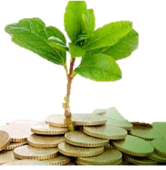
The impact on the economy
We have already established that the goal of green careers are to:
Increase efficient consumption of energy
Limit green house gas emissions
Minimise waste and contamination
Protect and restore ecosystems
Contribute to adaption to climate change
Another benefit of these green jobs is their effect on the global economy.
The International Labour Organisation has warned that, if nothing changes, growth in future employment will be insufficient to satisfy the growth in the workforce in emerging and developing countries.
However, the increase of green careers is set to create around 18 million jobs.
The more people who are working, the more taxes are being paid.
The more taxes that are paid, the more money our national economy has.
People having more money also means they spend more, which is also good for local economies.
Notes:
TEACHER NOTES & IDEAS

Slide 13
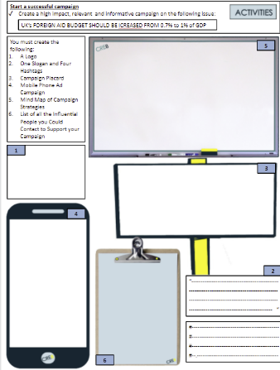
How can you prepare?
10 Minutes
Task
Use your worksheet to create a campaign that can be used in schools, on social media and through offline media such as posters to raise awareness of green careers and what people can do to prepare.
Consider what skills people need to build to be ready for green careers.
Using statistics, images and catchy slogans will help your campaign to get noticed and remembered by the public.
Notes:
TEACHER NOTES & IDEAS

Slide 14
Confidence Checker
AFTER THE LEARNING | 1 | 2 | 3 | 4 | 5 | 6 | 7 | 8 | 9 | 10
I know what green careers are.
I can explain the effects of green careers on the national and global economy.
I understand how to prepare for green careers.
Complete the confidence checker of where you think you are at for this lesson (Discussion or complete sheet)
3 Minutes
Notes:
TEACHER NOTES & IDEAS
This could be done by writing a number down in the books – Compare to the start of the lesson
Show of fingers in the air or use Red Amber Green Cards
Quick Partner Discussion & reflect on before the lesson and progress made
Print off the Assessment Opportunity Sheet – Fill in the Confidence Checker / Compare with the baseline
Author Attribution :https://pixabay.com/en/traffic-lights-traffic-light-phases-2147790/

Slide 15
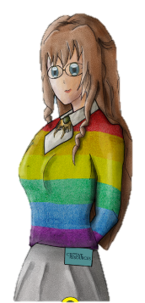
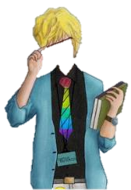
FOR MORE INFORMATION ABOUT THE TOPICS COVERED IN THIS UNIT WE WOULD ADVISE ONE OF THE BELOW: SPEAK TO YOUR PARENTS/GUARDIANS OR HEAD OF YEAR, TRUSTED ADULT OR FRIEND IF YOU HAVE ANY CONCERNS ABOUT YOURSELF OR SOMEONE YOU KNOW – IT IS ALWAYS IMPORTANT TO TELL SOMEONE!
Enjoy the lesson, Challenge your perceptions and understand how to seek further advice and support
SPECIFIC FURTHER INFORMATION ON THIS TOPIC CAN BE FOUND HERE:
https://www.bbc.co.uk/teach/nine-astonishing-ways-david-attenborough-shaped-your-world/z4k2kmn
https://www.bbc.co.uk/news/world-europe-49918719
https://www.unep.org/explore-topics/climate-action/facts-about-climate-emergency
https://www.climateemergency.uk/
2 Minutes
Notes:
TEACHER NOTES & IDEAS
Teachers should add in specific local signposting to charities, careers organisations / Connections or Careers officer at school. If RSE topics the local NHS services in their area
Add / adapt or remove any suggested sites.
Print this slide and leave on door notice board after the lesson

Slide 16
I know if I need further
support or help I could
speak to…. or contact…
Before I could/would say
and do ... but now I feel I
am able to say
Before I only knew ...
now I also know ...
I supported others by…
One thing I didn’t
realise was… now I know that…
The key words for
this lesson are…
I always knew ... but now
I can see how it connects to…
The most important thing I
have learnt today is…
I’m really proud of the
way I have…
I used to feel ...
but I now feel ..
One assumption of
mine that was
challenged was…
I would like to learn…
A question I
would like to
ask is…
Before I thought that ...
but now I realise..
Today I have tried to…
Next lesson I would like to..
Before I would have done…
Now I will …
Before I would have
said ... but now I will say…
2 Minutes
A problem I overcame
today was…
Notes:
TEACHER NOTES & IDEAS
: Have students pick either 1/2/3 tickets depending on their ability and tell a partner
Pick a few students at random to feedback to the class
As students leave the room have them tell you their reflection on the way out

