Slide 1
Physics A Level

Slide 2
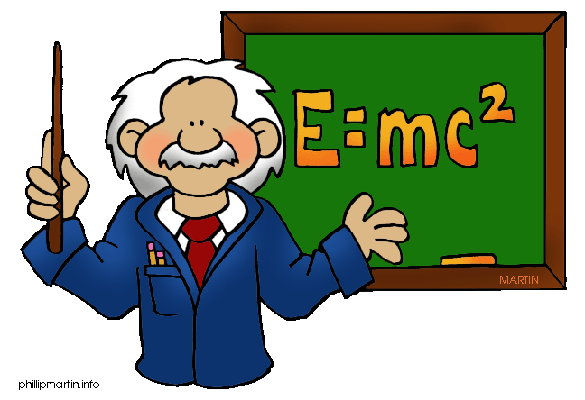
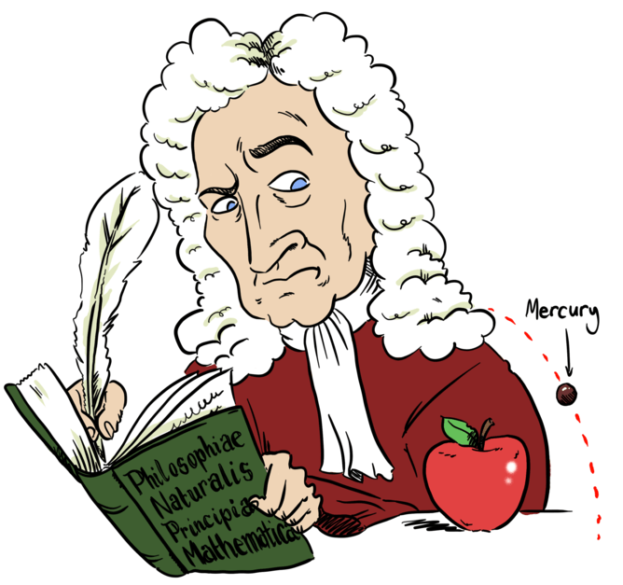
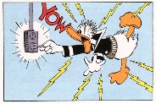
Why choose Physics at A-level?
Physics Makes Things Possible. Without physics there would be no:
You will need to use mathematical skills to model everything from the tiniest quark to the largest galaxies!
Cars | Aeroplanes | Fibre optics
Mobile phones | Digital cameras | Medical equipment
Solar cells | Space rockets | Computers
DVD players | Satellites | Flat screen TVs

Slide 3
Why choose Physics at A-level?
Physics OCR A has a content-led approach. A flexible approach where the specification is divided into topics, each covering different key concepts of physics.
As learners progress through the course they will build on their knowledge of the laws of Physics, applying their understanding to solve problems on topics ranging from sub-atomic particles to the entire universe.
The Practical Endorsement will also support the development of practical skills
CERN Trip!

Slide 4
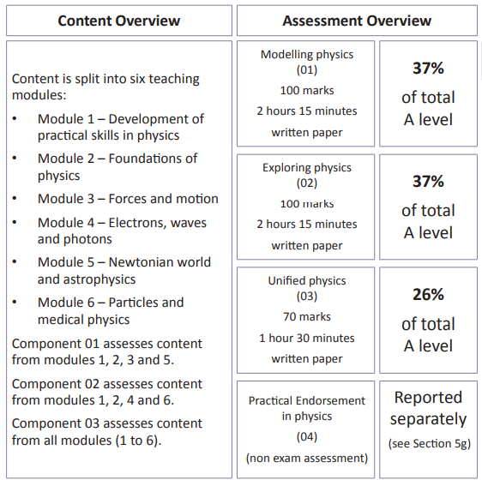
Structure of the course: Specification OCR A H556
pmann@bishopstopford.com
Head of Subject:
Dr Mann

Slide 5
Year 12:
Foundations of Physics
Physical quantities
Making measurements and analysing data
Nature of quantities

Slide 6
Year 12:
Forces and motion
Forces in action
Work, energy and power
Materials
Newton’s laws of motion and momentum

Slide 7
Year 12: Electrons, waves and photons
Charge and current
Energy, power and resistance
Electrical circuits
Waves
Quantum physics

Slide 8
Year 13: Newtonian world and astrophysics
Thermal physics
Circular motion
Oscillations
Gravitational fields
Astrophysics and cosmology

Slide 9
Year 13: Particles and Medical physics
Capacitors
Electric fields
Electromagnetism
Nuclear and particle physics
Medical imaging

Slide 10
Years 12 and 13:
Practical Endorsement
Relates to the practical skills learners are expected to gain throughout the course, which are assessed throughout the written examinations and also through the Practical Endorsement.
Practical activities are embedded within the learning outcomes of the course to encourage practical activities in the classroom which contribute to the achievement of the Practical Endorsement

Slide 11
Methods of study
Reading text books and online articles
Note taking in class and from books
Discussions
Presentations
Practical work in class
Exam analysis
Trips

Slide 12
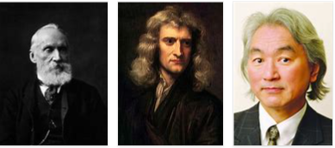
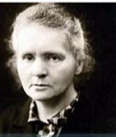
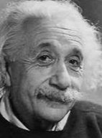
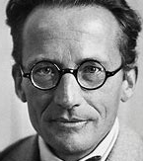
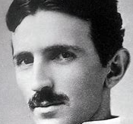
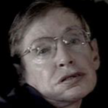
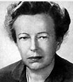
Future career options
Aeronautical engineering to architecture, from medical imaging to inventing new technology or new materials. Not only that, geologists, meteorologists, music producers, doctors and pilots all need a solid understanding of physics.
Can you name these famous physicists?

Slide 13
Entry Requirements
Grade 6 or above in GCSE Physics or Trilogy
AND Grade 6 or above in GCSE Maths

Slide 14
