Slide 1
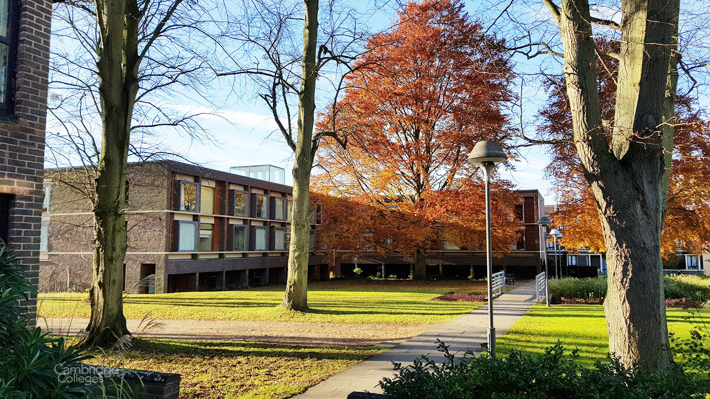
Applying to Cambridge: What You Should Know
Emily Betts, Bishop Stopford 2016-2023

Slide 2
What do I need to apply?
A passion for your subject that goes beyond the classroom or institution.
Solid predicted grades.
You need to genuinely, personally want to.
Confidence!

Slide 3
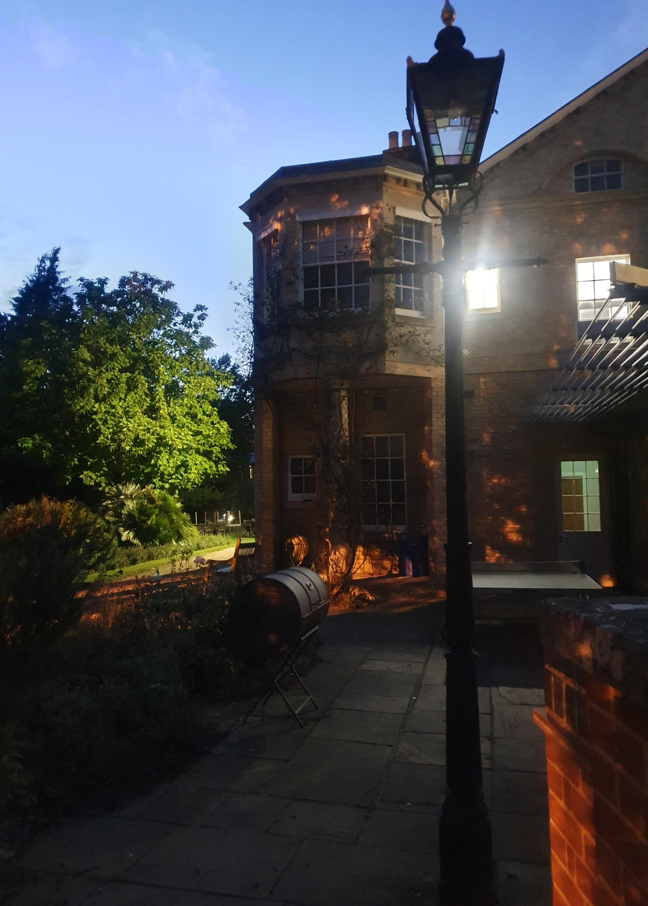
Where should I apply?
There is no STEM and no Humanities university.
However, you should be aware that different universities offer different degrees and different routes through them.
Degrees may also differ by college!
Picking a college:
Accommodation & Facilities
Size, architecture, location
Worth looking at endowment/financial support
Visit!

Slide 4
What Now?
Find out about admissions assessments.
Go to some open days if possible.
Apply before 15th October.
Interview, if successful.
Hear back in January.

Slide 5
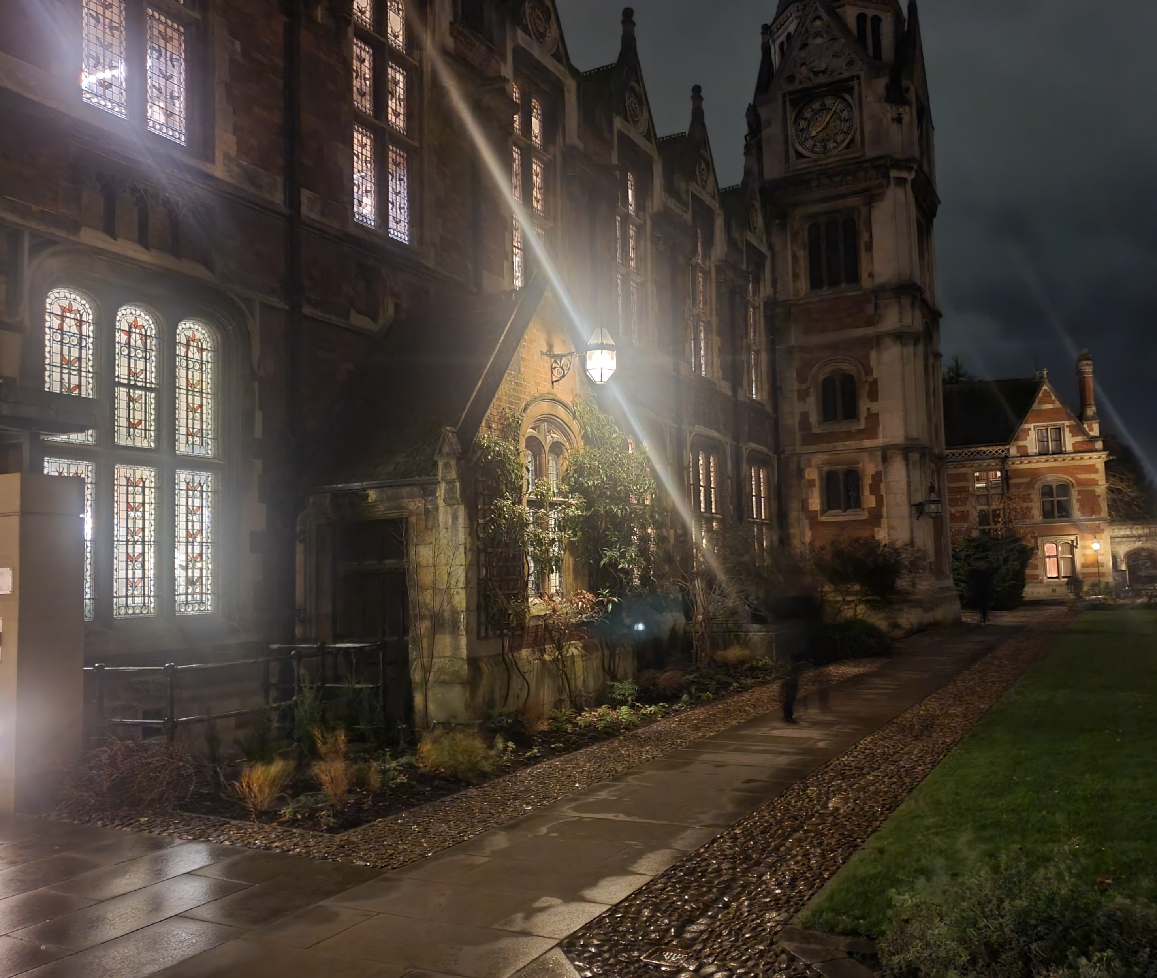
Personal Statements
Yes, people do read this. Please take care over it.
Supracurriculars.
Extracurriculars.
Work at it over time.

Slide 6
Interview Advice
Dress in a way that will make you feel comfortable and confident.
Practise.
Know your course.
Read around, and if you have mentioned anything in your personal statement make sure you can talk about it.
Expect pre-reading, especially for humanities subjects, but be prepared for them to surprise you.
Breathe.
It doesn’t all hinge on one interview.

Slide 7
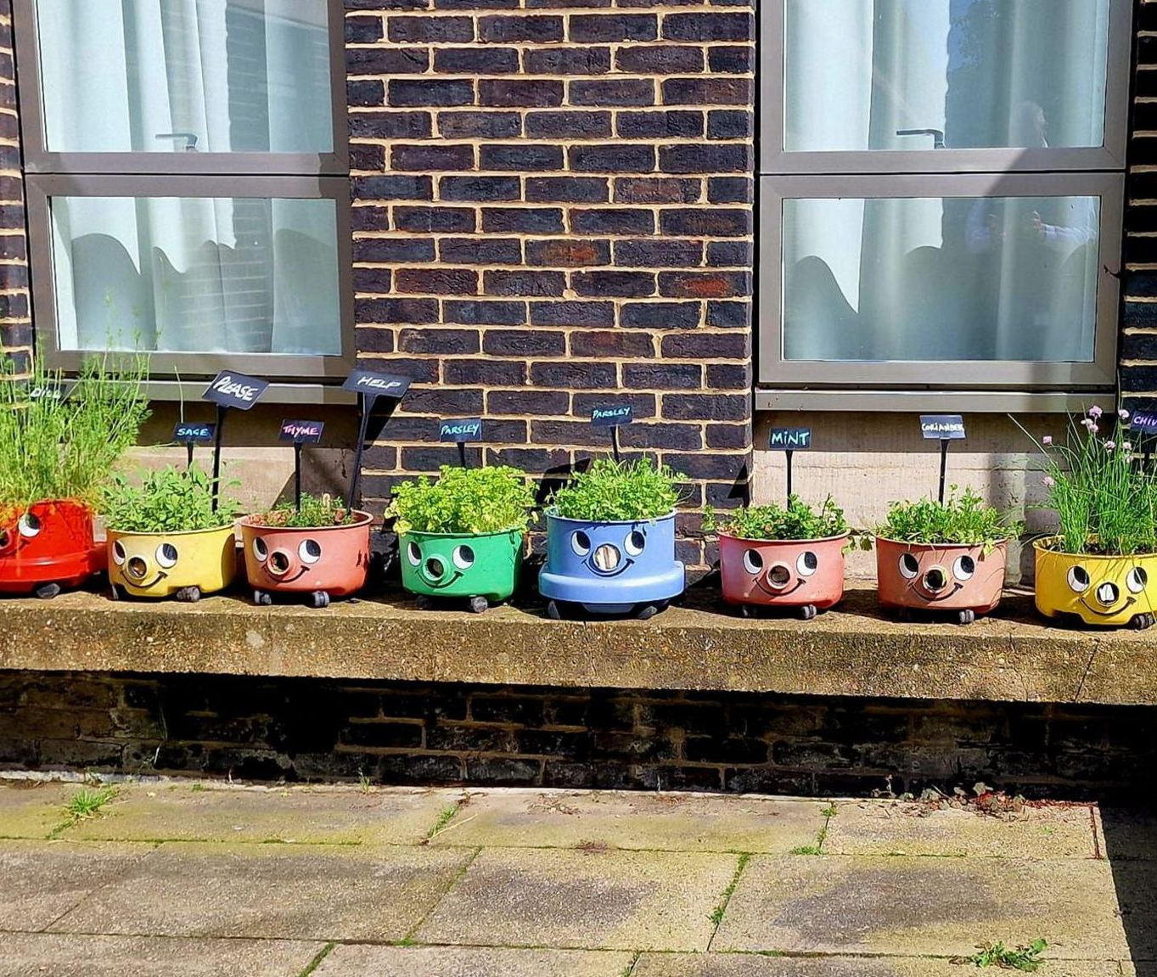
General Tips
Be a student they want to teach.
Don’t be afraid to be yourself, even if that self is a little odd or over-enthusiastic.
Know your goals, know your resources and know your deadlines.

Slide 8
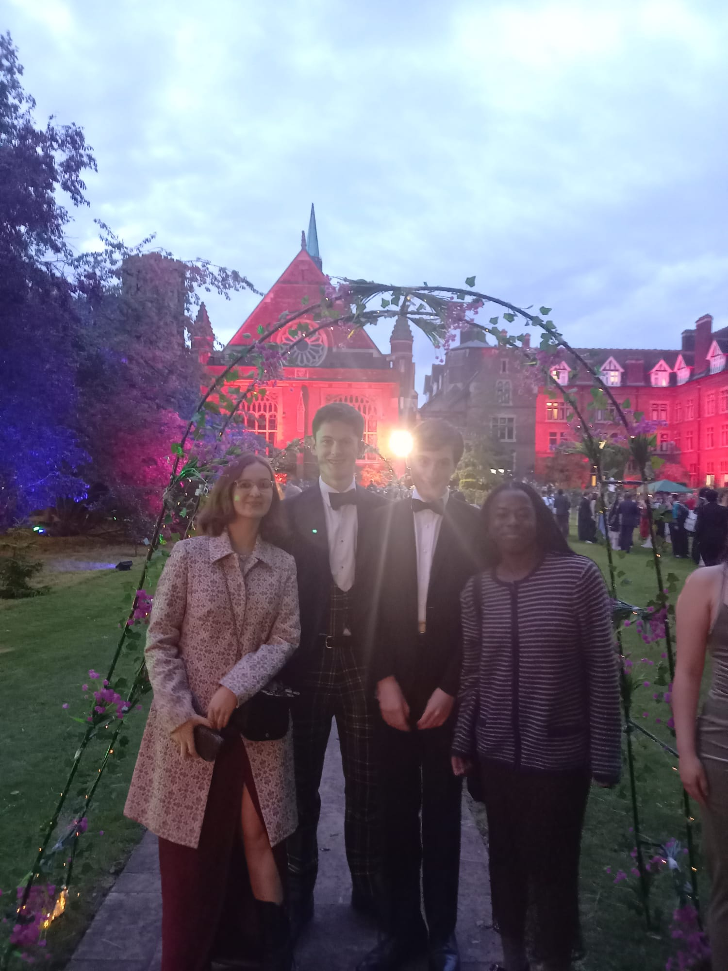
Questions!
Colleges, my degree, college life, societies, academic pressure, questions about the admissions process… anything you like, really!

