Slide 1
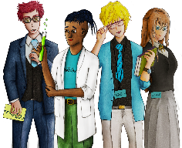
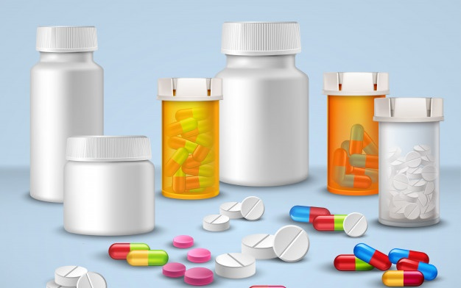
Exploring drugs through a documentary of real life short stories
Copy
title
Knowledge, Skills & Actions
To understand the impact drugs can have on the individual, their family and friends
To explore real life stories of those mixed up with drugs
To evaluate what support networks are available to help those at risk of abusing drugs
3 Minutes
Think of an illegal drug
Do you know any street names for this drug?
Do you know the legal status of the drug?
Do you know any risks associated with the drug? Do you know how the drug is taken?
New Vocabulary
Inhalants, Huffing, VSA, Crystal Meth, Heroin, Alcohol, Ecstasy, Spice, Marijuana
Tasks

Slide 2
All drugs can be divided up according to the main effect they have on users.
Stimulants
These are painkillers and include heroin, opium, pethidine and codeine. They make users less sensitive to emotion and physical pain and produce feelings of warmth and contentment.
A
They relax you, making you feel less tense and anxious, but at the same time impair mental and physical activity and decrease self-control These include minor tranquillisers such as Valium, Librium, solvents, glues, aerosols and gases
Depressants
B
Analgesics
These include cannabis, LSD and magic mushrooms. Hallucinogens act on the mind, heightening sensations and distorting the way users see and hear things.
C
Users generally feel more confident and alert, are able to stay awake for longer and can perform physical tasks for a longer period of time. High doses can cause nervousness and anxiety. Examples include caffeine, tobacco amphetamines, anabolic steroids, ‘poppers (ecstasy), cocaine and crack
Hallucinogens
D
TASK
Match up the definitions with the categories
CHALLENGE
Which category would alcohol fit into and why?
What is volatile substance abuse?

Slide 3
Click to be taken to this part of the documentary The class would like to focus on.
SELECTION SLIDE
INTRODUCTION
CRYSTAL-METH
HEROIN
Each section is around 8 minutes
ALCOHOL
ECSTASY
CANNABIS
A BAD TRIP
PRESCRIPTION DRUGS
SYNTHETIC DRUGS
CRACK
INHALENTS

Slide 4
BACK TO SELECTION
“In the long term you
will hurt yourself
and all of those
around you”
8 Minutes
Truth About Drugs Documentary: Introduction
Play video
Review
Discussion
Task
Video Review Questions
Why do people do drugs?
How are drugs used as a coping mechanism?
Why should people say no to drugs?
What is addiction?
How are drugs glamourized by the media and movies?
Is education the best weapon we have against the war on drugs?

Slide 5
BACK TO SELECTION
BACK TO SELECTION
“In the long run it can
hurt your body and kill
your brain cells.”
8 Minutes
Truth About Drugs Documentary: Inhalants
Play video
INHALENTS
Review
Discussion
Task
Video Review Questions
Why are Inhalants so addictive?
What substances do people abuse?
What are the effects of inhaling substances?
Why are inhalants some of the most dangerous drugs?
What are the long-term effects of inhalants?
“Inhalants (Volatile Substance Abuse) unlike other drugs you don’t build up a tolerance – you eventually die”.
Should inhalants be seen as dangerous as Class A drugs?

Slide 6
BACK TO SELECTION
“Once you start and get
going there is no
stopping it.”
8 Minutes
Truth About Drugs Documentary: Crystal-Meth
Play video
CRYSTAL-METH
Review
Video Review Questions
What is Crystal-Meth? How is it used?
Why is it so addictive?
What are the effects of ingesting this drug?
Why are the dangerous consequences of using this drug?
What are the long term effects of this drug?
Why do people choose to use this drug?
Discussion
Task
Is Crystal Meth the most dangerous drug in the world?

Slide 7
BACK TO SELECTION
“I woke up and didn’t know how
I got there and I was just about dead and homeless with nowhere to go and I didn’t care about anything.
I just wanted more
of the dug”
8 Minutes
Truth About Drugs Documentary: Heroin
Play video
HEROIN
Review
Video Review Questions
What is Heroin? Where does it come from?
How is Heroin taken?
What are the effects of ingesting this drug?
Why are the dangerous consequences of using this drug?
What are the long term effects of this drug?
Why are the withdrawal symptoms of using this drug? (Appearance)
Discussion
Task
Is Heroin the most dangerous drug in the world?

Slide 8
BACK TO SELECTION
“It probably took 20 years of my life and I can’t get them back.”
8 Minutes
Truth About Drugs Documentary: Alcohol
Play video
ALCOHOL
Review
Video Review Questions
What is Alcohol? How is it made?
Why is it so addictive? Why is it legal?
What are the effects of ingesting Alcohol?
Why are the dangerous consequences of abusing alcohol?
What are the long term effects of this drug?
Why do people choose to use this drug?
What is binge Drinking? Alcohol poisoning?
Discussion
Task
Should Alcohol be made illegal in the UK?

Slide 9
BACK TO SELECTION
“Some people think that because a doctor gives you drugs that makes them safe.”
8 Minutes
Truth About Drugs Documentary: Prescription Drugs
Play video
PRESCRIPTION DRUGS
Review
Video Review Questions
What is a prescription drug?
What are the four categories of drugs?
Why do people misunderstand the dangers of prescription drugs?
Why are the dangerous consequences of using this drug?
What are the long-term effects of this abuse?
Why do people take these kinds of drugs?
Discussion
Task
Should doctors give out less prescription drugs?

Slide 10
BACK TO SELECTION
“I’ve seen people take a pill and seen them taken away in an ambulance. You never know what you are taking.”
8 Minutes
Truth About Drugs Documentary: Ecstasy
Play video
ECSTASY
Review
Video Review Questions
What is Ecstasy? What is it made of?
Why is it so addictive?
What are the effects of ingesting this drug?
Why are the dangerous consequences of using this drug?
What are the long-term effects of this drug?
Why do people choose to use this drug?
How can we tackle the wide spread abuse of this drug?
Discussion
Task
How can nightclubs and festivals do more to stop people taking drugs?

Slide 11
BACK TO SELECTION
“These are drugs made in a lab out in China. There are 200-300 designer drugs. You never know what kind of trip you will have”
8 Minutes
Play video
Synthetic Drugs & Effects - The Truth About Synthetic Drugs Including Spice
SYNTHETIC DRUGS
Review
Video Review Questions
What is a synthetic drug? Why are they so popular?
What are the effects of ingesting this drug?
Why are the dangerous consequences of using this drug?
What are the long term effects of this drug?
How does dependency on this drug impact your friends and family?
How are drugs transported from producer to user?
Discussion
Task
How can Governments tackle these new synthetic drugs?

Slide 12
BACK TO SELECTION
“They said synthetic drugs would give me a safe high. They lied!”
1 Minute
Truth About Drugs Documentary: A Bad Trip
Play video
A BAD TRIP
Review
Video Review Questions
What is a hallucination?
Which drugs cause hallucinations?
Why can a bad trip have serious dangerous consequences?
What are the long term effects of a bad trip? (Psychosis)
Why do people choose to get high and have a trip?
How can we tackle the wide spread abuse of this drug?
Discussion
Task
Why do people turn to drugs as a way of coping with their own problems?

Slide 13
BACK TO SELECTION
“I’ve seen people take a pill and seen them taken away in an ambulance. You never know what you are taking.”
8 Minutes
Truth About Drugs Documentary:
Play video
ECSTASY
Review
Video Review Questions
What is Ecstasy? What is it made of?
Why is it so addictive?
What are the effects of ingesting this drug?
Why are the dangerous consequences of using this drug?
What are the long-term effects of this drug?
Why do people choose to use this drug?
How can we tackle the wide spread abuse of this drug?
Discussion
Task
How can night clubs and festivals do more to stop people taking drugs?

Slide 14
BACK TO SELECTION
“Some people think that because a doctor gives you drugs that makes them safe.”
8 Minutes
Truth About Drugs Documentary: Marijuana
Play video
CANNABIS
Review
Video Review Questions
What are the nick names for Cannabis?
Why is Cannabis a popular drug?
Why do people misunderstand the dangers of cannabis use?
What are the dangerous consequences of using this drug?
What are the short and long term effects of cannabis use?
Discussion
Task
Should Cannabis be made illegal in every country?

Slide 15
BACK TO SELECTION
“It gets its name from the sound it makes when you smoke it. It’s 80% to 100% more pure than cocaine”
8 Minutes
Truth About Drugs Documentary: Crack (Refined From of Cocaine)
Play video
CRACK
Review
Video Review Questions
What is Crack? What names does it take?
How will it ruin your life?
What are the effects of ingesting this drug?
Why are the dangerous consequences of using this drug?
What are the long-term effects of this drug?
Why do people choose to use this drug?
What different forms can it take?
Discussion
Task
How can nightclubs and festivals do more to stop people taking drugs?

Slide 16
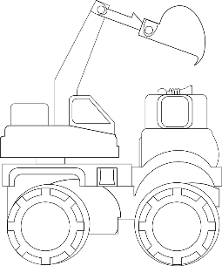
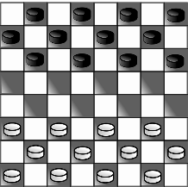
WHAT DO YOU THINK?
Talking points
I think that …
I don’t think… is right because…
My opinion is…
I would argue the same because…
I disagree with… because
Building on what ….
An alternate way of looking at this is…
I sort of agree, however….
In my view…
I would challenge what… said because …
“The war on drugs will never be won with force alone”
?
AGREE
ALTERNATE IDEA
DEVELOP
Disagree
Challenge
Alternative
Idea/option
DISAGREE
Develop
CHALLENGE
Notes:
TEACHER NOTES & IDEAS
Ask students what they think of this image (collection of images)
Reveal the talking points after some discussion time
To provoke discussion with a quiet class – play devils advocate
Challenge a student to a debate

Slide 17
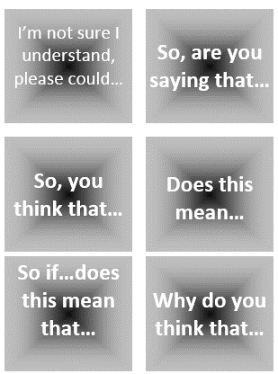
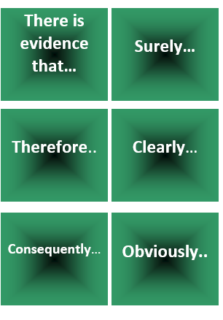
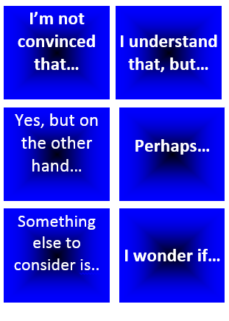
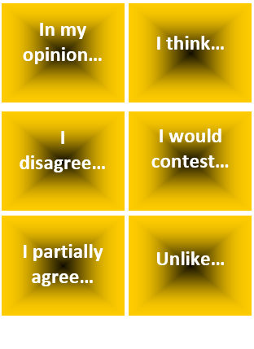
“Substance addiction is the biggest problem facing young the world in 2020”
Start with this card….
Or these cards….
Task 1: Discuss / Debate with your partner your own personal views towards this statement /idea
Extension: Can you think of specific examples of recent events that would support this statement and other specific examples that would go against this statement?
Discussion task
2-3 Minutes
Notes:
TEACHER NOTES & IDEAS
Pair student sup and have them use the sentence starter prompts on the board to help them (each colour represents a different set of prompts E.G Challenge, agree, build upon etc)
-Arrange for two confident students (or two pairs of students) to come to the front and have a debate challenge off with a timer
-Challenge a student to debate you (allow them to pick whether they will argue for the statement or against it)

Slide 18
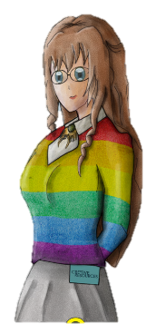
FOR MORE INFORMATION ABOUT THE TOPICS COVERED IN THIS UNIT WE WOULD ADVISE ONE OF THE BELOW: SPEAK TO YOUR PARENTS/GUARDIANS OR HEAD OF YEAR, TRUSTED ADULT OR FRIEND IF YOU HAVE ANY CONCERNS ABOUT YOURSELF OR SOMEONE YOU KNOW – IT IS ALWAYS IMPORTANT TO TELL SOMEONE! SUBMIT ANNONYMOUS QUESTION TO https://riseabove.org.uk/wall/
Enjoy the lesson, Challenge your perceptions and understand how to seek further advice and support
SPECIFIC FURTHER INFORMATION ON THIS TOPIC CAN BE FOUND HERE:
https://kidshealth.org/en/teens/drug-alcohol/
https://www.talktofrank.com
https://www.childline.org.uk/info-advice/you-your-body/drugs-alcohol-smoking/drugs/
https://www.nhs.uk/live-well/healthy-body/the-effects-of-drugs/
2 Minutes
Notes:
TEACHER NOTES & IDEAS
Teachers should add in specific local signposting to charities, organizations or local NHS services in their area
Add / adapt or remove any suggested sites.
Print this slide and leave on door notice board after the lesson

Slide 19
I know if I need further
support or help I could
speak to…. or contact…
Before I could/would say
and do ... but now I feel I
am able to say
Before I only knew ...
now I also know ...
I supported others by…
One thing I didn’t
realise was… now I know that…
The key words for
this lesson are…
I always knew ... but now
I can see how it connects to…
The most important thing I
have learnt today is…
I’m really proud of the
way I have…
I used to feel ...
but I now feel ..
One assumption of
mine that was
challenged was…
I would like to learn…
A question I
would like to
ask is…
Before I thought that ...
but now I realise..
Today I have tried to…
Next lesson I would like to..
Before I would have done…
Now I will …
Before I would have
said ... but now I will say…
2 Minutes
A problem I overcame
today was…
Notes:
TEACHER NOTES & IDEAS
: Have students pick either 1/2/3 tickets depending on their ability and tell a partner
Pick a few students at random to feedback to the class
As students leave the room have them tell you their reflection on the way out

