Slide 1
Further Mathematics A Level

Slide 2
Why choose Further Maths at A-level?
A-Level Further Mathematics opens doors to many future University and career options.
It will prepare you for the study of Mathematics at University and also subjects such as Physics and Engineering.
Previous students have gone onto Computer Science, Architecture and Economics courses and careers.
It is a well respected A-level due to its challenging nature and its ability to improve your problem solving and reasoning skills.
It will introduce you to areas of mathematics beyond the A-level Maths curriculum such as hyperbolic functions and complex numbers which help describe the word around us.

Slide 3
Structure of the course
Specification: Edexcel 9FM0
Year 12/13:
Compulsory units (50%)
Core Pure 1 25%
Core Pure 2 25%
Optional units (50%)
Further Pure 1 25%
Further Mechanics 1 25%

Slide 4
Structure of the course
Specification: Edexcel 9FM0
Exams in Year 13
There are exams in each of the four units:
Core Pure 1
Core Pure 2
Further Pure 1
Further Mechanics 1
Each exam is 1 hour 30 minutes long and worth 75 marks.
Head of Subject: Mr Ready sready@bishopstopford.com

Slide 5
Core Pure Mathematics
Students will study:
Complex numbers
Matrices
Series
Hyperbolic functions
Roots of polynomials
Vectors
Differential equations
Polar coordinates
Methods in calculus
Proof

Slide 6
Further Pure 1
Students will study:
Conic sections
Inequalities
The t-formulae
Methods in calculus
Taylor series
Numerical methods
Reducible differential equations
Vectors

Slide 7
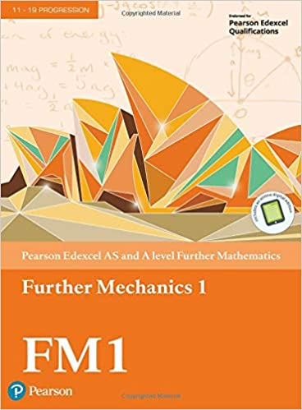
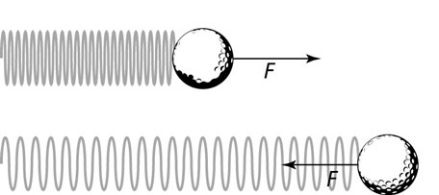
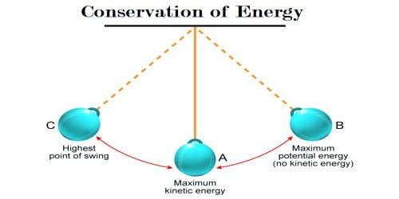
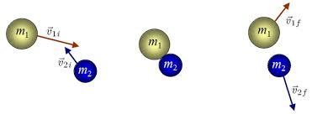
Further Mechanics 1
Students will study the:
Modelling of collisions in one and two dimensions
Application of finding work, energy and power in different situations
Use of Hooke’s Law in relation to the modelling of springs and strings

Slide 8
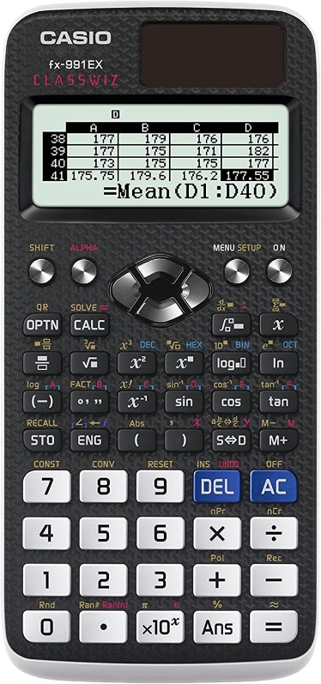
Calculators
Calculators will be allowed in all exams and the ability to use them for more sophisticated calculations will be tested.
We require students to purchase the Casio fx-991EX Classwiz.
Click the picture for an amazon link.
We will make an order when back in school,
however you may wish to order this now to start
getting used to it.

Slide 9
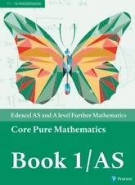
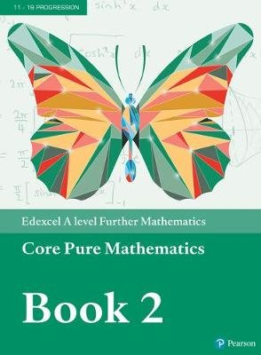
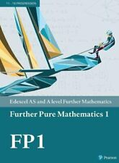
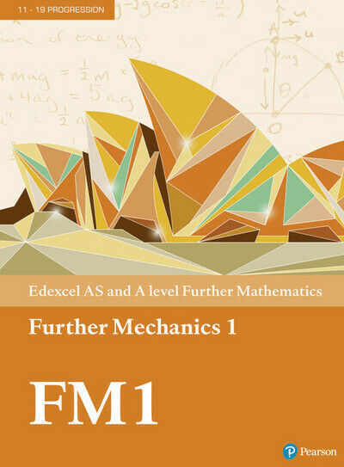
Textbooks
Students will be expected to purchase their own textbooks which should be brought to every lesson.
We will make an order when back in school, however you may wish to order these now (click on each picture for an amazon link).
We use all the textbooks in Year 12, so we expect students to purchase all 4.

Slide 10
Methods of study
Worked examples
Formula sheet
Practice
More practice!
Consolidation
Past exam questions
Assessments
Maths Help

Slide 11
Future career options
Further Mathematics A-Level is widely respected and develops skills required by many different subjects.
Being able to apply logic and reasoning is a sought after employability skill, which has its roots firmly in mathematics.
Accountancy, finance, business, economics, engineering, research all require able mathematicians.

Slide 12
Entry Requirements
Grade 9 at GCSE Mathematics
(Students who wish to study the course with a grade 8 may be considered but this will be done on an individual basis)

Slide 13
“The highest form of pure thought is in Mathematics"
Plato

