Slide 1
Spanish A Level

Slide 2
Why choose Spanish at A-level?
Choosing A-level Spanish is a wise decision if you want a fascinating subject that offers you a range of career possibilities at the end and is a lot of fun along the way. A-level Spanish is interesting and varied and gives you a broad range of knowledge and skills.
A-level Spanish builds upon your existing knowledge gained at GCSE and is stimulating, challenging and rewarding. It gives you the skills required to become global citizens of the 21st century.
In our course, we investigate technological and social change. You will study highlights of Hispanic artistic culture, including a focus on Spanish regional identity and the cultural heritage of past civilisations as well as exploring the influence of the past on present-day Spanish-speaking communities. Throughout your studies, you will learn the language in the context of Spanish-speaking countries and the issues and influences which have shaped them.
Through this variety of topics you will develop the skills of speaking, listening, reading , writing and translation. New grammar is learnt and existing grammatical knowledge is revisited and revised. Transferable skills are applied as we study a book and a film and learn how to write an analytical essay in Spanish.
But most importantly we hope to encourage you to fall in love with learning Spanish!
.

Slide 3
Structure of the course
Specification: AQA 7691
Year 12
El ciberespacio
Monarquías y dictaduras
El patrimonio cultural
Jóvenes de hoy, ciudadanos de mañana
La igualdad de los derechos
La influencia de los ídolos
Play- »La casa de Bernarda Alba » by
Federico García Lorca
Film- »El Laberinto del Fauno »
Head of Faculty-Mrs Rogers jrogers@bishopstopford.com
Year 13
Los valores tradicionales y modernos
La identidad regional en España
El racismo
La convivencia y la integración
Movimientos sociales
La inmigración

Slide 4
Paper 1 (50%) Listening, reading and writing
For this paper you will
practice listening and responding to spoken passages from a range of contents and sources.
practice reading and responding to a variety of
texts drawn from a range of authentic sources.
practice translating from Spanish to English and English to Spanish.

Slide 5
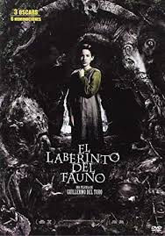
Paper 2 (20%) Writing
You will study the play “La casa de Bernarda Alba” by Federico Garcia Lorca and the film “El Laberinto del Fauno”
In the 2 hour exam you will write an essay in Spanish(approximately 350 words) on both of these.

Slide 6
Paper 3 (30%):Speaking
Speaking will naturally be an essential part of your studies. You will research, present and discuss all the sub-themes as we progress through the course.
In the speaking exam you will have a discussion on one of the sub-themes based on a stimulus card.
The second part of the exam is your Individual Research Project, where you will present and discuss a topic of your choice related to Spain or the Spanish speaking world.

Slide 7
Methods of study
Reading
Listening
Discussions
Presentations
Grammar practice
Translation
Essay writing
Research

Slide 8
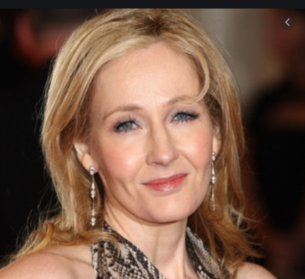
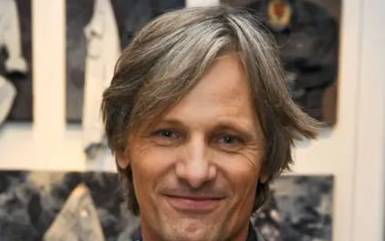
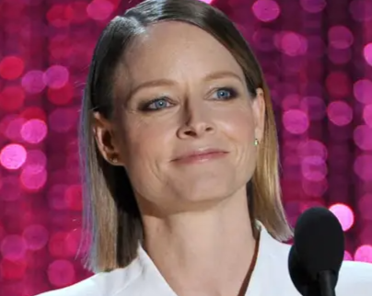
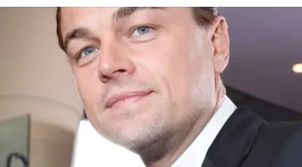
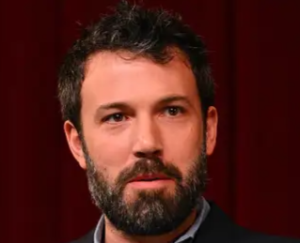
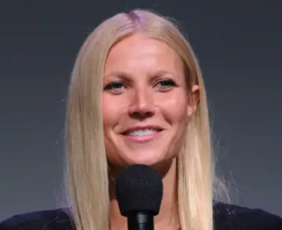
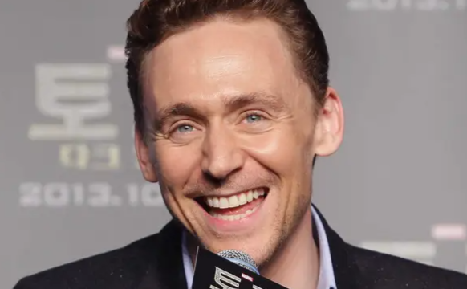
Future career options
With the globalisation of industry and commerce, graduates with a good command of modern languages are sought after for numerous roles in a variety of organisations and sectors.
Careers where language skills are the primary focus are those of interpreter (spoken word), translator (written word) and teacher/lecturer, specifically in secondary education or above, and teaching English as a second language in the UK or abroad.
Alternative career options include the travel industry, working overseas or in the UK, retail buying, logistics and distribution, where goods or equipment are moved across international borders. The government's diplomatic service is often a target for modern languages graduates.
All of these famous faces speak at least one other language fluently.

Slide 9
Entry Requirements
6 or above in GCSE Spanish

