Slide 1
The A-Level Mindset
How to be successful at A levels

Slide 2
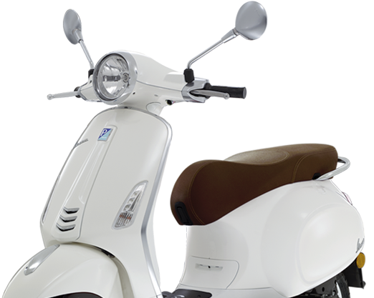
VESPA is the key to success at A Level
Having a Vision
Commitment to the Effort
Having Systems
Practice
Positive Mental Attitude
All of these can be practiced and learned and we will help and support you with this.
Bishop

Slide 3
Effort – how much hard work you do. Commitment to the Effort.
Notes:
You have decided to come into the 6th Form at Bishop Stopford School. Why? Speed dating. You will have 30 seconds to answer the question that appears and then you must listen while you ‘date’ answers the next question.

Slide 4
Remember - You need to be proactive not reactive!
Completing tasks set be teachers only forms a small part of a successful student's private study.
Private study is more about setting yourself work.

Slide 5
BSS28 Year 12 Videos –
Habit Changers
Resources Search Results | Net Sixth Form

Slide 6
Planning your Effort
Use the handout or electronic copy that has been sent to you to fill in the following:
School day - timetabled lessons, assemblies, driving lesson and any other commitments.
Evenings – what regular commitments do you have?
Weekends – what regular commitments do you have?
Even with all this on you should still have plenty of time to fit in the 15 hours of study a week you need to do. You need to plan when you are doing it and make it a habit.
Record that you have done it.

Slide 7
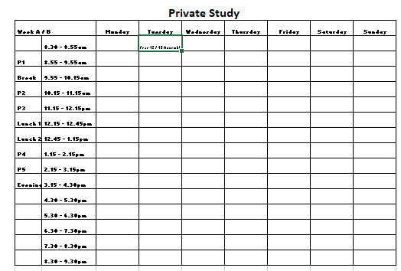
Plan your Private Study

