Slide 1
AQA A level Drama and theatre
TASTER SESSION june 2022

Slide 2
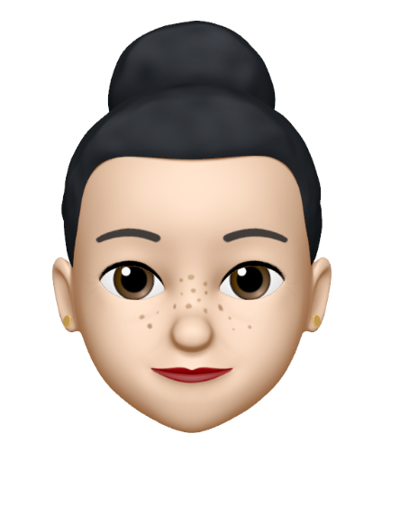
DRAMA DEPARTMENT AT BISHOP STOPFORD
Mrs fraser (head of department ) mrs Bamford (drama teacher)
33 years experience
NEW VIEWS PROJECT / YEAR 12 DRAMA CLUB / WHOLE SCHOOL PRODUCTION / READING WITH YEAR 7
efraser@bishopstopford.com jbamford@bishopstopford.com

Slide 3
COMPONENT 1: WRITTEN EXAM (40%)

Slide 4
COMPONENT 2: CREATING ORIGINAL DRAMA (30%) - DEVISING

Slide 5
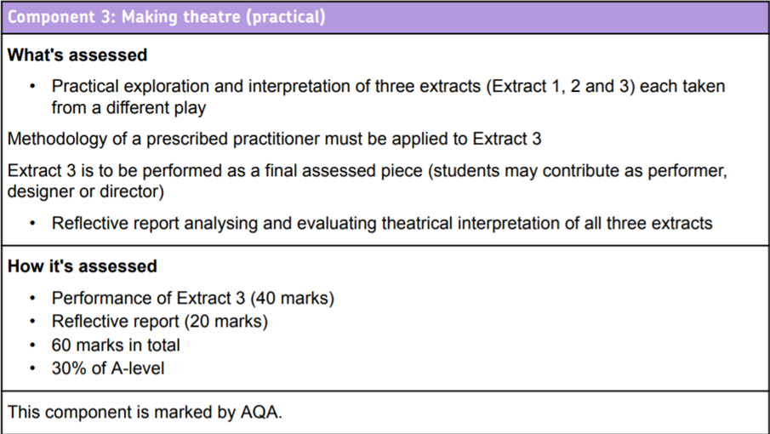
COMPONENT 3: MAKING THEATRE (30%) - SCRIPTED

Slide 6
FIREFLY – RESOURCES – SCHOOL INFORMATION – SIXTH FORM
https://bishopstopford.fireflycloud.net/sixth-form/year-11---looking-ahead/theatre-studies
https://bishopstopford.fireflycloud.net/sixth-form/year-11-into-12-induction-summer-2021

Slide 7
TAKE A COUPLE OF MINUTE TO THNK ABOUT THE FOLLOWING QUESTIONS:
What is the purpose of theatre?
How might A level Drama and Theatre be different to GCSE Drama?
What kind of attributes would somebody need to study Drama and Theatre?

Slide 8
A passion for performance (as an actor or designer)
An interest in the history of theatre – where it is coming from and where it is going to.
An interest in the function of theatre.
An interest in going to see live theatre.
An interest in reading plays and learning about their context.
A skill for communicating through writing.
The confidence to share ideas and lead a group.

Slide 9
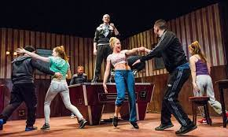
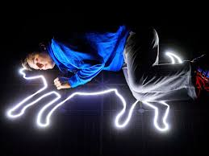
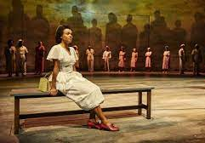
What is the best performance or moment from a performance that you have seen and why?
Notes:
HYPERLINKS EMBEDDED IN THE PHOTOS

Slide 10
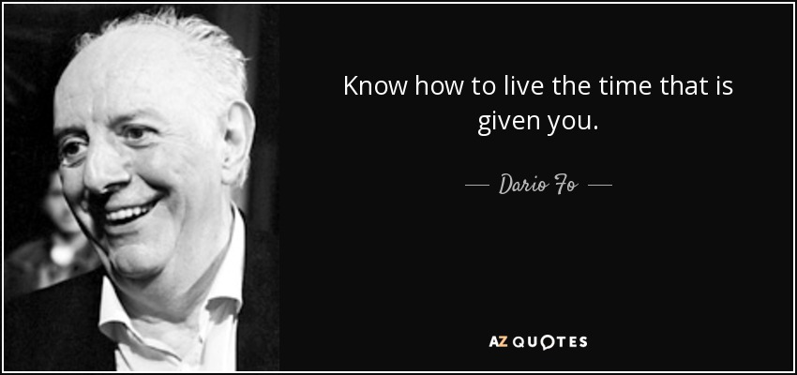
Accidental Death of an Anarchist
Culturally, I have always been part of the proletariat. I lived side by side with the sons of glassblowers, fishermen and smugglers. The stories they told were shaper satires about the hypocrisy of authority and the middle classes, the two-facedness of teachers and lawyers and politicians. I was born politicized.
Dario Fo
How do you think Fo can use theatre to achieve his intentions above?

Slide 11
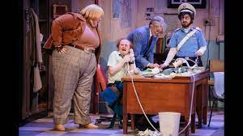
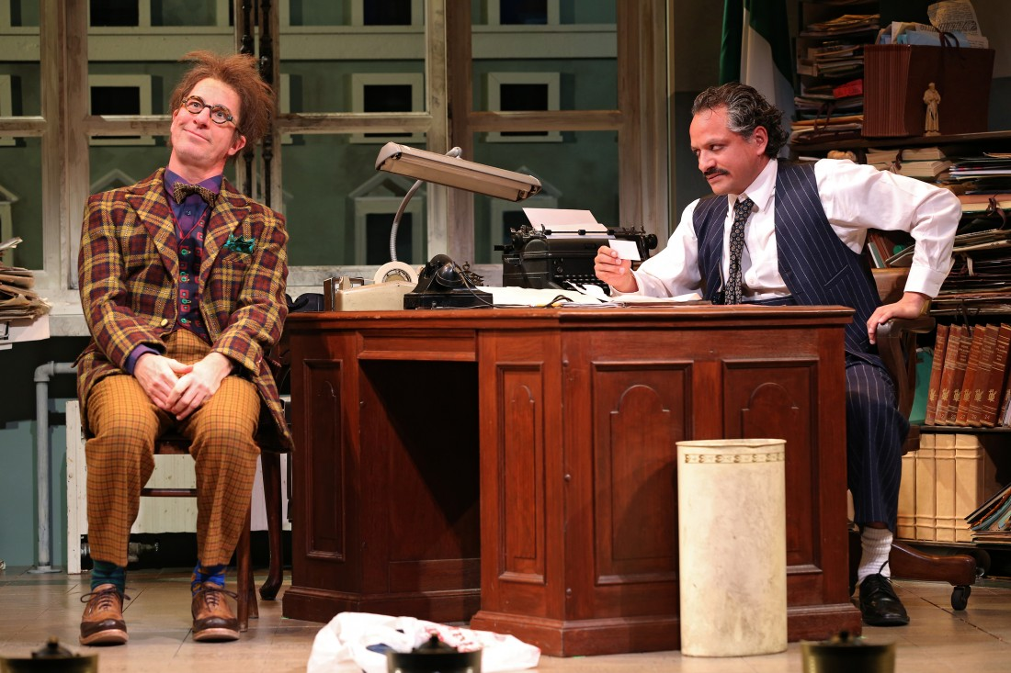
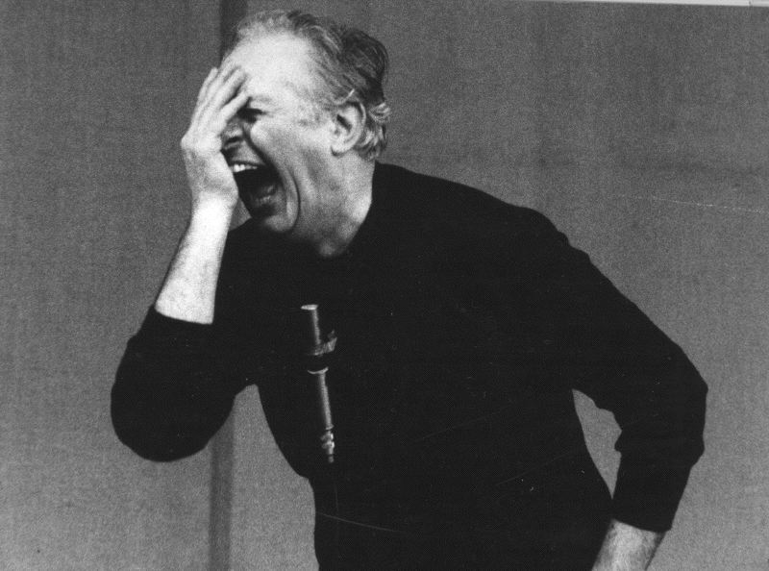
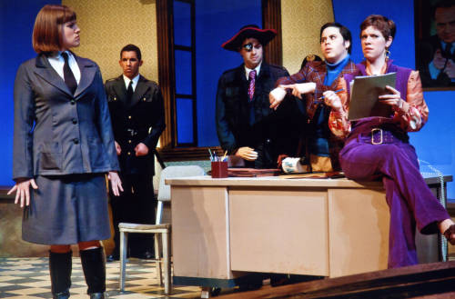
He was deeply affected by the Pinelli scandal in 1969
He writes of his time, in the 1970’s but his material is still relevant today.
SHE WRITES ABOUT A TRUE STORY in allegorical form– USING THEATRE to progress his own political message:
AS An education about the corruption of the police
TO give the middle left side of the political story
TO foster a theatrical culture of questions, where people should trust their governments.

Slide 12
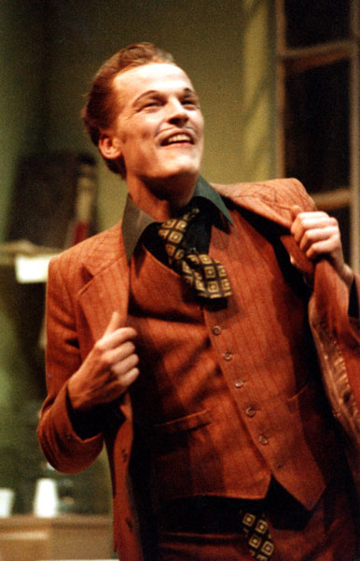
Accidental Death of an Anarchist is a farcical parody of a pretend investigation into the pinelli scandal of 1969 – where a wrongly accused railway worker (pinelli) was defenestrated (thrown out a window) during police questioning. Fo highlights police and political corruption through his use of a ‘Maniac’ at his main character
The Maniac is a somewhat omniscient character. His purpose is to be the catalyst for Fo. In the original production, the Maniac was played by Fo himself, based on his famous character Mistero Buffo. This character has little in the way of a moral compass, and spends his time attempting to thwart the authority – though we have no good reason why. Let’s look at his first major monologue.

Slide 13
In small groups, of 2-3 consider the first speech.
This comes after a small, very farcical, silly exchange between a corrupt police officer (Bertozzo) and the Maniac, where we are introduced to a man who seems to go through his life impersonating other people. He has been arrested and questioned about this, but after a hilarious chase scene, Bertozzo and a constable are late for a meeting, literally chuck the Maniac out, and leave the office.
This is him re entering, on his own, with the wonderful use of both audience direct address, monologue, and the unheard phone character to establish this zany comical character based on Arlechio of Commedia Dell Arte.
Work together, think about use of the space, the application of the silly, farcical character, how to distinguish this character as ‘different’ from the norm – consider use of levels, proxemics, interaction with the audience etc.

Slide 14
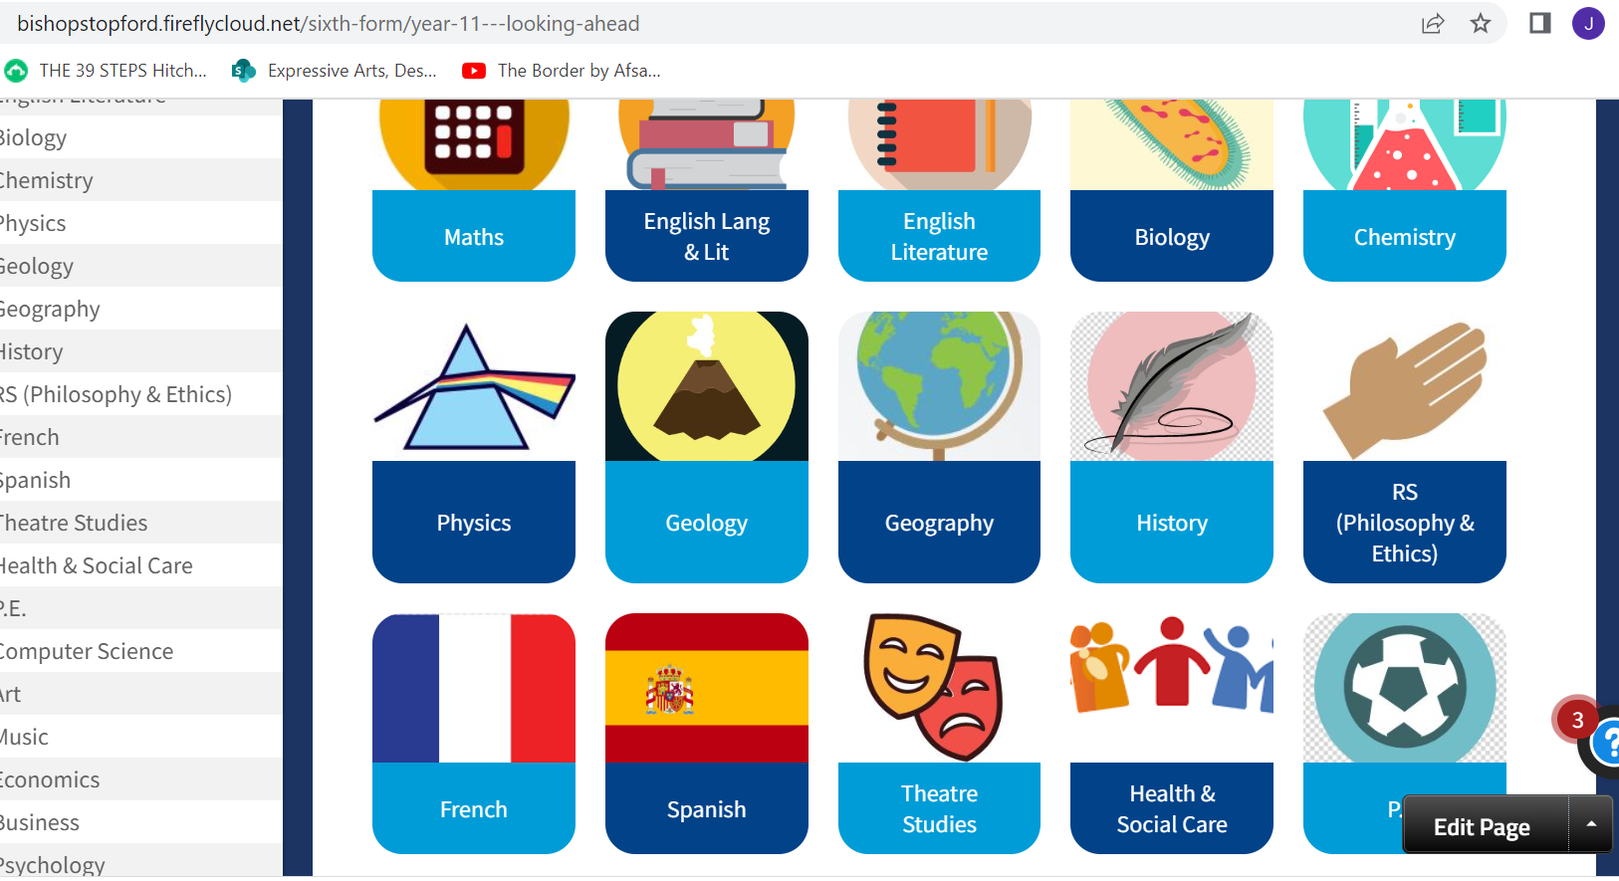
FIREFLY – RESOURCES – SCHOOL INFORMATION – SIXTH FORM
Right here:
https://bishopstopford.fireflycloud.net/sixth-form/year-11---looking-ahead/theatre-studies

