Slide 1
A Parent’s guide to GCSEPod

Slide 2
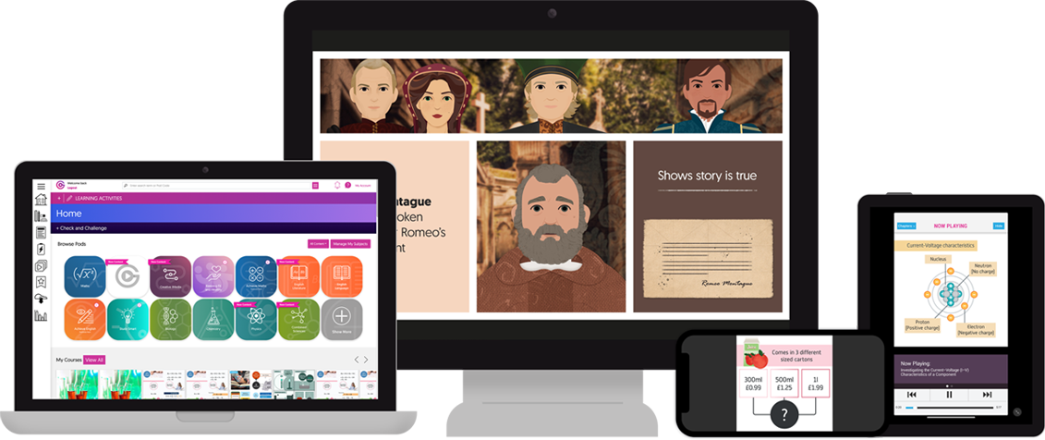
r Introduction
What is GCSEPod?
10 years experience as an award
winning educational publisher
3-5
minute
‘Pods’
28+
subjects
Easy
to use
Available for all, even Year 7 and 13
Mapped to the curriculum
Available on all platforms
1 in 3 secondary schools in the UK subscribe
In use across 40+ countries
“The Netflix of GCSE Content”

Slide 3
Teacher Introduction
GCSEPod Global Stats
v
v
57.9M
Pods watched
17.4M
Pods watched
All time
In the last
academic
year

Slide 4
Teacher Introduction
GCSEPod’s Content
Written by subject experts
Produced in-house
Exam board mapped
Rigorously quality assured

Slide 5
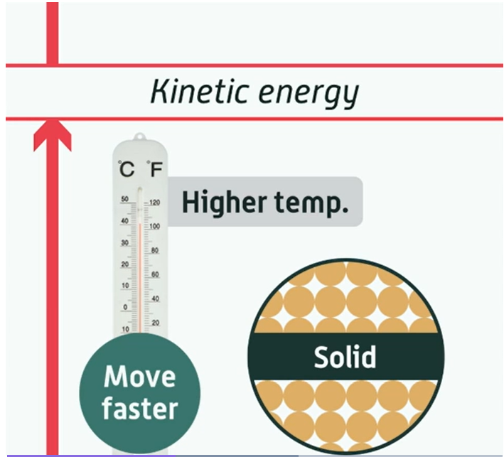
Pods – the content your child will access and use
Pods are 3-5 minute videos designed to keep your child engaged. They have audio and visual content that is mapped their exam board.
This is an example of a combined science Pod displaying information on kinetic energy.

Slide 6
GCSEPod covers a broad range of subjects
The subjects are filtered on your child’s account to what they study and their exam boards

Slide 7
Teacher Introduction
Homework
Assessment
Revision
Independent learning
Prep for their next lesson
Examples of how GCSEPod may be used

Slide 8
Teacher Introduction
Check and Challenge – The independent learning tool.
Allows your child to test their knowledge after watching a Pod
Provides scaffolded support like a teacher would
1-2-1
Helps identify misconception in knowledge and prepare for exams
Get hints, win diamonds and watch their progress improve
To find what subjects have Check and Challenge available simply go to ‘All content’ on the home page and select Check and challenge.

Slide 9
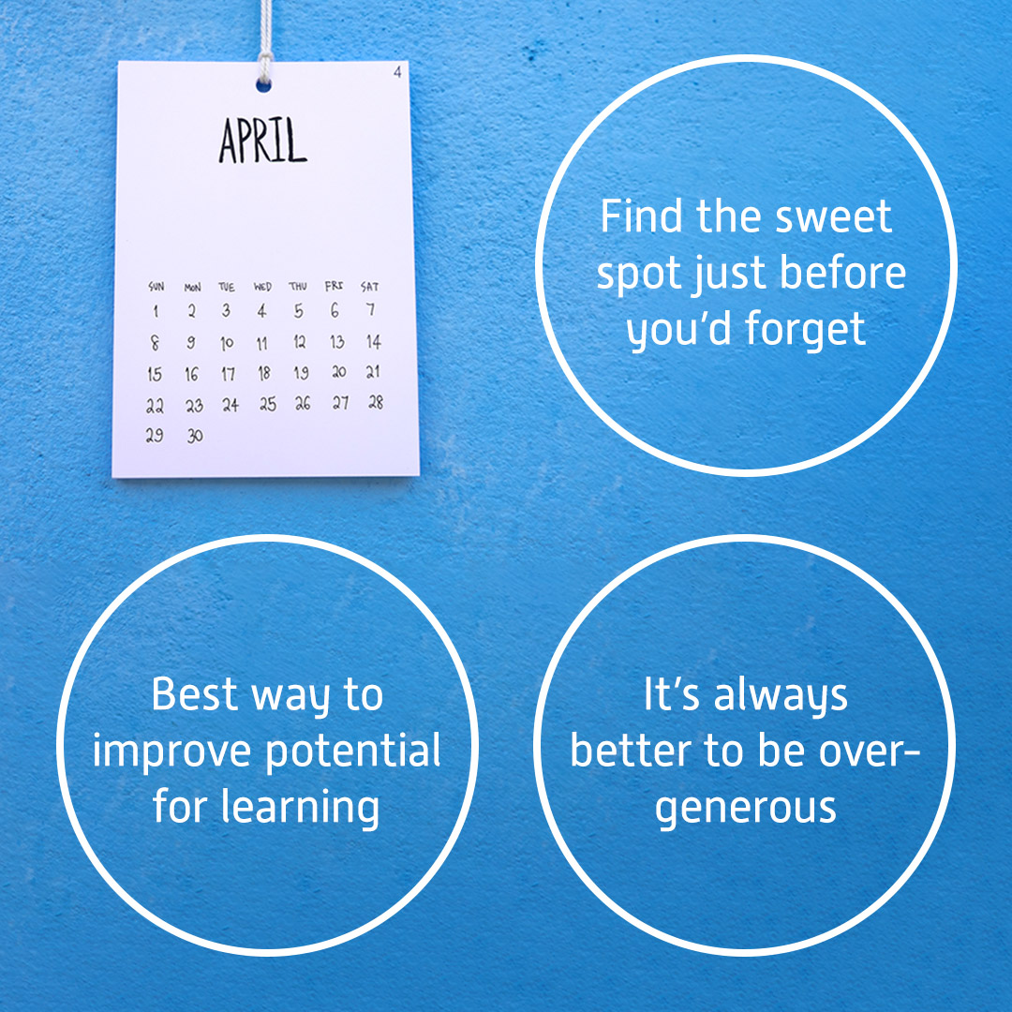
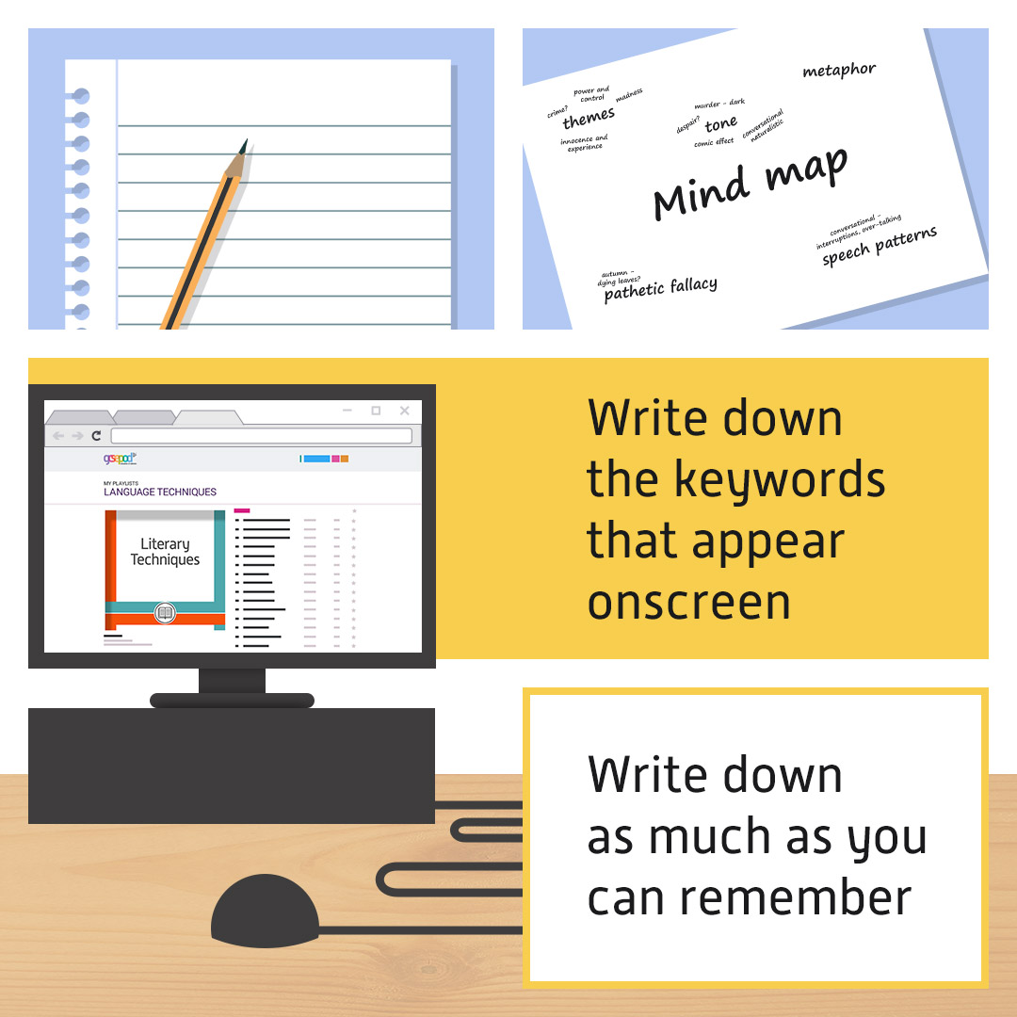
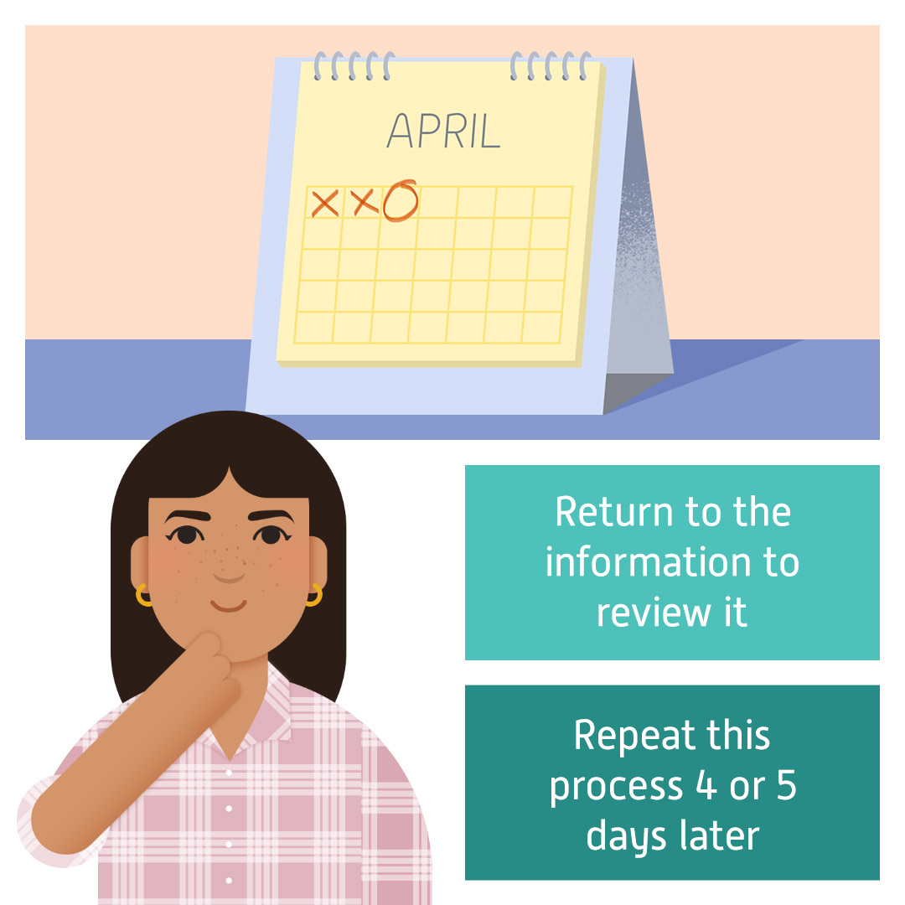
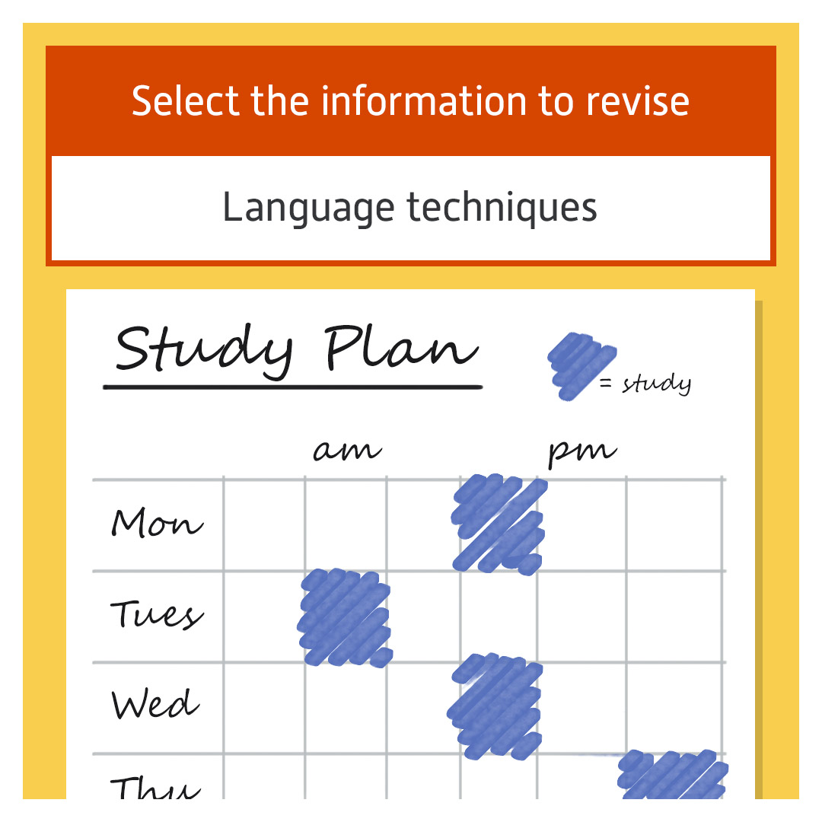
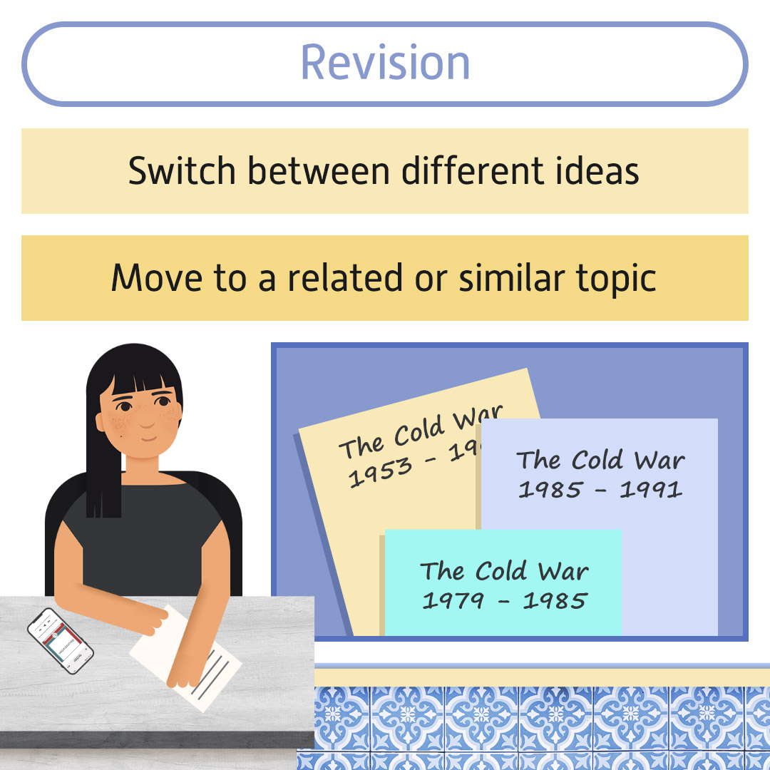
Teacher Introduction
Study smart
Study Smart Pods
help you and your child
learn how to learn smarter
The Pods look at the theory behind the science and helps to identify new methods of learning and revision

Slide 10
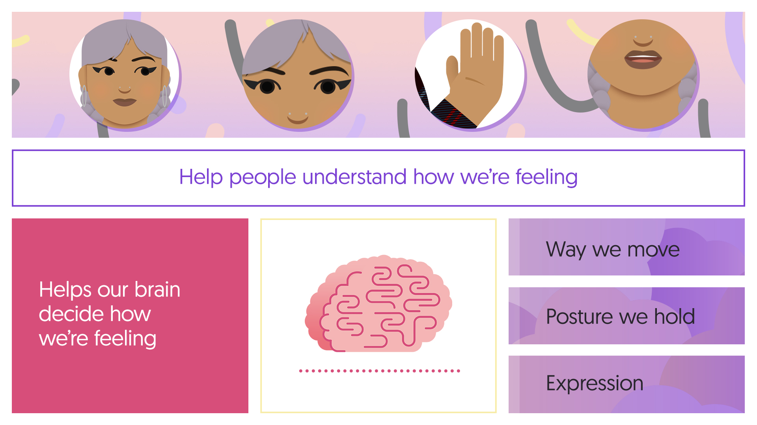
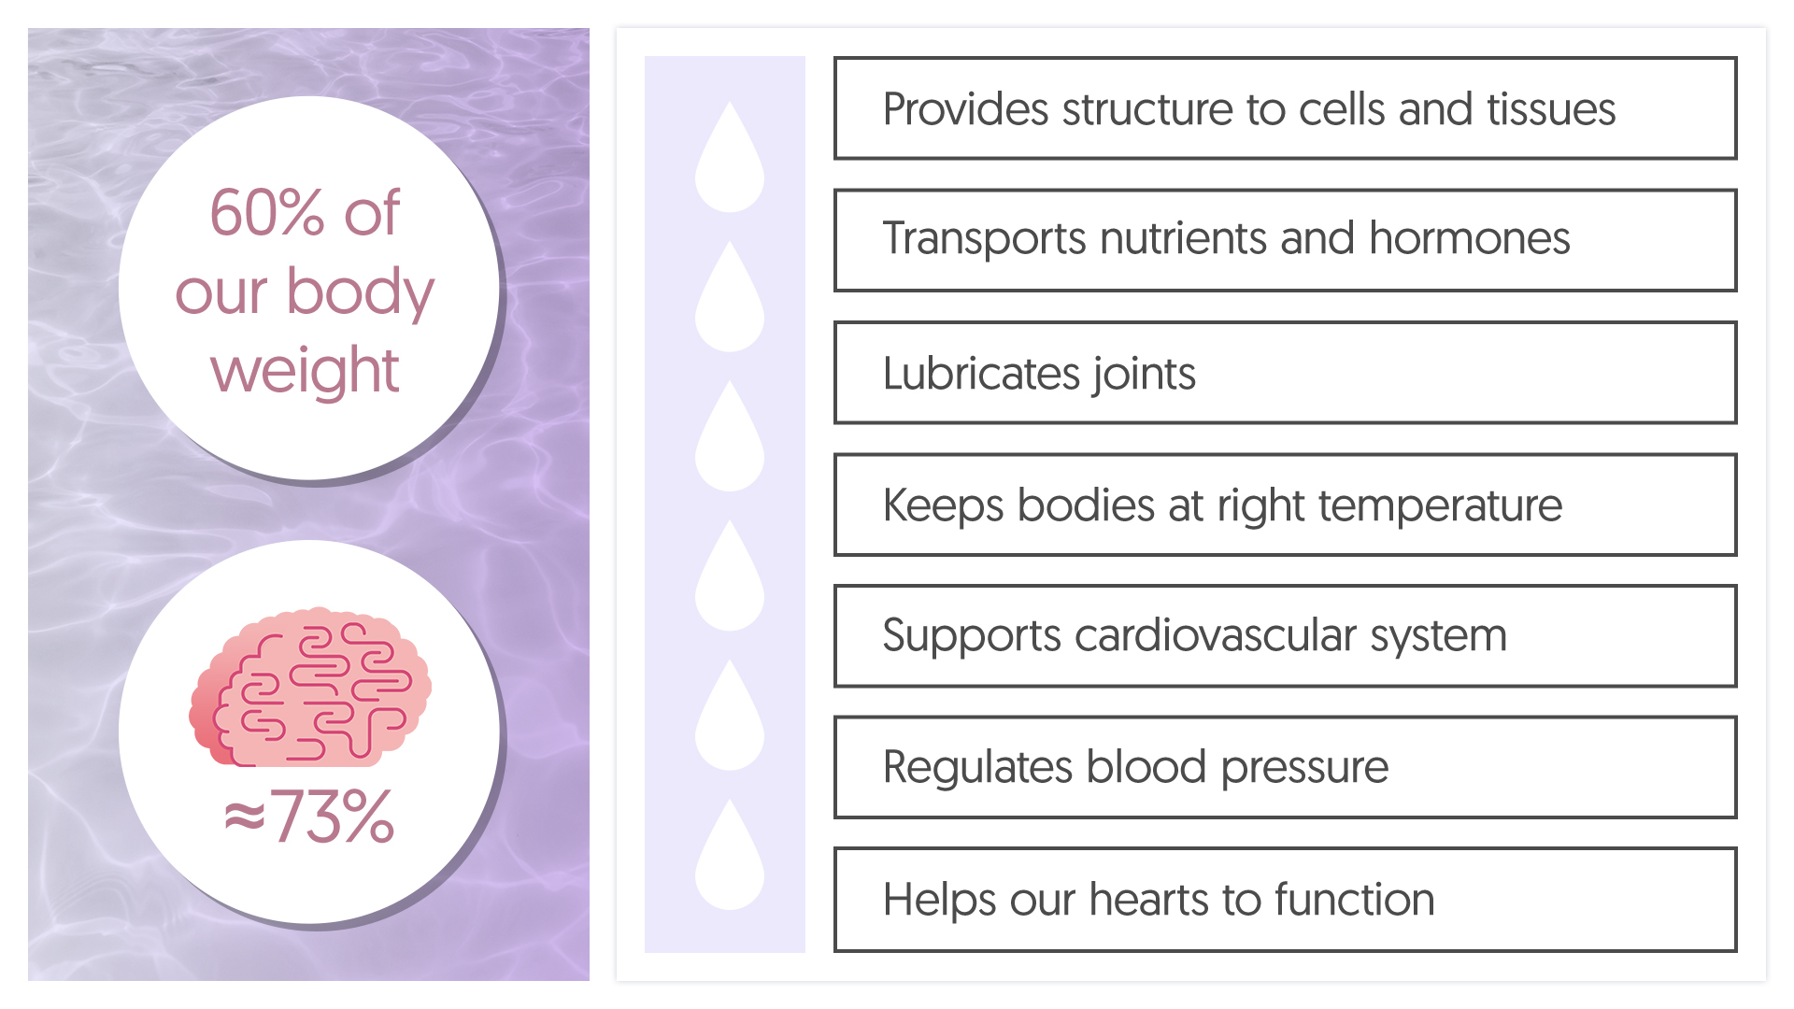
Teacher Introduction
Keeping fit and healthy
Keeping Fit & Healthy Pods are ideal to watch together and focus around techniques to cope with stress and the importance of a good night’s sleep

Slide 11
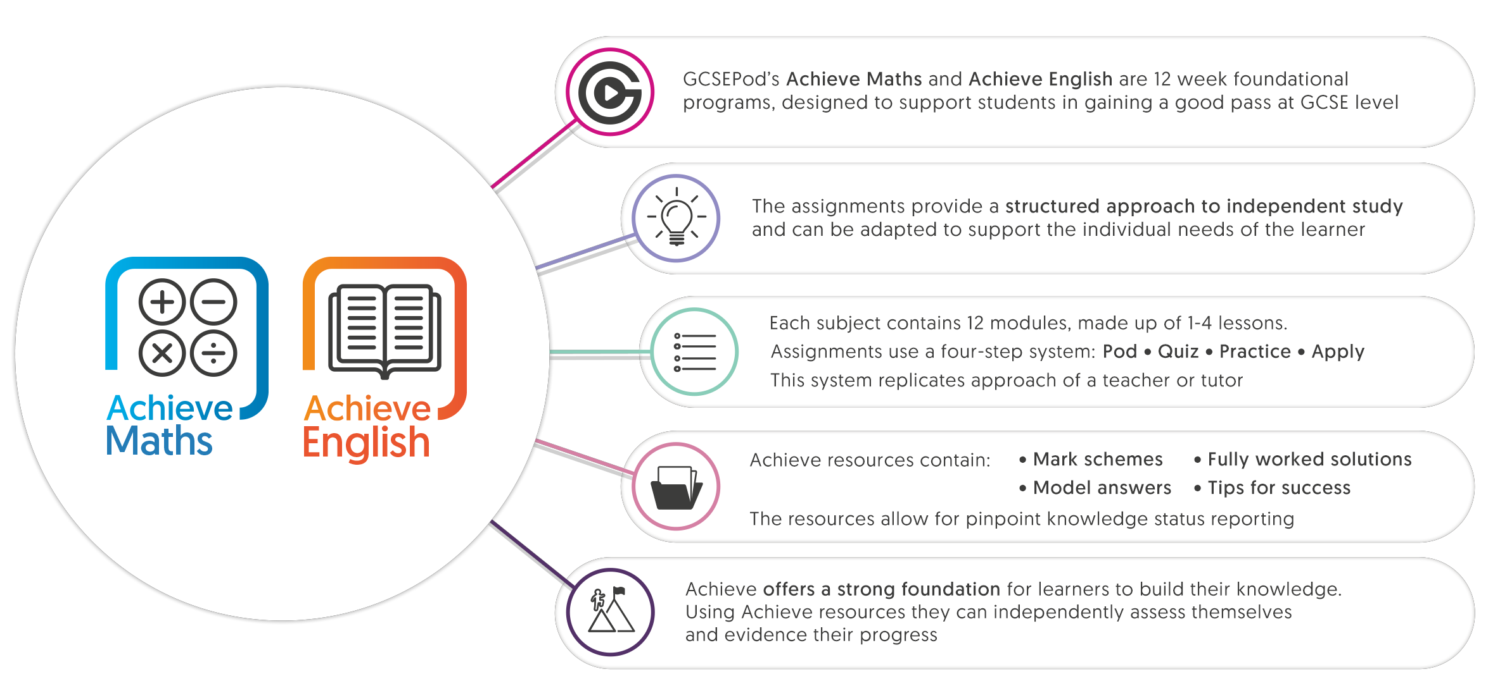
Teacher Introduction
Is your child striving for a grade 4/5 or in KS3?

Slide 12
Teacher Introduction
Why it works!
Year 11 Impact Analysis
On average, regular users of GCSEPod achieved
On average,
the highest users achieved
Regular users of GCSEPod
achieve, on average
0.7
20
1
more
Progress 8
points than
non-users
Attainment
8 points
more than
non-users
grade
higher per
subject than
non-users

Slide 13
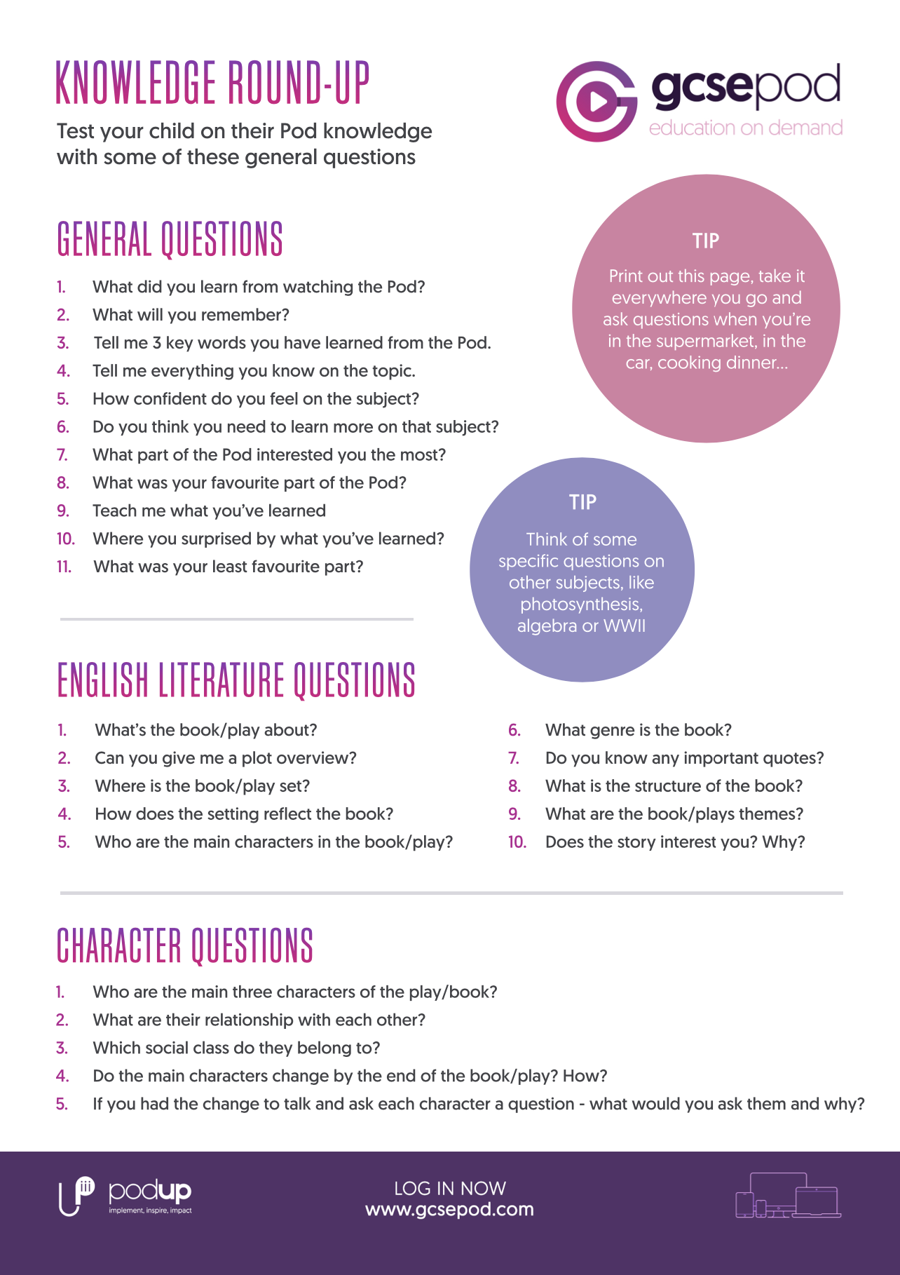
Teacher Introduction
Want to know more?
Visit www.gcsepod.com/parents to find out more and get exclusive access to additional resources that will help you support your child
Register on one of our free
parent/carers webinars to find out more
www.gcsepod.com/podup-presents-webinars/

