Slide 1
AQA - A LEVEL DRAMA AND THEATRE FOUNDATION LEARNING: PRACTITIONERS
In preparation for the A Level Drama and Theatre Course, I would like you to create a Fact file on each of the following Practitioners. You will be drawing upon the theories and work of each of these practitioners during the course. Mr and Mrs Giddings have added some fantastic resources for some of the practitioners on Firefly.
Antonin Artaud - Early 20th century - Theatre of Cruelty
Steven Berkoff - Contemporary Expressionism/Physical Theatre
Bertolt Brecht - Early 20th century - Political/epic theatre
Peter Brook - Contemporary Wide spectrum of approaches
Dario Fo & Franca Rame - Contemporary Political/comic theatre
Frantic Assembly - Contemporary Physical theatre
Kneehigh Theatre - Contemporary Multi-disciplined/storytelling/physical theatre
Punchdrunk - Contemporary Immersive theatre
Max Stafford-Clark - Contemporary Political/ensemble theatre
Konstantin Stanislavski - Late 19th, early 20th century Naturalism → Katie Mitchell

Slide 2
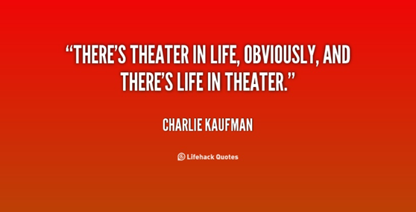
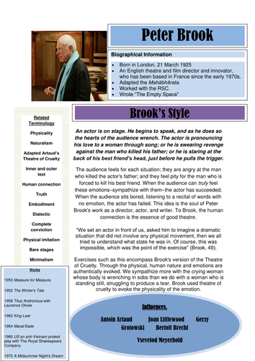
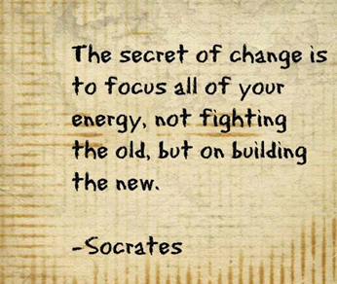
DETAILS OF FACTFILE
Your fact file can be presented in any format, but should include the following information:
Biographical Information (including key life experiences)
Mission Statement (what they want to achieve through theatre)
Influences
Style of Theatre (description)
Key Works (performance or other)
Key Quotes (from them or about them)
Key Terminology

Slide 3
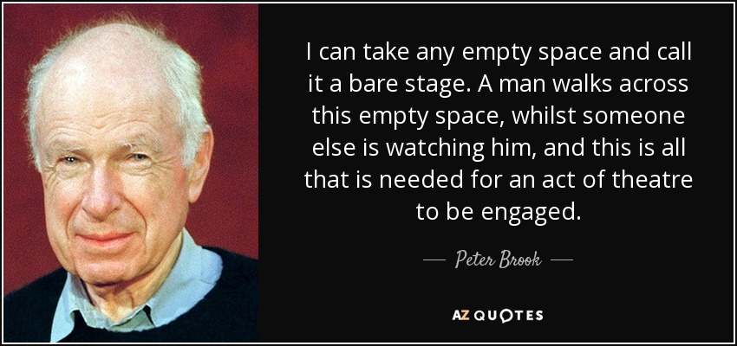
Antonin Artaud
https://thedramateacher.com/theatre-of-cruelty-conventions/
Bertolt Brecht
https://www.bbc.co.uk/bitesize/guides/zwmvd2p/revision/1
https://www.youtube.com/watch?v=l-828KqtTkA
https://www.youtube.com/watch?v=t-A8mCjRu5g
https://www.youtube.com/watch?v=c7fqMPDcKXM
Frantic Assembly
https://www.franticassembly.co.uk/frantic-digital
You could also look at/watch the following:
https://www.franticassembly.co.uk/the-frantic-method
https://www.youtube.com/watch?v=V7R_V2iCZoY
Kneehigh Theatre
https://www.kneehigh.co.uk/
PunchDrunk
https://www.punchdrunk.org.uk/
Konstantin Stanislavski
https://www.bbc.co.uk/bitesize/guides/zxn4mp3/revision/1
https://www.youtube.com/watch?v=iB1fPZX5Zgk

Slide 4
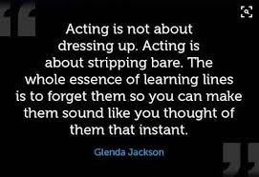
COMPARING PRACTITIONERS
Watch the videos below to see a comparison of how different practitioners would portray/adapt the same piece of text and character.
Use your findings to add to your notes.
Brecht: https://www.youtube.com/watch?v=62-gYcO6jrY
Stan: https://www.youtube.com/watch?v=2OD7phopWWk
Artaud: https://www.youtube.com/watch?v=gHn2Lj7R0Rc
Peter Brook: https://www.youtube.com/watch?v=YIjjLpshfCQ

