Slide 1
The A-Level Mindset
How to be successful at A-levels

Slide 2
Have a go at the puzzles ……..

Slide 3
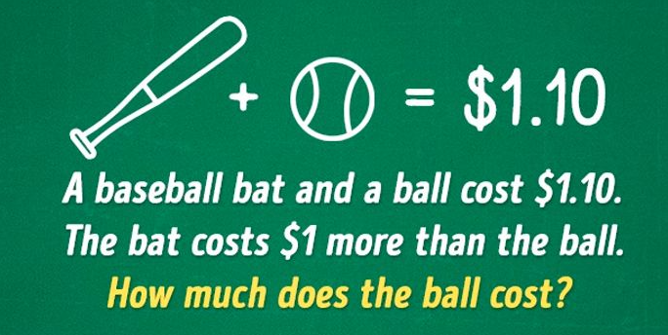
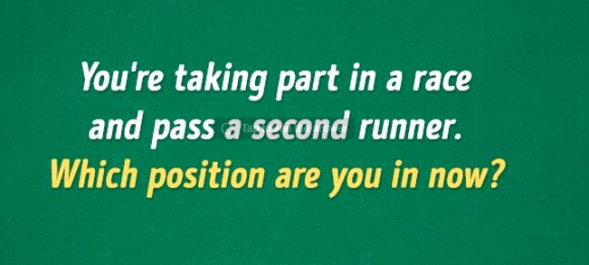

Slide 4
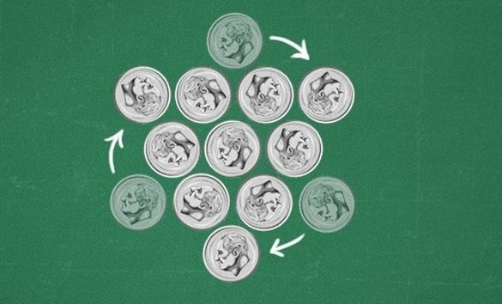

Slide 5
How did you get on?
Did you get them?
Did you keep going or did you give up easily.
Did you ask for help from others?

Slide 6
Attitude – attitude is a settled way of thinking.
Notes:
You have decided to come into the 6th Form at Bishop Stopford School. Why? Speed dating. You will have 30 seconds to answer the question that appears and then you must listen while you ‘date’ answers the next question.

Slide 7
It means…….
The process of learning – having a fixed or growth mindset.
Response to challenge or difficulty.
Resilience and grit.

Slide 8
Fixed or Growth Mindset
Students with a fixed mindset are unable to thrive under challenging conditions.

Slide 9
Developing a Growth Mindset
https://www.youtube.com/watch?v=2nF90sAW-Yg
7 minutes

Slide 10
Response to challenge or difficulty
How do you respond to failure – give up or go and do something to make you more successful next time?

Slide 11
Attitude – Stopping Negative Thoughts (page 20-21)
Read through these either on your own or with a partner. Do any apply to you?
Try and reframe your thinking.

Slide 12
Response to challenge or difficulty
Falling forwards – failure needs to accelerate progress.

Slide 13
Attitude – Falling Forwards (page 22)

Slide 14
Falling Backwards
Blaming others
Repeating the same mistakes
Expecting never to fail
Being limited by past mistakes
Withdrawal of effort
Falling Forwards
Taking responsibility
Learning from each mistakes
Knowing failure is part of the process
Maintaining a positive attitude
Taking new risks
Persevering

Slide 15
Resilience and Grit
Resilience is the ability to deal effectively with stress.

Slide 16
You have to want to succeed more than you fear failure! Mistakes are crucial – failure is a necessary part of learning.
Notes:
You have decided to come into the 6th Form at Bishop Stopford School. Why? Speed dating. You will have 30 seconds to answer the question that appears and then you must listen while you ‘date’ answers the next question.

