Slide 1
Applying for medicine
By Berny Kwei-Tagoe

Slide 2
What we will discuss
Types of course/learning
Volunteering/Work experience
Personal research/learning resources
Personal statements
Entrance exams
Strategic applications
Life in medical school

Slide 3
Course types
Traditional
Non-Clinical stage(book learning) and Clinical stage(placements)
PBL(Problem Based Learning)
Clinical exposure from an early stage as well as book learning
Integrated
Mixture of the two above
Initially more non-clinical learning, clinical exposure builds over the years
Notes:
Traditional- Oxford, Cambridge
PBL involves working through cases and learning from them and is guided by group work. More self-directed.
Lancaster, Manchester, Sheffield
Integrated- most unis.
E.g. Nottingham, Leeds

Slide 4
Learning styles
System based learning
Learn content based on the system its part of
Case based learning
Learn content surrounding a ‘patient’ you are ‘treating’
Enquiry based learning
Focus is on you learning, rather than being taught
Solving problems vs being given facts
Cadaveric dissection
Using cadavers to study anatomy
Cadaveric prosection
Using pre-prepared specimens to study anatomy
Notes:
Nottingham – cadaveric dissection
Cadaveric prosections – most unis. Birmingham and Leeds I know do prosections
Prosections- done by someone else, not dissecting just examining and touching and having a look at what has already been cut.
Dissection – cut yourself.

Slide 5
Volunteering/Work experience
Medical Schools have relaxed their requirements when it comes to work experience
Virtual/Remote work experience is still available
Observe a GP
Brighton and Sussex medical school
Any volunteering opportunities available would be helpful in your application
https://www.themedicportal.com/application-guide/work-experience/medical-school-requirements-medicine-work-experience/?v=79cba1185463
The most important thing is reflection and what you have learnt from your work experience not what you have done!!
Notes:
Varies for different medical schools Medic portal has a list of all the medical schools and what they require/ want to see.
Also look on the universities websites to be sure.

Slide 6
Personal research/learning resources
Nottingham university provided several live seminars on areas of medicine a few years ago these were recorded but unsure as to whether they are still available.
YouTube videos
Osmosis.org
Armando Hasudungan
British medical journal(BMJ)
Resources like these are a good starting point for further research that can be used to produce a presentation

Slide 7
Personal statements
Reflect on what you’ve done and link this back to how it will assist you in pursuing medicine
Customer service job- acting in a professional manner and communicating effectively to solve problems
Volunteering at local youth group- responsibility, leadership skills and teamwork within leadership
Include academic aspects, people-focused aspects, any volunteering/work experience or substitutes and personal motivations to pursue medicine
Oxbridge personal statements should be mostly academic
Notes:
By academic I mean research papers read, articles you may have written or lectures you’ve attended not as in your A level subjects.
For example, I wrote a paper for medic mentor on the treatments being developed and used for COVID at the time

Slide 8
Entrance exams- UCAT
2-hour exam, 5 Sections
Verbal reasoning
Decision making
Quantitative reasoning
Abstract reasoning
Situational judgement
Scored out of 3600 (300-900 per section) and a band (1-4)
Average score is around 2510, band 2(2020)

Slide 9
UCAT-Registration
£70 fee

Slide 10
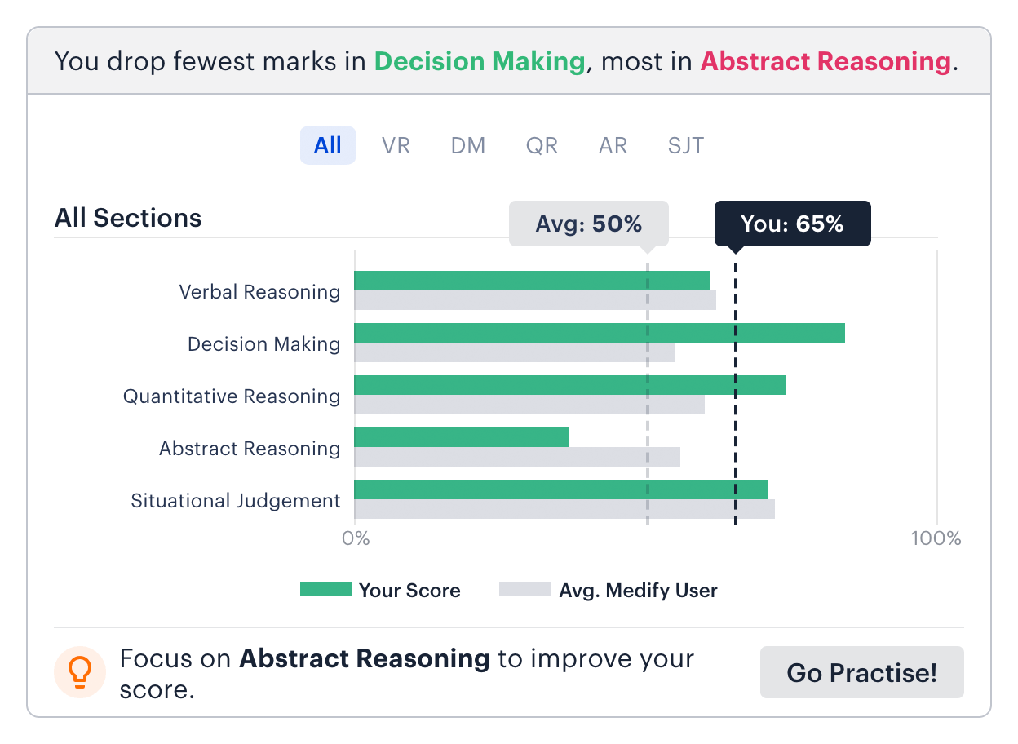
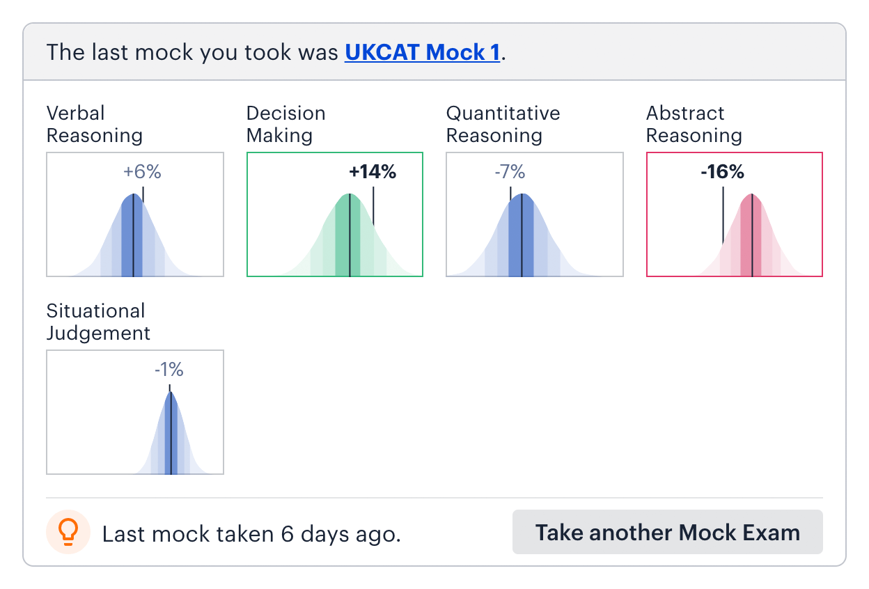
UCAT preparation
Practice as much as possible
Ensure timings are solid
Gradually increase volume of prep to increase stamina
Medify is the most widely recommended UCAT prep resource
Watch youtube videos for top tips and what to expect on the day to help relax you

Slide 11
Entrance exams-BMAT
2-hour exam, 3 sections
Section 1:
Problem-solving, understanding arguments, data analysis and inference.
Section 2:
Application of GCSE level scientific/ mathematical knowledge
Section 3:
Select, develop and organise ideas, and communicate them in an essay
Scored from 1.0-9.0 (av. approx 5.0)

Slide 12
BMAT registration
Register through the school
No registration fee
1 September – Registration opens
15th September – Deadline to apply for modified papers (e.g. enlarged print)
29th September - Deadline for test centres to register candidates. Deadline to apply for Access Arrangements (e.g. extra time). Deadline to apply for test voucher code*
18th October 2023- Test date
24th November – Results released
1 December – Deadline to apply for a results enquiry

Slide 13
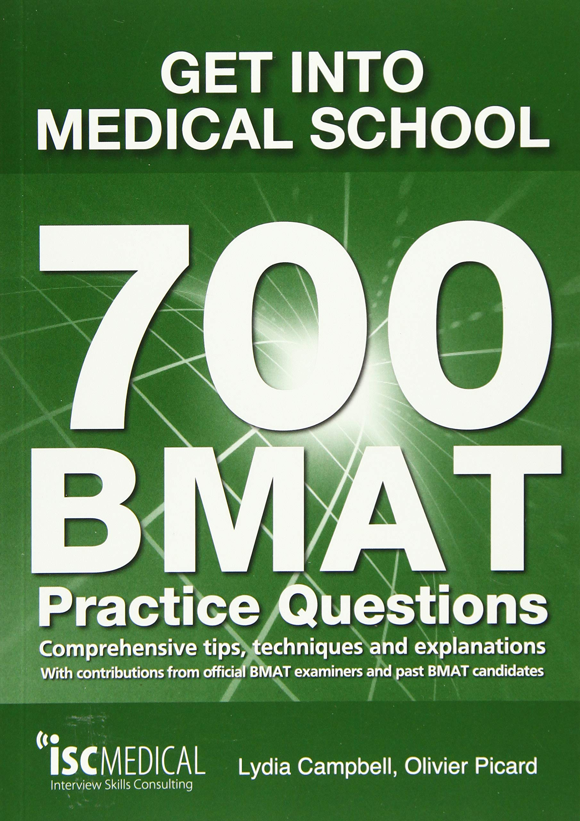
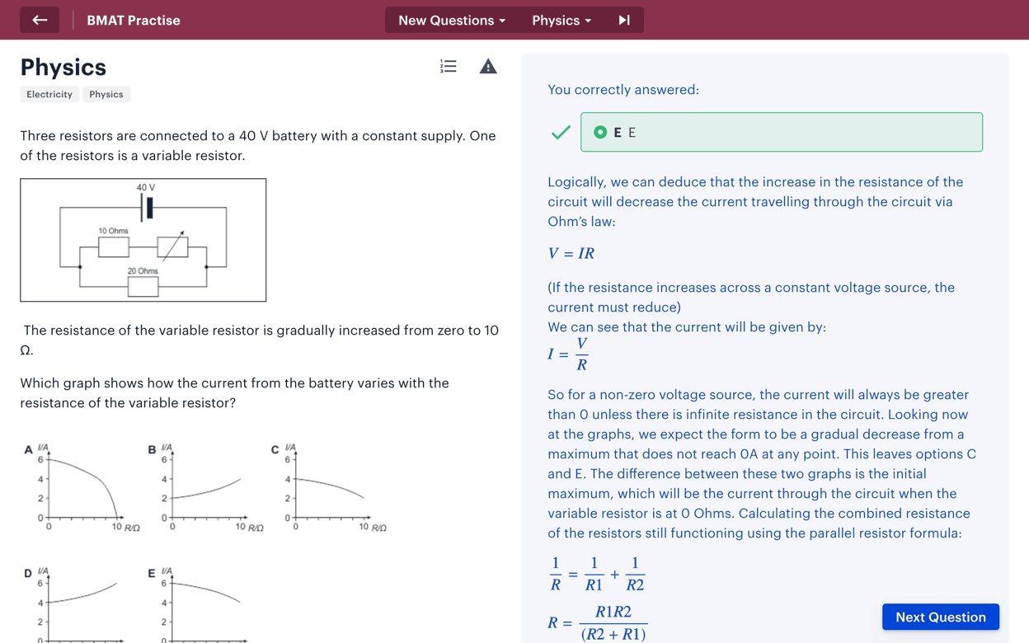
BMAT preparation
Revise GCSE science/maths content for section 2
Practice answering questions in BMAT format
Use BMAT books or Medify for this
Write practice essays for section 3 under time pressure
Read BMAT specification and annotate this
Notes:
I personally just used Medify. I revised the science sections and maths section on there before answrring questions, mainly went over things I wasn’t as sure about/ hadn’t done yet.
Used the official Cambridge BMAT website first so I had an idea of the paper. Before using medify.
Practice essay questions as well. I did multiple so I got used to planning and answering quickly.

Slide 14
How exams are used
Majority of universities use UCAT, the universities that use BMAT are:
Brighton and Sussex, Imperial College, Lancaster, UCL, Manchester, Leeds, Oxford and Cambridge
Most universities have average cut off scores for these exams, however these change every year (UCAT)
All universities weight these exams differently, check individual websites for specifics

Slide 15
Strategic application
Different universities prioritize different aspects of your application
GCSE grades
UCAT/BMAT score
Personal statement
Identify your strongest areas and look at universities you like that will focus on that aspect more
Generally, universities will have a holistic approach and consider multiple factors
Ensure the main factor they look at is strong
Notes:
This may not be possible with the BMAT as you usually sit this exam after the application deadline. E.g. Oxford required you to do the November sitting.
For me personally, I knew I found the BMAT easier, so I applied to 2 UCAT and 2 BMAT universities.

Slide 16
Interviews
Practice as many questions as possible
Take part in mock interviews
Do your research on the university and the course
Remember that they want to give you a place, and that being stressed just shows that you care and that it’s perfectly normal. Be confident in the preparation you’ve done and try and enjoy the conversation and be yourself
Notes:
Should this be included???

Slide 17
Typical week as a first year Medical student (Leeds)
Body systems- Respiratory, Cardiovascular, Gastrointestinal, Reproductive
Anatomy
EMS (extension of sciences covered in A level)
IDEALS (Personal development, reflective models like the Gibbs reflective cycle)
RESS (research, research methods, statistical tests)
CARES (Clinical based, ethics, medications)
I&P (Psychology, child attachments, mental health e.g.)
Tuesdays- Half day on placement (2nd year – 1 day a week, 3rd year- 4 days a week)
Wednesdays- Finish lectures and group work at 13:00
All other days begin at 9 and have a 4 or 5 finish
Notes:
- Tried to find my timetable but we can’t access it after the year has passed.

Slide 18
Any questions?

Slide 19
Thanks for listening
Good luck with your applications!

