Slide 1
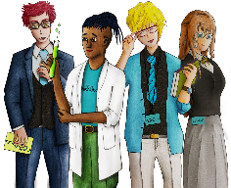
Careers and financial education
Banking and Personal Finance
Copy
title
Knowledge, Skills & Actions
To understand the different types of bank account
Understand the range of mobile banking only services
Be able to evaluate which account would be most suitable for different situations
3 Minutes
Which city is this?
Clue: Begins with an F and is in Europe
What is the purpose of banks in society?
New Vocabulary
Mobile banking, saving, interest, bank branch, AER, overdraft, credit card, monetary value, hyper inflation
Tasks
Notes:
TEACHER NOTES & IDEAS
Remind students of the learning journey (What theme you are doing – Possibly recap what they can remember from last lesson.
Answer - Frankfurt
ATTRIBUTION AND COPYRIGHT
– All icons and logos for Cre8tive Curriculum are created Inhouse by Michael Gillman ©
All images are sourced correctly – mainly through the following sites
either Premium licence at https://www.freepik.com/ or www.Pixabay.com or https://www.pixelscrapper.com/help
Some image have purchased also.
Factual information is not copyrighted.
Where information has been taken from reliable 3rd party websites – it is done so for analytical purposes in small pieces of text and for educational purposes.
Always check the content of any lesson and videos linked before teaching to ensure suitability for your classroom and your school
Further Terms and Condition regarding Copyright and our terms of use can be found on our website here https://cre8tiveresources.com/terms-of-use/

Slide 2
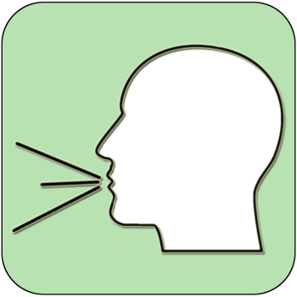
REFERENCE SLIDE
Teamwork
New Vocab
Discussion task
Play video
NEW
VOCABULARY
DISCUSSION TASK
THE LAW
EXPLAINED
TEAMWORK TASK
PROJECT
WORK
PLAY
VIDEO
Thoughts
Research
Extension
task
Tasks
Problem
solving
TASKS
EXTENSION
TASK
THOUGHTS
FURTHER RESEARCH
HOMEWORK
PROBLEM SOLVING
Feelings
Copy
information
Revision
Design Task
ASSESSMENT OPPORTUNITY
FEELINGS
REVISION
TASK
DESIGN
TASK
COPY INFORMATION
SENSITIVE ISSUE
WARNING
Notes:
TEACHER NOTES & IDEAS
This is a teacher reference slide - Icons will be used throughout Cre8tive Curriculum lessons to denote what students can do.
Could be printed and laminated on A3 and stuck up in the classroom

Slide 3
PSHE
Show respect
By listening
Not interrupting
Only 1 person talking at a time
Be open and honest but no personal comments – Discussions will be about ‘general situations’
Don’t make assumptions about people’s values, attitudes, behaviours, life experiences or feelings
PSHE CLASSROOM RULES
DEALING WITH SENSITIVE TOPICS
SAFEGUARDING YOUR WELFARE & HAVING YOUR INTERESTS AT HEART
You don’t have to say things about yourself if you don’t want to (You have the right to pass)
There are no stupid questions. A question box for anonymous Questions
It’s OK to get things wrong
Have a non-judgemental approach. No put downs and challenge the opinion not the person
Enjoy the lesson, Challenge your perceptions and understand how to seek further advice and support
Use the agreed appropriate Language (Avoid slang terms)
Conversations stay in the room unless it is a safeguarding issue
Don’t show the fact you are embarrassed through silliness
Notes:
TEACHER NOTES & IDEAS
Reinforce ground rules at the start of every new topic / new term
Adapt this set of rules to suit your classroom and your teaching.
Display your agreed PSHE classroom rules in a prominent place so students have a constant reminder and when/if a student breaks a rule you can use as a prompt to get them back on track.
If behavior is an issue revisit the ground rules – Use raffle tickets , positive behavior management (look for the good behavior)
Reward the behavior you want to see, be consistent and fair with students.
Create a classroom charter with the students (optional)

Slide 4
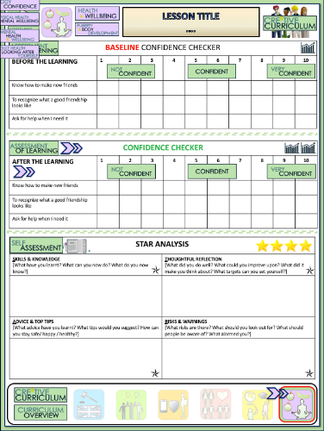
Banking and Personal Finance
BASELINE CONFIDENCE CHECKER
BEFORE THE LEARNING | 1 | 2 | 3 | 4 | 5 | 6 | 7 | 8 | 9 | 10
I understand the various characteristics of money
I can evaluate different banking options for mobile and traditional banking
I understand the range and purpose of different types of bank accounts
Complete a baseline assessment of where you think you are at for this lesson
(Discussion or complete sheet)
2 Minutes
I’m not confident at all
I’m getting more confidence
Confident
Very
confident
Super
confident
Notes:
TEACHER NOTES & IDEAS
This could be done by writing a number down in the books
Show of fingers in the air. /Red amber Green Cards
Quick Partner Discussion
Print off the Assessment Opportunity Sheet – Fill in the Baseline Confidence Checker

Slide 5
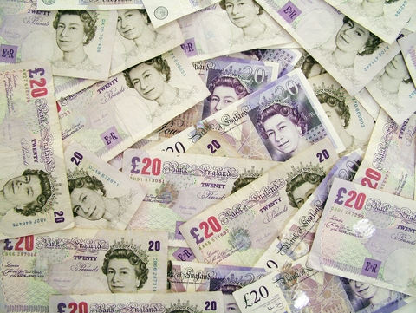
How can you keep your money safe?
Notes:
TEACHER NOTES & IDEAS

Slide 6
What are the characteristics of money/currency?
Signatures, watermarks and security features
Hard wearing so it lasts a long time
Easily recognisable by all
Metallic strip
Available in different amounts
Easy to carry around
Always worth the same amount
Accepted by people and shops
Come up with another?
What gives money its value?
What happened to the value of German currency during hyper-inflation when the German government kept printing more and more money?
Tasks

Slide 7
How and where can you store money?
Where to store money | Advantages | Disadvantages
Under the bed / hidden In a drawer Purse or wallet With your parents Bank account National Savings and investment Buy a property Long term investment
Lose it misplace it
Theft
Keep track
Safe
Risk
What is a safe amount of cash to carry on you at any one time?
Do you have a bank account?
What benefits does your bank account give you?
Where does the money come from that you pay into your account?
How can you access your money?
Access
Interest
Trust

Slide 8
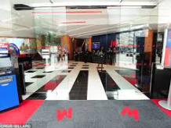
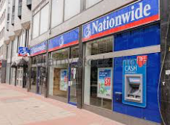
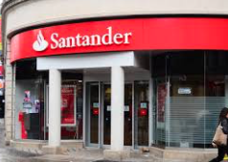
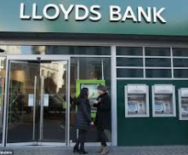
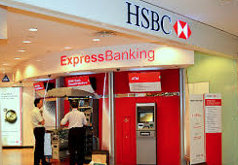
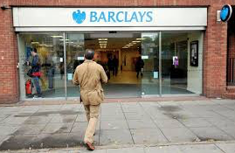
NAME THAT BANK BRANCH
A
B
C
D
E
F
Notes:
A = NO ATTRIBUTION REQUIRED
B=Free for Commercial use
C= Free under Creative Commons
D=
E=
F=
A list of licenses for the images used in this presentation can be found here: https://creativecommons.org/licenses/

Slide 9
NAME THAT BANK BRANCH
A
B
C
Metro Bank
Nationwide
Santander
D
E
F
Lloyds
HSBC
Barclays
Notes:
A = NO ATTRIBUTION REQUIRED
B=Free for Commercial use
C= Free under Creative Commons
D=
E=
F=
A list of licenses for the images used in this presentation can be found here: https://creativecommons.org/licenses/

Slide 10
Saving money
Save up for a holiday
Reasons to save money
SCORES
1 – 5 More needed
5- 7 Not bad
8-10 OK
11 -13 Good
14+ Outstanding
Put money in to your pension for when you are older
Notes:
TEACHER NOTES & IDEAS

Slide 11
Mobile only banks – the new banking for millennials
11 Minutes
What is the best mobile banking service?
Play video
What facts do I know? What else do I need to know? What do I want to know?
How do I feel about this? What don’t I like about this? What do I like about this?
Can something be done? New ideas?
What are the solutions/ suggestions?
What thinking is needed? Next steps? Where are we now?
What is wrong? Is it safe? Can it be done?
INFORMATION
FEELINGS
CREATIVITY
THINKING
JUDGEMENT
Watch the video and complete the table provided on the next slide
What did this video make you think about?
Did you learn anything new?
Tasks
Notes:
TEACHER NOTES & IDEAS

Slide 12
COMPARING THE BEST MOBILE BANKS
Name of Bank | Monzo | Revolut | Starling | N26
Advantages
Disadvantages
Costs & Extra features
Usability of the App & Customer Service

Slide 13
Different Bank Accounts
Current account
Savings account
Notice accounts (savings)
Regular savings account
Packaged account
Instant access accounts
(savings)
ISA
Child Trust Fund / Junior ISA
You must tell the bank or building society before you want to take money out. You will earn more interest though.
Allows you to remove your money when ever you want it.
A current account that will offer extra benefits (breakdown, mobile and travel insurance) in return for a monthly fee.
Put money away on a regular basis usually away standing order from your current account..
Most common type of bank account and suitable for everyday needs. Income / salary will be paid in and bills will come out
An account that you put money away in that you don’t need in the short term and it can earn interest.
Individual Savings Account- When your savings earn interest you will not be taxed on it unlike most other savings accounts.
A long-term, tax-free savings account for children, but only children born between 1 September 2002 and 2 January 2011. IF you are born after you can have a junior ISA instead.
TASKS
1. Match up the Bank account to the definition
2. Copy them into your books
3. Explain the advantages of the current account / packaged account and the savings account.

Slide 14
Advantages of having a bank account
Financial advice & Support
Cheque book
You receive a debit card
Bank account
You can earn interest on your money
Have more money
Notes:
TEACHER NOTES & IDEAS

Slide 15
Joint Accounts
Joint Accounts
You can open a bank account in your name only or open a joint account with one or more people.
This can apply to either Current or Savings accounts.
Some couples decide to do this and agree to have equal access to the funds, regardless of whether they pay in different amounts. Other couples choose to have separate accounts.
You could set up a joint account from which bills are paid by direct debit or standing order. Both of you can pay into the account.
Me
Direct Debit
£££
JOINT ACCOUNT
£££
Direct Debit
BILLS
You
Standing Order
BANKING

Slide 16
COMPARING TRADITIONAL BANK ACCOUNTS
Name of Bank | NatWest | Barclays | Your choice: | Santander
What accounts do they offer?
What are the features of the current account?
What is the AER interest rate?
What is the overdraft rate?
Do they offer mobile banking?
Costs involved and fees

Slide 17
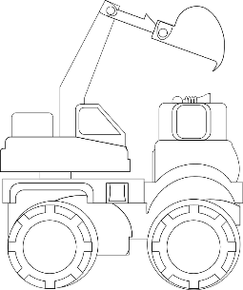
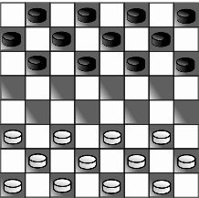
WHAT DO YOU THINK?
Talking points
I think that …
I don’t think… is right because…
My opinion is…
I would argue the same because…
I disagree with… because
Building on what ….
An alternate way of looking at this is…
I sort of agree, however….
In my view…
I would challenge what… said because …
“Ultimately schools are the most responsible for ensuring their children have good personal finance skills”
Ourselves
Media
Government
Parents
Businesses
?
AGREE
ALTERNATE IDEA
DEVELOP
Disagree
Challenge
Alternative
Idea/option
DISAGREE
Develop
CHALLENGE
Notes:
TEACHER NOTES & IDEAS
Ask students what they think of this image (collection of images)
Reveal the talking points after some discussion time
To provoke discussion with a quiet class – play devils advocate
Challenge a student to a debate

Slide 18
Confidence Checker
AFTER THE LEARNING | 1 | 2 | 3 | 4 | 5 | 6 | 7 | 8 | 9 | 10
I understand the various characteristics of money
I can evaluate different banking options for mobile and traditional banking
I understand the range and purpose of different types of bank accounts
Complete the confidence checker of where you think you are at for this lesson (Discussion or complete sheet)
3 Minutes
Notes:
TEACHER NOTES & IDEAS
This could be done by writing a number down in the books – Compare to the start of the lesson
Show of fingers in the air or use Red Amber Green Cards
Quick Partner Discussion & reflect on before the lesson and progress made
Print off the Assessment Opportunity Sheet – Fill in the Confidence Checker / Compare with the baseline
Author Attribution :https://pixabay.com/en/traffic-lights-traffic-light-phases-2147790/

Slide 19
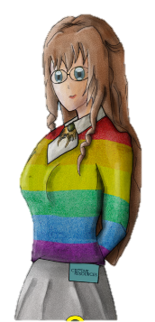
FOR MORE INFORMATION ABOUT THE TOPICS COVERED IN THIS UNIT WE WOULD ADVISE ONE OF THE BELOW: SPEAK TO YOUR PARENTS/GUARDIANS OR HEAD OF YEAR, TRUSTED ADULT OR FRIEND IF YOU HAVE ANY CONCERNS ABOUT YOURSELF OR SOMEONE YOU KNOW – IT IS ALWAYS IMPORTANT TO TELL SOMEONE!
Enjoy the lesson, Challenge your perceptions and understand how to seek further advice and support
SPECIFIC FURTHER INFORMATION ON THIS TOPIC CAN BE FOUND HERE:
https://www.citizensadvice.org.uk
https://vinspired.com – young peoples volunteering charity
https://www.ncsyes.co.uk 15-17 Year olds National Citizen Service
https://nationalcareersservice.direct.gov.uk/ Explore career opportunities
https://www.startprofile.com/ - Explore your dream Job!
2 Minutes
Notes:
TEACHER NOTES & IDEAS
Teachers should add in specific local signposting to charities, careers organisations / Connections or Careers officer at school. If RSE topics the local NHS services in their area
Add / adapt or remove any suggested sites.
Print this slide and leave on door notice board after the lesson

Slide 20
I know if I need further
support or help I could
speak to…. or contact…
Before I could/would say
and do ... but now I feel I
am able to say
Before I only knew ...
now I also know ...
I supported others by…
One thing I didn’t
realise was… now I know that…
The key words for
this lesson are…
I always knew ... but now
I can see how it connects to…
The most important thing I
have learnt today is…
I’m really proud of the
way I have…
I used to feel ...
but I now feel ..
One assumption of
mine that was
challenged was…
I would like to learn…
A question I
would like to
ask is…
Before I thought that ...
but now I realise..
Today I have tried to…
Next lesson I would like to..
Before I would have done…
Now I will …
Before I would have
said ... but now I will say…
2 Minutes
A problem I overcame
today was…
Notes:
TEACHER NOTES & IDEAS
: Have students pick either 1/2/3 tickets depending on their ability and tell a partner
Pick a few students at random to feedback to the class
As students leave the room have them tell you their reflection on the way out

