Slide 1
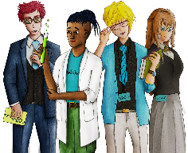
Exploring a Payslip
Copy
title
Knowledge, Skills & Actions
To understand what the common features of a payslip are
To be able to work out using calculations Gross Pay and Net Pay on a payslip
To evaluate the importance of paying tax and NI contributions
3 Minutes
If Mr. Alan works as a teacher and earns £3,000 a month what is his annual salary?
If Mr. Alan is paid £3,000 a Month how much money goes into his bank account?
New Vocabulary
BACS, Deductions Payslip, Net Pay, Gross Pay, National Insurance, Salary, Tax, NI, Tax Code, PAYE
Tasks
Notes:
TEACHER NOTES & IDEAS
Remind students of the learning journey (What theme you are doing – Possibly recap what they can remember from last lesson.
ATTRIBUTION AND COPYRIGHT
– All icons and logos for Cre8tive Curriculum are created Inhouse by Michael Gillman ©
All images are sourced correctly – mainly through the following sites
either Premium licence at https://www.freepik.com/ or www.Pixabay.com or https://www.pixelscrapper.com/help
Some image have purchased also.
Factual information is not copyrighted.
Where information has been taken from reliable 3rd party websites – it is done so for analytical purposes in small pieces of text and for educational purposes.
Always check the content of any lesson and videos linked before teaching to ensure suitability for your classroom and your school
Further Terms and Condition regarding Copyright and our terms of use can be found on our website here https://cre8tiveresources.com/terms-of-use/

Slide 2
REFERENCE SLIDE
Teamwork
New Vocab
Discussion task
Play video
NEW
VOCABULARY
DISCUSSION TASK
THE LAW
EXPLAINED
TEAMWORK TASK
PROJECT
WORK
PLAY
VIDEO
Thoughts
Research
Extension
task
Tasks
Problem
solving
TASKS
EXTENSION
TASK
THOUGHTS
FURTHER RESEARCH
HOMEWORK
PROBLEM SOLVING
Feelings
Copy
information
Revision
Design Task
ASSESSMENT OPPORTUNITY
FEELINGS
REVISION
TASK
DESIGN
TASK
COPY INFORMATION
SENSITIVE ISSUE
WARNING
Notes:
TEACHER NOTES & IDEAS
This is a teacher reference slide - Icons will be used throughout Cre8tive Curriculum lessons to denote what students can do.
Could be printed and laminated on A3 and stuck up in the classroom

Slide 3
PSHE
Show respect
By listening
Not interrupting
Only 1 person talking at a time
Be open and honest but no personal comments – Discussions will be about ‘general situations’
Don’t make assumptions about people’s values, attitudes, behaviours, life experiences or feelings
PSHE CLASSROOM RULES
DEALING WITH SENSITIVE TOPICS
SAFEGUARDING YOUR WELFARE & HAVING YOUR INTERESTS AT HEART
You don’t have to say things about yourself if you don’t want to (You have the right to pass)
There are no stupid questions. A question box for anonymous Questions
It’s OK to get things wrong
Have a non-judgemental approach. No put downs and challenge the opinion not the person
Enjoy the lesson, Challenge your perceptions and understand how to seek further advice and support
Use the agreed appropriate Language (Avoid slang terms)
Conversations stay in the room unless it is a safeguarding issue
Don’t show the fact you are embarrassed through silliness
Notes:
TEACHER NOTES & IDEAS
Reinforce ground rules at the start of every new topic / new term
Adapt this set of rules to suit your classroom and your teaching.
Display your agreed PSHE classroom rules in a prominent place so students have a constant reminder and when/if a student breaks a rule you can use as a prompt to get them back on track.
If behavior is an issue revisit the ground rules – Use raffle tickets , positive behavior management (look for the good behavior)
Reward the behavior you want to see, be consistent and fair with students.
Create a classroom charter with the students (optional)

Slide 4
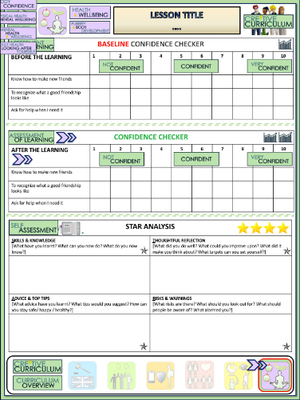
Exploring a Payslip
BASELINE CONFIDENCE CHECKER
BEFORE THE LEARNING | 1 | 2 | 3 | 4 | 5 | 6 | 7 | 8 | 9 | 10
I understand how to interpret a payslip
I know how to work out Gross Pay and Net Pay on a payslip
I am aware of all the deductions that are likely to come out of my salary when I’m older
Complete a baseline assessment of where you think you are at for this lesson
(Discussion or complete sheet)
2 Minutes
I’m not confident at all
I’m getting more confidence
Confident
Very
confident
Super
confident
Notes:
TEACHER NOTES & IDEAS
This could be done by writing a number down in the books
Show of fingers in the air. /Red amber Green Cards
Quick Partner Discussion
Print off the Assessment Opportunity Sheet – Fill in the Baseline Confidence Checker

Slide 5
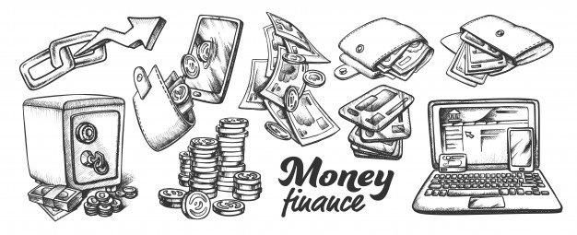
What do you think should be included on a payslip?
Answers– [Click to Reveal]
What are some of the things you should find on a payslip?
Your personal information:
The date:.
The tax period:
Your tax code:
Gross pay
The amount of Income tax deductions
The amount of National Insurance tax deductions
Other deductions
Net Pay.
The method for payment of wage
Notes:
TEACHER NOTES & IDEAS

Slide 6
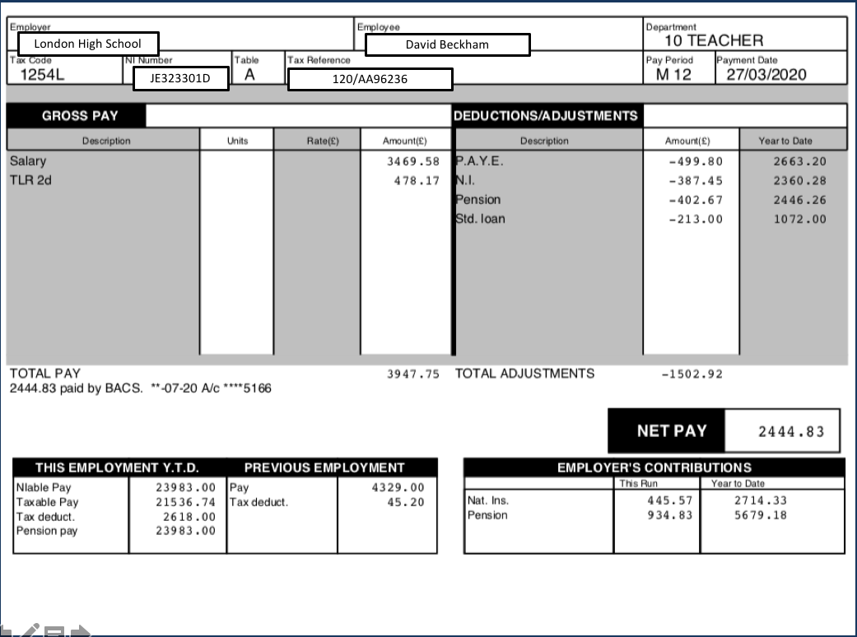
Here we see the employer’s name and your name.
HERE IS AN EXAMPLE PAYSLIP

Slide 7
Here is your national insurance number The number always consists of two letters, six numbers and a letter, for example, AB 123456 C.
(Contributions made will go towards the NHS and your state pension 12% of salary)
The number in the tax code is usually three figures. It represents the total of all available allowances, minus any amount to be deducted to cover other income or benefits, and with the last digit removed.

Slide 8
This is the total income you are being paid – Including regular hours, Overtime and Bonuses
Total Gross Pay (Amount before taxes and deductions
The payment method is BACS
BACS stands for Bankers Automated Clearing System.

Slide 9
This is the deductions column
PAYE (Pay As You Earn) is a tax that is spread out throughout the year
NI – National Insurance Contributions
Pension – Is what you pay to get money back after you retire later on in life
Std. Loan – Repaying the student loan you took out for university
Total deductions from your salary is shown here

Slide 10
Working out your NET PAY
(The money actually paid into your bank account)
GROSS PAY – DEDUCTIONS = NET PAY
£3947.75 – £1502.92. = £2444.83
This is known as NET PAY

Slide 11
Your employer will have to pay some costs too. This may include Employer’s National Insurance Contributions and any payments contributions your employers pays on your behalf into a pension scheme. Different Employers will pay varying amounts (% of salary). Recently the Government introduced a Workplace pension scheme with a minimum contribution of 3%

Slide 12
Y.T.D – Year to Date
Often a payslip will give you a summary of how much you have earnt, paid in tax, paid in NI contributions since the start of your employment or start of the current tax year

Slide 13
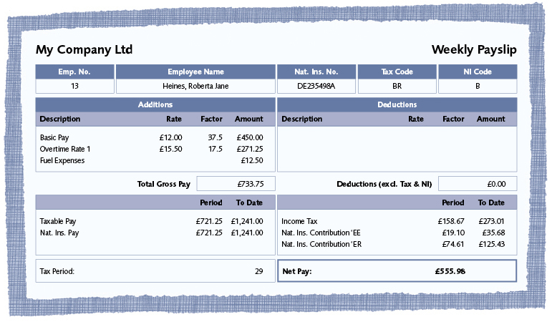
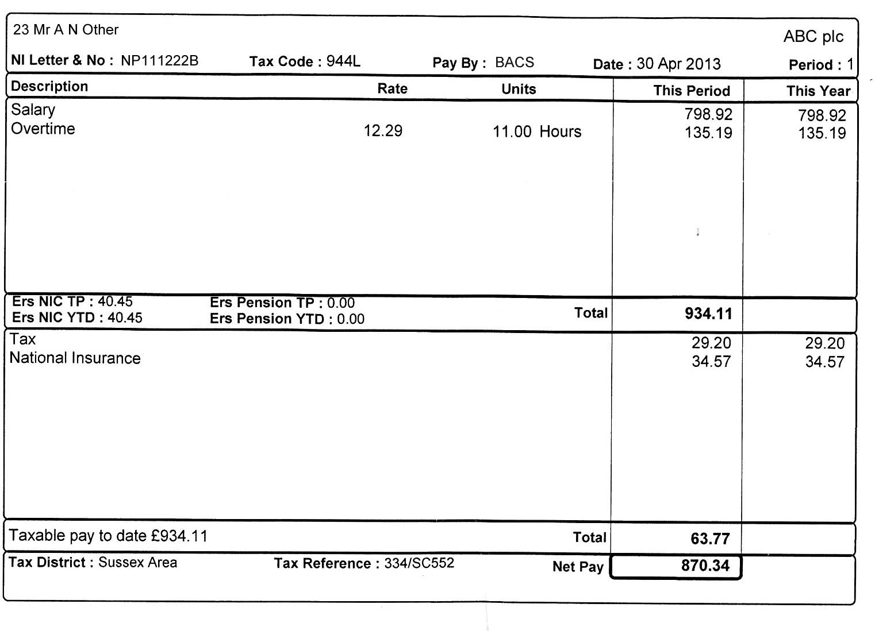
IT IS IMPORTANT TO REMEMBER THAT NOT ALL PAYSLIPS WILL LOOK THE SAME – THEY SHOULD ALL CONTAIN SIMILAR INFORMATION!

Slide 14
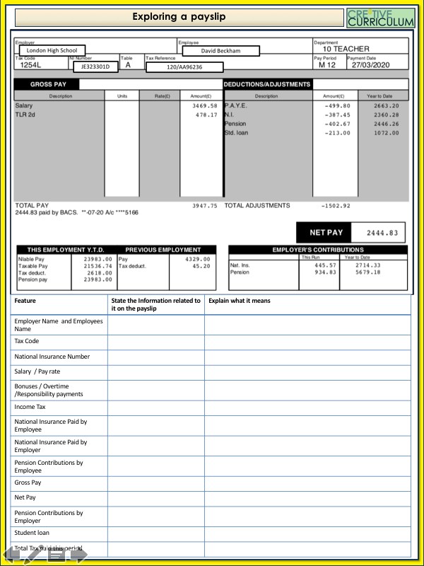
EASY VERSION
Task 1
Complete the first column using information provided on the example payslip
Task 2
Complete the second column explaining what each piece of information means and why it is important

Slide 15
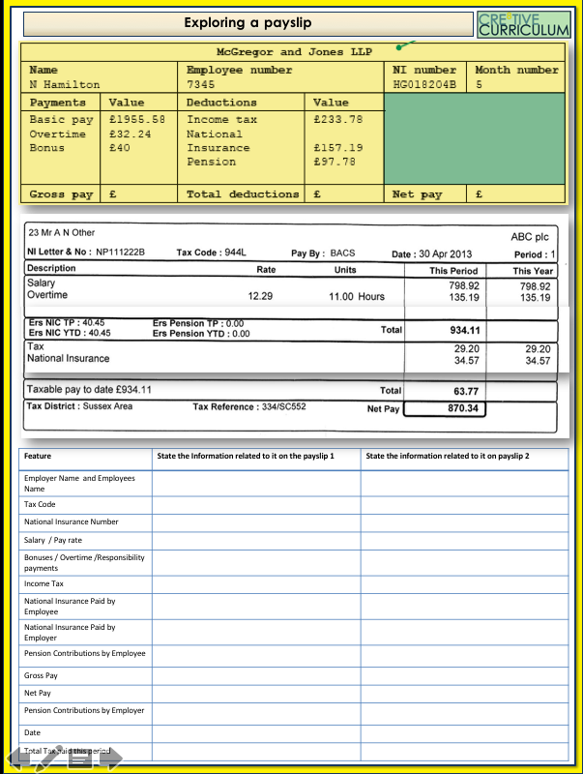
HARD VERSION
Task 1
Complete the first and second columns using the information provided on the example payslip. You may need a calculator as some of the key information is missing
Remember:
Gross Pay – Deductions = Net Pay

Slide 16
This will tell you any income you receive from your job and any compulsory deductions. Usually given once a month or once a pay period
Gross Pay
A
Money taken off your salary that is dependant on how much you earn and is paid to the government to help run public services
Net Pay
B
Income Tax
Gross Pay – Deductions =
C
Payslip
The total amount you are paid by your employer before any deductions happen
D
Personal Allowances
The amount you can earn free from tax. This will vary from person to person and can be adjusted year to year to take into account overpayment or underpayment of taxes in the previous year(s)
E

Slide 17
Lesson Success Criteria:
REVIEW QUESTIONS
What do you call your pay after tax and deductions?
Name two deductions from your pay
Name 5 features of a pay slip
What does NI stand for?
What does PAYE stand for?
Why do all employees have a tax code?
What is the point of paying in to a pension?
2 Minutes
Notes:
TEACHER NOTES & IDEAS
Always share success criteria with students before you set the task and evaluate the task – Students need to know what you are looking for.
If you have done this task before with another class show your new class a WAGOLL (What a good one looks like)

Slide 18
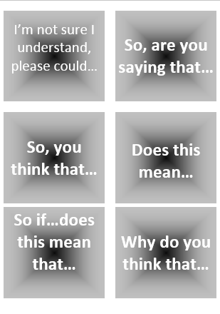
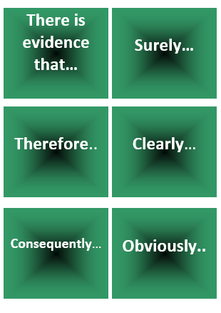
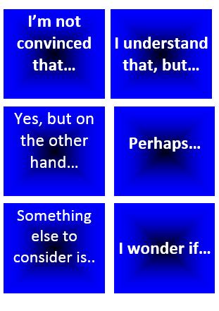
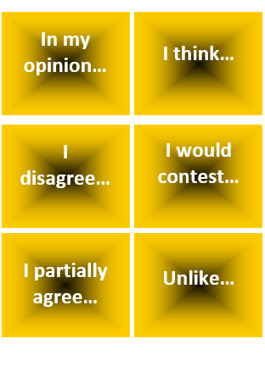
“We pay too much tax and National Insurance contributions in the UK”
Start with this card….
Or these cards….
Task 1: Discuss / Debate with your partner your own personal views towards this statement /idea
Extension: Can you think of specific examples of recent events that would support this statement and other specific examples that would go against this statement.
Discussion task
2-3 Minutes
Notes:
TEACHER NOTES & IDEAS
Pair student sup and have them use the sentence starter prompts on the board to help them (each colour represents a different set of prompts E.G Challenge, agree, build upon etc.)
-Arrange for two confident students (or two pairs of students) to come to the front and have a debate challenge off with a timer
-Challenge a student to debate you (allow them to pick whether they will argue for the statement or against it)

Slide 19
Confidence Checker
AFTER THE LEARNING | 1 | 2 | 3 | 4 | 5 | 6 | 7 | 8 | 9 | 10
I understand how to interpret a payslip
I know how to work out Gross Pay and Net Pay on a payslip
I am aware of all the deductions that are likely to come out of my salary when I’m older
Complete the confidence checker of where you think you are at for this lesson (Discussion or complete sheet)
3 Minutes
Notes:
TEACHER NOTES & IDEAS
This could be done by writing a number down in the books – Compare to the start of the lesson
Show of fingers in the air or use Red Amber Green Cards
Quick Partner Discussion & reflect on before the lesson and progress made
Print off the Assessment Opportunity Sheet – Fill in the Confidence Checker / Compare with the baseline
Author Attribution :https://pixabay.com/en/traffic-lights-traffic-light-phases-2147790/

Slide 20
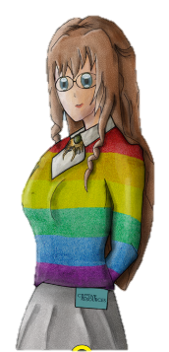
FOR MORE INFORMATION ABOUT THE TOPICS COVERED IN THIS UNIT WE WOULD ADVISE ONE OF THE BELOW: SPEAK TO YOUR PARENTS/GUARDIANS OR HEAD OF YEAR, TRUSTED ADULT OR FRIEND IF YOU HAVE ANY CONCERNS ABOUT YOURSELF OR SOMEONE YOU KNOW – IT IS ALWAYS IMPORTANT TO TELL SOMEONE!
Enjoy the lesson, Challenge your perceptions and understand how to seek further advice and support
SPECIFIC FURTHER INFORMATION ON THIS TOPIC CAN BE FOUND HERE:
https://www.myworldofwork.co.uk/
http://www.careersforyoungpeople.co.uk/careersinfo/job-searching/
https://www.princes-trust.org.uk/help-for-young-people/who-else/employment/careers-advice
https://www.careerconnect.org.uk/Young-People-i2.html
2 Minutes
Notes:
TEACHER NOTES & IDEAS
Teachers should add in specific local signposting to charities, careers organisations / Connections or Careers officer at school. If RSE topics the local NHS services in their area
Add / adapt or remove any suggested sites.
Print this slide and leave on door notice board after the lesson

Slide 21
I know if I need further
support or help I could
speak to…. or contact…
Before I could/would say
and do ... but now I feel I
am able to say
Before I only knew ...
now I also know ...
I supported others by…
One thing I didn’t
realise was… now I know that…
The key words for
this lesson are…
I always knew ... but now
I can see how it connects to…
The most important thing I
have learnt today is…
I’m really proud of the
way I have…
I used to feel ...
but I now feel ..
One assumption of
mine that was
challenged was…
I would like to learn…
A question I
would like to
ask is…
Before I thought that ...
but now I realise..
Today I have tried to…
Next lesson I would like to..
Before I would have done…
Now I will …
Before I would have
said ... but now I will say…
2 Minutes
A problem I overcame
today was…
Notes:
TEACHER NOTES & IDEAS
: Have students pick either 1/2/3 tickets depending on their ability and tell a partner
Pick a few students at random to feedback to the class
As students leave the room have them tell you their reflection on the way out

