Slide 1
A Level Sociology AQA 7192 https://www.aqa.org.uk/subjects/sociology/as-and-a-level/sociology-7191-7192/specification-at-a-glance

Slide 2
Why choose Sociology?
Sociology increases the understanding and power of social action. Sociology studies the role of social institutions (home, school, church and more) in the development of the individuals. Sociology provides critical insight and perspective to the solution of social problems
It is an evidence-based subject – this means it is not just about personal opinions.
Sociologists create theories and then collect evidence by carrying out research to work out whether the theories are true or not.
Sociologists investigate the structure of groups, social institutions (like the family, school and prisons) and how people interact within these settings. The methods that are used are theoretical analysis, statistics, and observation. Some of the theories we will explore are: Functionalism, Marxism, Feminism and Interactionism.

Slide 3
A Level Sociology: What topics do we study?
YEAR 1:
PAPER 1: Education with Methods in Context
PAPER 2: Topics in Sociology: The Family
YEAR 2:
PAPER 2: Topics in Sociology: The Media
PAPER 3: Crime and Deviance with Theory and Methods

Slide 4
Assessment: Year 2
Paper 1 | Paper 2 | Paper 3
Education with Theory and Methods | Topics in Sociology (Families and Media) | Crime and Deviance with Theory and Methods
Three exams at the end of Year 13
Each exam is worth 80 Marks and is 2 Hours in length
Questions range from 4 Mark short responses to 20 and 30 Mark Essays
No Coursework

Slide 5
Methods of study
Reading
Note taking
Discussions
Documentaries
Presentations
Work booklets
Case studies
Theoretical analysis
Statistics and observation

Slide 6
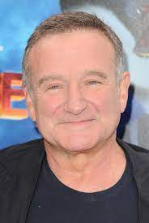
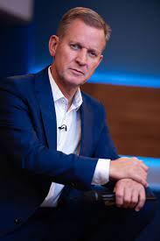
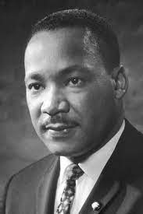
Future career options
Advice worker
Community development worker
Further education teacher
Higher education lecturer
Housing manager/officer
Marketing executive
Police officer
Policy officer
Secondary school teacher
Social researcher
Youth worker
Charity officer
Civil Service administrator
Family support worker
Human resources officer
International aid/development worker
Life coach
Newspaper journalist
Probation officer
Public relations officer
Social worker
Special educational needs coordinator (SENCO)
Some famous Sociology graduates…

Slide 7
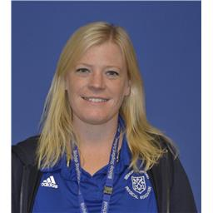
Mrs Martin – lmartin@bishopstopford.com

